Slide 1
Act 88 – Advisory Council on Heroin and Opioid Prevention and Education
December 7, 2018

Slide 2
HOPE Council Members
Welcome
Chair Dr. Hussey: Department of Health
Vice Chair Matt Adams: Board of Regents
Mona Michelli: Department of Children and Family Services
Michael Comeaux: Department of Education
Dr. John Morrison: Department of Corrections and Public Safety
Major Bob Brown: State Police
Linda Theriot: Veterans Affairs
Sheral Kellar: Workforce Commission
Senator Regina Barrow: State Senate
Troy Prevot: House of Representatives
Keetsie Gunnels: Attorney General’s Office
Thomas Travis: Department of Insurance
Judge Jules D. Edwards, III: 15th Judicial Court
Dr. Chaunda Mitchell: Governor’s Office, Drug Policy
Review
Discussion
Next Steps / Adjournment

Slide 3
Agenda
Welcome
Call to Order
Roll Call
Approval of Agenda
Approval of Minutes from the February, May, and August Meetings
Pew Charitable Trusts
Review of HOPE Year-End Report
Vote- Council Approval
Public Comment
HOPE Advisory Council Next Steps
Statewide Data-sharing Agreements and Governance
Date, Time, Place of Future HOPE Meetings
Adjournment
Review
Discussion
Next Steps / Adjournment

Slide 4
Pew Charitable Trusts
Welcome
Presenters: Andrew Whitacre and Alaina McBournie
Review
Discussion
Next Steps / Adjournment

Slide 5
Pew Treatment Systems Assessment Update December HOPE Council Meeting
Notes:
Thank you to the Chair of the Council, Dr. Hussey, and members of the Council for inviting us to provide a quick update on our work in Louisiana. We look forward to continuing to work with you and other stakeholders across Louisiana as we develop recommendations to expand access to treatment for opioid use disorder.
[TRANSITION]: To start off our discussion today, we plan to cover…

Slide 6
Today’s Topics
Key Policy Challenges in Louisiana
Potential Policy Solutions
Next Steps
Notes:
In the brief time we have today, we plan to discuss:
From our systems assessment to date, the most significant challenges that impede access to effective treatment in the state.
To address those challenges, what types of policy solutions could expand access to effective treatment statewide. I’ll talk conceptually about some of the policy recommendations that we are considering for our final report.
And, what are the next steps for our state systems assessment and timeline for delivering recommendations to the Council for action.
We have also built in time for discussion after the presentation.
I’m sure everyone in the room is familiar with the scope of the opioid crisis here in Louisiana, but to frame our conversation: Fatal and non-fatal opioid-related overdoses and opioid-related hospital visits continue to rise in Louisiana. According to the Louisiana Opioid Data and Surveillance System, opioid-related overdose deaths have more than doubled since 2014 and non-fatal overdoses are increasing across the state . Between 2013 and 2015, emergency department visits due to suspected opioid overdose increased by 25 percent. Opioid-related inpatient visits also increased to 1,271 in 2016; a 35 percent increase since 2013.
[TRANSITION] So, how did we get here…
*Note – remind me if it would be helpful to quickly walk through how Pew defines effective treatment.

Slide 7
Pew’s Technical Assistance
Stakeholder Outreach
Notes:
Reminder of how we got here….
Pew was invited in by the Governor, Speaker of the House, Senate President, Secretary Gee, the Chair and Co-Chair of the HOPE Council to deliver a set of policy recommendations to expand access to medication-assisted treatment.
There are three stages of our technical assistance:
First – we conducted a systems assessment to identify the gaps in the state’s treatment system. This assessment includes an analysis of the state’s data. We supplement these analyses with extensive stakeholder engagement. We have had conversations across Louisiana with over 100 individual stakeholders, including 7 out of 10 local governing entities/human service districts, the Louisiana Hospital Association, the Louisiana Psychiatric Medical Association, the Louisiana Primary Care Association, state agency leaders, and others.
Second – we develop and deliver a set of state-specific policy recommendations. These recommendations target concrete policy changes that can be made through executive, legislation, or administrative action.
Third – we work with the state to support enactment of those policy recommendations by providing ongoing guidance and education about the impact these changes could have on the treatment system.
Pew’s final policy recommendations will be delivered to the House Health and Welfare Committee on January 28th, and for a vote of the HOPE Council on February 13th.
[TRANSITION]: So, what are the most significant barriers to accessing effective treatment we have seen in Louisiana…

Slide 8
Medication-Assisted Treatment for Opioid Use Disorder
Medication-assisted treatment (MAT) increases adherence and reduces:
Illicit opioid use
Overdose risk and fatalities
Health care utilization
Criminal activity
Mattick RP et al., 2009;3:CD002209; Comer SD et al. JAMA Psych. 2006;63:210-8; Fudala PJ et al., NEJM. 2003;10:949-58;
Schwartz RP et al. AJPH. 2013;103,917-22;. Tsui JI et al. JAMA Intern Med. 2014;174:1974-81; Metzger DS et al., J Acquir Immune Defic Syndr. 1993;6:1049-56.
Notes:
MAT is the gold standard for the treatment of opioid use disorder. Since access to these therapies are central to our recommendations, I want to quickly highlight a few reasons why:
MAT is more effective than taking medication or behavioral therapy alone
Abstinence-based treatment only had a 20% retention rate in a 12-month period and long term retention rates dropping as low as 8.6%.
Individuals on MAT are less likely to relapse and more likely to adhere to treatment
MAT significantly reduces illicit opioid use compared to abstinence-based approaches
One study showed that 80% of patients on MAT did not use illicit or prescription opioids after 18 months of treatment. This compares to only 36% in the non-MAT group. (Source: Weiss, R.D.; Potter, J.S.; Griffin, M.L. et al. Long-term outcomes from the National Drug Abuse Treatment Clinical Trials Network Prescription Opioid Addiction Treatment Study. Drug and Alcohol Dependence 150:112-119, 2015.
MAT can result in significant decreases in overdose fatalities
Use of MAT can result in reduced risk of harmful outcomes due to risky behavior (such as injection of illicit drugs)

Slide 9
Key Policy Challenges

Slide 10
Limited Availability of Medication-Assisted Treatment
Lack of outpatient providers, including those that offer ANY form of MAT
Accessibility of methadone
MAT not widely offered at residential facilities
Access to MAT for pregnant women is even more limited than the general population
All forms of MAT for OUD are not available within prisons and jails.
Notes:
The most significant issue that we have seen from our assessment is that there aren’t enough providers across the state that offer effective treatment. In both rural and urban areas, there aren’t enough providers to meet the need for treatment. We have heard this concern from stakeholders statewide.
There aren’t enough treatment providers across care settings, but the issue is particularly acute with community-based outpatient providers. A strong treatment system that is able to provide treatment at or near capacity needs to rely upon community-based providers that are accessible in all parts of the state. Outpatient providers in Louisiana frequently either a) don’t offer MAT or b) don’t accept Medicaid patients.
Louisiana ranks 46th in per capita accessibility of OTPs (licensed methadone providers)
MAT is not widely offered at residential facilities. Anecdotally, this level of care is used as a default, even though it is only clinically appropriate for a smaller percent of individuals with OUD.
Mothers with OUD and their children both benefit from MAT during pregnancy. For instance, MAT is associated with better prenatal care, and improved neonatal outcomes, including higher birthweight. However, pregnant women in Louisiana are largely unable to access any form of MAT.
Another underserved population in Louisiana are justice-involved individuals. During incarceration, many are largely unable to access any MAT regardless of whether they were maintained on medications upon entry into prison or jail. This disruption in access to effective treatment can put individuals reentering the community at a high risk for relapse, overdose, or death. In fact, within two weeks of release, overdose deaths are responsible for more than twice as many deaths as any other cause. Since there is a high percentage of justice-involved individuals with SUD, estimated to be near 80 percent of offenders in state prisons by the Louisiana Department of Corrections, there is an opportunity to reduce overdose deaths and improve transition and retention in treatment.
[TRANSITION] Here are some visualizations of those challenges…

Slide 11
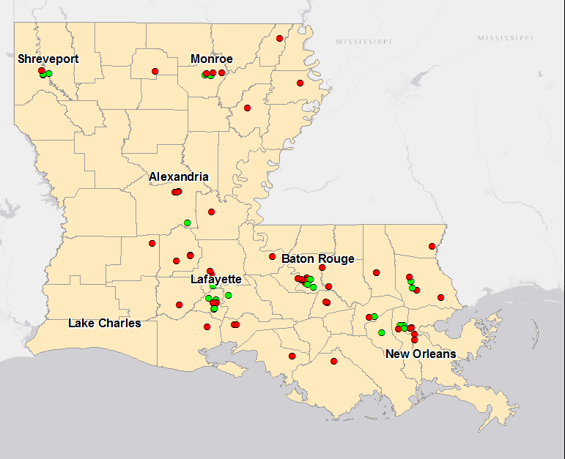
Louisiana Lacks MAT Treatment Capacity
According to SAMHSA data:
106 total treatment facilities
30 offer at least one form of MAT
Centers that provide MAT
Centers that do not provide MAT
Source: NSSATS
Notes:
First, there aren’t enough treatment providers that offer MAT to meet the need for treatment across the state of Louisiana.
For instance, this map shows treatment centers across the state. This does not capture primary care physicians and other community-based providers that offer office-based treatment.
National Survey of Substance Abuse Treatment Services (NSSATS) is self-reported survey conducted by SAMHSA – Louisiana’s response rate in 2018 was 67.2%. They contacted a total of 131 SUD providers in-state.
10 of these provide methadone (OTPs)
47% of facilities are classified as either “Does not use medication for opioid addiction” or “Does not treat opioid addiction”
Focus on poor distribution and general lack of SUD providers
Furthermore, not enough SUD treatment providers take Medicaid patients. In Louisiana, only 62 percent of SUD treatment providers accept Medicaid patients.
[TRANSITION]: In particular, there is a shortage of methadone providers….

Slide 12
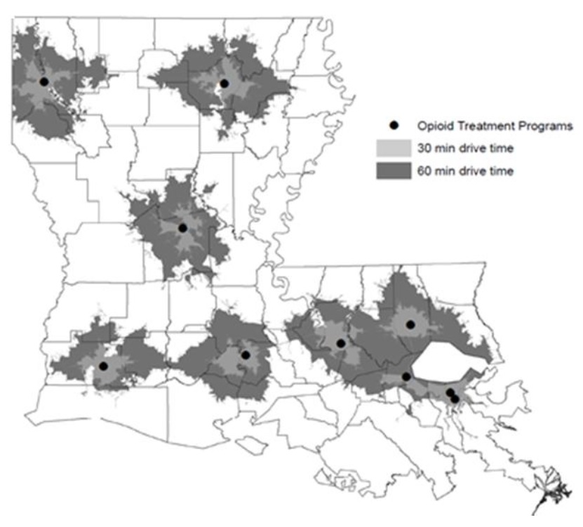
Limited Access to Methadone
Source: Louisiana Commission on Preventing Opioid Abuse Report
Notes:
Second, there aren’t enough providers that can offer methadone.
OTPs are a critical part of any state’s treatment system and key provider of MAT. A provider must be licensed as an OTP to offer methadone to treat OUD. Nationwide 79.8 percent of individuals on MAT receive care at OTPs. This trend is consistent in Louisiana, where 75 percent of individuals on MAT receive care at OTPs.
Despite their importance in delivering care for OUD, there are only 10 OTPs across the state. Louisiana has one of the lowest numbers of OTPs per capita in the country – 46th. Of other Gulf states, Alabama, Florida and Texas have more OTPs per capita, compared to Louisiana. As the only licensed providers that can offer methadone to treat OUD, access to these services are important for a comprehensive treatment system. As you can see there are large swaths of the state that are more than an hour drive from the nearest OTP. As methadone is administered daily, this travel distance creates a substantial burden to access effective care.
[TRANSITION]: In addition to limited treatment capacity, many treatment providers don’t accept Medicaid patients…

Slide 13
Coverage and Integration Gaps
Medicaid does not cover:
Methadone
Lack of OTP integration
Notes:
The second challenge is incomplete Medicaid coverage of the full continuum of care, including levels of care and FDA-approved medications to treat OUD.
The American Society of Addiction Medicine, or ASAM, has a patient placement criteria that is considered the gold-standard for determining what level of care is clinically appropriate for patient. ASAM, as well as other national associations and clinical experts, also recommend the availability of all three FDA-approved medications.
Louisiana’s Medicaid program does not cover methadone for the treatment of OUD
Louisiana’s OTPs are siloed, rarely offering all forms of FDA-approved medications, and not integrated with primary care and co-occurring mental health services.
[TRANSITION] Louisiana is one of only a few state Medicaid programs that does not cover methadone to treat OUD…

Slide 14
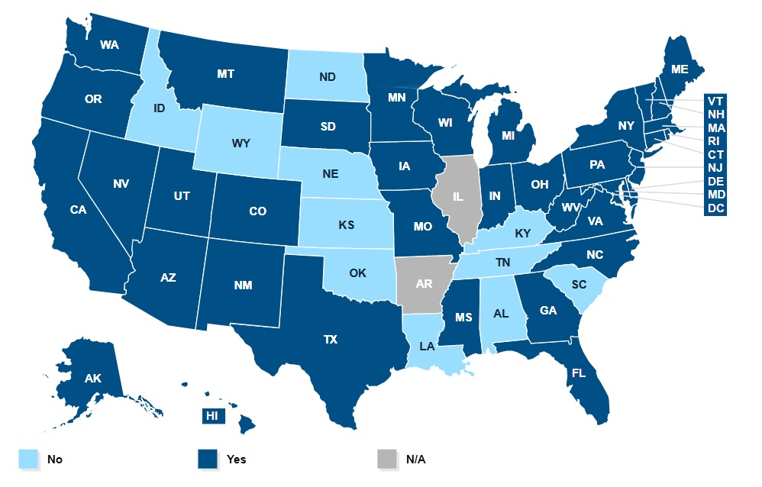
Medicaid Coverage of Methadone
Source: Analysis of annual 50-State Medicaid Budget Surveys conducted by the KFF and HMA, 2018
Notes:
The limited access to providers that offer methadone is, in part, connected to Medicaid not covering the service. Louisiana is currently one of 12 states that don’t cover methadone to treat OUD. However, Secretary Gee and other leaders at LDH have made this a priority and undertaken a significant amount of work to change that.
Because Medicaid does not cover methadone, currently, OTPs in Louisiana are largely cash-based, siloed clinics that don’t offer comprehensive care.
[TRANSITION]: Although Louisiana does cover most of the continuum of care…

Slide 15
Potential Policy Solutions

Slide 16
Increase MAT Provider Availability
Encourage provider participation in MAT:
Enhance Medicaid rates for coordination and office-based treatment services
Eliminate prior authorization
Provide training and billing support to residential facilities to offer MAT
Require licensed SUD providers that treat pregnant women to offer MAT
Notes:
To expand Medicaid provider networks and engage community-based providers, Louisiana could pursue reforms to Medicaid that target MAT access in outpatient and residential facilities by:
Paying for care coordination, including with OBGYNs
Offering enhanced rates for MAT administration in community-based providers to high-quality providers (in addition to the care coordination rate)
Eliminating prior authorization for buprenorphine and naltrexone
Aligning medical necessity criteria across MCOs
Offering statewide provider technical assistance to support training on addiction medicine and Medicaid billing practices
Provide training and billing support to residential facilities to increase use of MAT.
Another important step to ensure pregnant women can access MAT is to require all licensed SUD providers that treat pregnant women to offer MAT.

Slide 17
Enhance Coverage and Integration
Provide adequate Medicaid coverage for all three FDA-approved medications
Increase access to methadone by incentivizing integration with other health settings, such as FQHCs
Integrate MAT availability into correctional facilities
Notes:
To improve access to all three FDA-approved medications, the state could also cover methadone. This could ensure that Medicaid patients are able to pay for services, and incentivize additional providers that are willing to integrate care.
Increase access to all three FDA-approved medications by incentivizing integration of OTPs in community-based provides, such as FQHCs and health systems. There are only a few providers that offer all three forms of MAT, and these providers are not able to offer primary care and behavioral health services. Expanding access to integrated care could help improve access and increase treatment retention. Engaging community-based providers, such as FQHCs, could help improve integrated care. In Louisiana, only a few FQHCs currently offer MAT. Those that currently don’t offer these services cite needed billing support, service capacity challenges, and staffing issues. With 34 FQHCs statewide, expanding access to MAT in health centers in Louisiana could help reach those that need effective treatment.
[TRANSITION] Between now and the next HOPE Council meeting we will be….

Slide 18
Next Steps

Slide 19
Key Dates
January 28 – House Health and Welfare Committee
February 13 – Potential date for HOPE Council Meeting
Pew will present final recommendations for a vote from the Council
February – April – Educating Stakeholders on recommendations
Notes:
November to January – developing the policy recommendations. In addition to what we’ve discussed today, there are other challenges that we plan to address in our final report.
A legislative committee meeting is being planned, with a tentative meeting date of January 28th. We plan to present our recommendations there.
February 13 – we will present our final report to the HOPE Council with a vote on approval of our recommendations.
February – April – we will work with legislative and executive branch leaders to move the recommendations forward for enactment in the spring.
[TRANSITION] In the time we have left, we’d like to have a few discussion questions. But first, any questions or reactions to anything we’ve talked about?

Slide 20
Questions?

Slide 21
Contact Information
Alaina McBournie
Officer
amcbournie@pewtrusts.org
202-540-6967
After February 11th:
Andrew Whitacre
Associate Manager
awhitacre@pewtrusts.org
202-552-2228
Notes:
Here is our contact information. I will not be in the office between the end of this presentation and February 11th, but Alaina will. In case you need to get in contact with us then, please email or call her.

Slide 22
Year-End Status Report Review
Overview
Listed in Act 88, the Council is charged with:
Establishing an Interagency Heroin and Opioid Coordination Plan,
Addressing Parish-level data on opioid overdoses and the dispensing of overdose-reversal medication,
Tracking progress of current initiatives in the state relating to the heroin and opioid epidemic,
Developing lists of specific impacts to agencies in addressing education, treatment including the use of medication-assisted treatment, prevention, overdose, and recovery, and
Coordinating a central online location to disseminate information and resources relative to the opioid epidemic, including the Interagency Heroin and Opioid Coordination Plan. www.ldh.la.gov/hope
Today we will review the Report, make any necessary changes, and vote to submit it on the HOPE webpage and to the drug policy board, Governor, President of the Senate, Speaker of the House, and Chief Justice of the Louisiana Supreme Court by the end of the calendar year.
Welcome
Review
Discussion
Next Steps / Adjournment

Slide 23
Discussion
Welcome
Vote
Public Comment
Review
Discussion
Next Steps / Adjournment

Slide 24
Next Steps
Welcome
Review of HOPE Advisory Council Next Steps
Discuss Statewide Data-sharing Agreements and Governance
Submit Year-End Report no later than December 31st, 2018
Share Year-End Report on central online location by December 31st, 2018: www.ldh.la.gov/HOPE
Minutes will be sent for review prior to the next meeting and approval during the next meeting
Future meeting dates
February or March
Adjournment
Organization
Discussion
Next Steps / Adjournment

