Slide 1
HOPE Advisory Council Meeting (Act 88 of 2017 - Advisory Council on Heroin and Opioid Prevention and Education)
September 10, 2019

Slide 2
Roll Call – HOPE Council Members
Welcome
Chair Dr. James Hussey: Department of Health
Co-Chair Mona Michelli: Department of Children and Family Services
Michael Comeaux: Department of Education
Blake LeBlanc: Department of Public Safety and Corrections
Major Bob Brown: State Police
Dr. Allison Smith: Higher Education
Linda Theriot: Veterans Affairs
Sheral Kellar: Workforce Commission
Senator Regina Barrow: State Senate
Troy Prevot: House of Representatives
Monica Taylor: Attorney General’s Office
Thomas Travis: Department of Insurance
Judge Jules D. Edwards, III: 15th Judicial Court
Review
Discussion
Next Steps / Adjournment

Slide 3
Approval of Agenda
Welcome
Call to Order
Roll Call
Approval of September 10, 2019 Agenda
Approval of Minutes from June 20, 2019 meeting
Introduction of New Members
Legislative Review and Update
LDH Opioid Response Plan Update
Louisiana Opioid Action Summit
OBH Grants Update
Shatterproof
OPH - LODSS (Louisiana Opioid Data and Surveillance System) and Overdose to Action Grant
Community of Caring Updates by Impact Group
Review Strategy for 2019 Interagency Coordination Plan Completion/Submission
Public Comment
Date, Time, Place of Next HOPE Council Advisory Meeting
Adjournment
Review
Discussion
Next Steps / Adjournment

Slide 4
Approval of June 20, 2019 Meeting Minutes Introduction of New Members
Welcome
Organization
Discussion
Next Steps

Slide 5
Legislative Review and Update
1) SCR 25 - Requests LDH to study the use of scrambler therapy as an opioid alternative for the treatment of pain
2) HCR 71 – LDH to issue guidance/regulations to establish new Opioid Treatment Providers

Slide 6
LDH Opioid Response Plan Louisiana Opioid Action Summit OBH Grants Update Shatterproof - Overview OPH - 1) LODSS (Louisiana Opioid Data and Surveillance System) 2) Overdose to Action Grant
Welcome
Organization
Discussion
Next Steps

Slide 7
Notes:
Governor declared it a “Call to Action” week
350 attendees
15 exhibitors
15 plenary speakers
18 breakout sessions
7 hrs of meeting credits for social workers, counselors, and physicians
The Governor made a detour to speak to the attendees about his commitment to their work.
Thursday we were trending on Twitter.

Slide 8
Topics
Social Determinants of Addiction
Housing
Transportation
Poverty
Addiction as a Chronic Disease
Stigma / Bias
Engagement with Law Enforcement & First Responders
Building Community Coalitions
Peer Recovery
Recovery-Oriented Systems of Care
Challenges with Specific Populations
LGBTQ+
Pregnant women and infants
African Americans
Students
Faith-based initiatives
Medication-Assisted Treatment
Harm Reduction
Importance of Data
LDH Opioid Response Plan
Notes:
Included as many people in recovery as we could recruit to speak on their topic of expertise and share their personal stories.
My three key takeaways:
Do not stop talking about stigma and shame, addiction as a disease, and changing the language.
Addressing social determinants of addiction and providing recovery-oriented systems of care are very similar conversations.
Treat the individual, meeting everyone where they are.
“You cannot solve a problem with the same level of conciousness that created it.” Dr. Monteic Sizer
“We have to start talking about this like these are our neighbors, not ‘the other’.” Dr. Alex Billioux

Slide 9
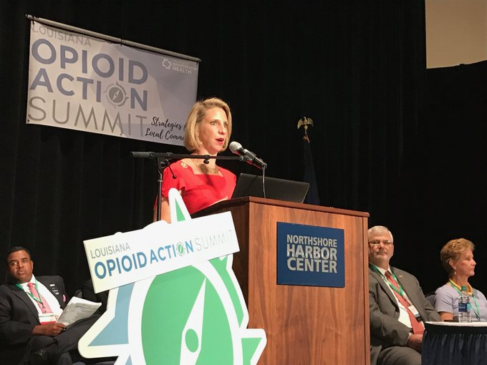
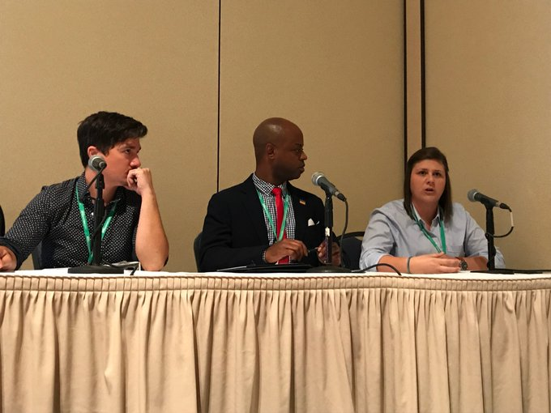
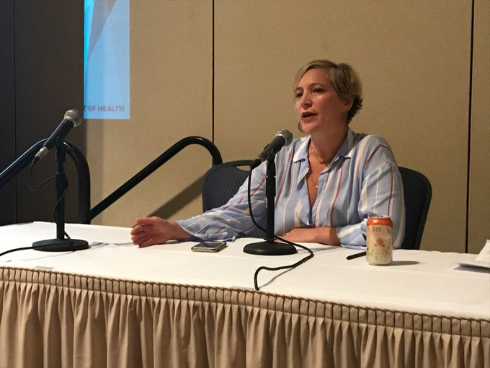
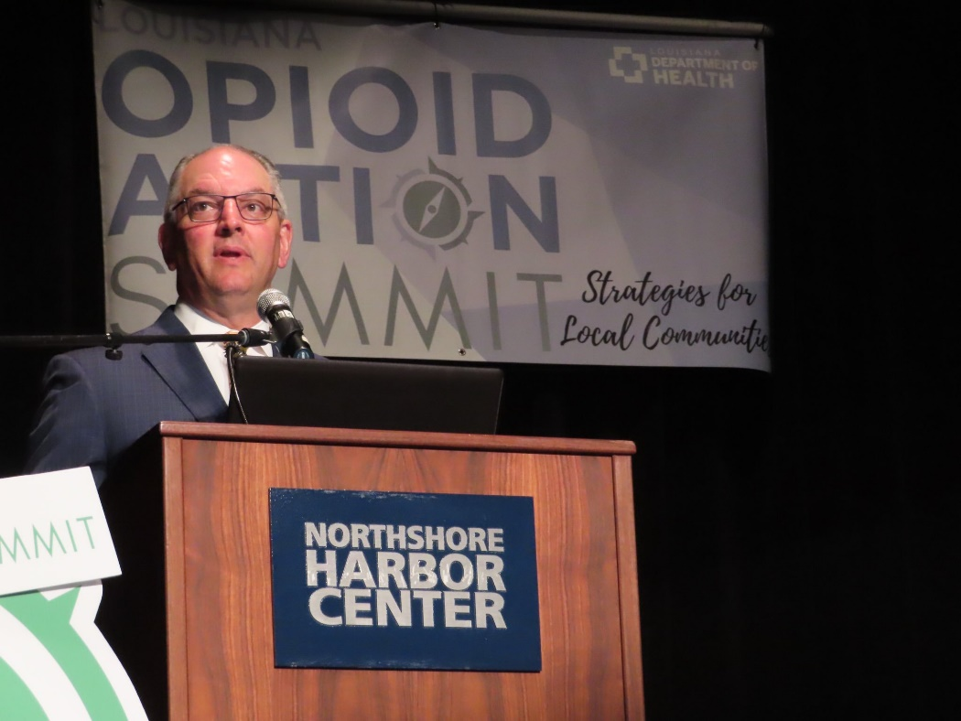

Slide 10
What’s next?
LDH commitment to putting the right resources in the right places.
Medicaid coverage of MAT
Reducing the prevalence of infectious diseases among PWID
Public health prevention, education, and linkage-to-care activities in new grant
More conversations about reducing the stigma and changing the language
Education on and utilization of recovery-oriented systems of care
Addressing social determinants of health and contributors to addiction:
Housing
Lack of primary care
Transportation
Workforce development
Co-occurring mental health conditions

Slide 11
ATLAS™ Pilot Update
September 2019

Slide 12
Agenda
Rebranding as ATLAS™
NC joins pilot!
Pilot is voluntary for LA providers
Recap and update on each data source
Claims-based measures testing
Patient Experience Survey pilot
Treatment Facility Survey revised

Slide 13
Agenda
Provider engagement is ongoing
Public facing display prototype
Treatment facility survey portal opens mid-October
Goal of going live in mid-2020

Slide 14
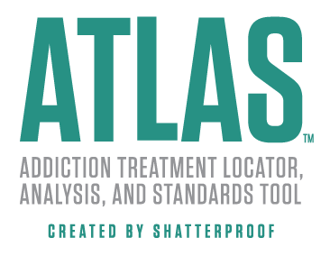
Public facing name:
Helping people navigate to high-quality addiction treatment; helping providers navigate to better quality care.
Notes:
This public-facing platform will help people locate high-quality addiction treatment and create a quality improvement infrastructure to help providers continuously improve program quality.

Slide 15
NC joins pilot – July
Pilot in Select States (2019-2020) & Phased Expansion
WA
ME
MT
ND
OR
MN
ID
SD
WI
MI
NY
WY
PA
IA
NV
NE
IN
OH
UT
IL
CA
CO
WV
KS
MO
VA
KY
NC
TN
NC
AZ
NM
OK
AR
SC
MS
AL
GA
AK
TX
LA
FL

Slide 16
Data sources informing ATLAS™
Unit of measurement:
Addiction treatment programs at the facility level
How?
Three data sources:
Commercial & Medicaid claims
Treatment facility reporting
Patient and family member reporting
Comprehensive view of care delivery
Notes:
Click to add notes

Slide 17
Upcoming Milestones & Events
September - Contact verification process for facilities
September - Patient Experience Survey Webinar for all states
September & October – Regional provider meetings
Mid-October – Treatment Facility Survey portal opens

Slide 18
Office of Public Health Update
LODSS
Overdose Action Grant

Slide 19
From LODDS
Number of Deaths by Specific Opioid Drugs Used, Louisiana 2014-2017
Opioid Prescriptions Issued by parish
Opioid Deaths by Parish of Occurrence and by Parish of Residence
Louisiana Opioid Involved Deaths, 2017 Rates per 100,000

Slide 20
Overdose Data to Action
Grant period: Sept 1, 2019 – Aug 31, 2022
First year award = $4,984,910
Surveillance = $1,313,055
Prevention = $3,671,855
Continues work Louisiana began in 2016
Data Driven Prevention Initiative
Enhanced State Opioid Overdose Surveillance
Public Health Crisis Response – Opioid Epidemic
Expands work in surveillance and prevention
Launches new partnerships and programs in public health and primary prevention
Project direction from Bureau of Health Informatics and Bureau of Community Preparedness
Notes:
$301 million
47 states, Washington DC, two territories, and 16 counties and cities Louisiana Board of Pharmacy
Partners:
Louisiana Hospital Association
Louisiana Coroner’s Association
Louisiana Public Health Institute
Louisiana Supreme Court Drug Specialty Courts
Louisiana 2-1-1
Louisiana Board of Nursing
Louisiana Highway Safety Commission

Slide 21
OD2A: Surveillance
Expand into stimulants and benzodiazepines
Describe the nature of the opioid epidemic in Louisiana
Measure outcomes and inform prevention and response efforts and linkages to care
Collect and distribute fatal and nonfatal overdose data, PMP data, treatment data, and other innovative surveillance projects
Treatment services utilized
Social determinants of addiction
Grow the state’s ability to made data-driven decisions in prevention and treatment
Support coroners through comprehensive toxicology testing
Notes:
#2 Comprehensively and quanitatitvely

Slide 22
OD2A: Prevention
Public health approach that addresses social factors and health disparities
Projects focused on families, youth and teens, justice-involved individuals, low-income women, and rural areas.
Continued deployment of Opioid Preparedness Outreach Coordinators
OPH LINKAGES TO OBH CARE!
Interruption of the transmission of HepC among PWID
Training opportunities for pharmacies, medical societies, EMS staff, academic programs, and the public.
Highlights:
Louisiana 2-1-1
Crisis Teen Text Line
Louisiana Supreme Court – Drug and Specialty Courts
Notes:
Led through regional efforts of the Opioid Preparedness Outreach Coordinators
#1 Part of addiction and limit social support systems
#2 Connecting persons with opioid use disorder utilizing public health services to education, prevention awareness, healthcare resources, and treatment services

Slide 23
OD2A: Contact
Nell Wilson
OD2A Principal Investigator
OPH Bureau of Health Informatics
nell.wilson@la.gov
(225) 342-7437
Notes:
Bureau of Health Informatics leading the surveillance program.
Bureau of Community Preparedness leading the prevention program. Any inquiries about the prevention component can be sent to me and I’ll route to the appropriate person.

Slide 24
Community of Caring Updates by Impact Group
Health/Healthcare Domain
Community Domain
Public Safety Domain

Slide 25
Domain One: Health/Healthcare
Understand the impact of opioids on individual health and the healthcare system(s) that support care of individuals
Areas of health care impacted by opioids can include:
Health care providers
Pharmacists
Insurers
Public health professionals
Health Policy Makers
Behavioral health providers
Coroners

Slide 26
Examples of Health/Healthcare Feedback
Clinical Impact/Challenges:
Difficulties making referrals, coordinating care, limited access to treatment, access to services for specialized populations
Lack of public and provider awareness regarding available treatments and providers, especially underserved populations
Adults on pain meds for numbers of years, difficult to taper off, etc.
Depression/PTSD comorbidities complicate management
Increasing difficulty to access opioids for those with proven chronic pain
Administrative Impact/Challenges:
Reimbursement to coordinate and integrate care, lack of peer services codes
Lack of specialized staff
Preparedness/Training:
support for complex cases, as in Hub/Spoke Model
Available treatments and treatment resources
Education for Pharmacists
Naloxone Training
Meds received directly from VA
Options for pregnant women
Top 3 Difficulties/gaps:
Decriminalize possession of small amounts of opioids and refer to tx
Lack of treatment resources
Activate care coordination reimbursement codes and per to peer codes
Foster greater integration among MCO’s
Data
Alternatives to opioids for pain management
Treatment gaps for pregnant women, especially at higher levels of care
No treatment/service gaps (from a psychiatrist/provider)
Solutions:
Legislative discussion about decriminalization
Activate care coordination/consultation codes
Provider Education and CE credits, make it easier to get DATA-certified
Unified MCO opioid strategies
Better policy on pain med prescriptions: what meds for what pain, etc.
Identify high MME prescribers, chart reviews -> corrective action/education, etc.
Lyft/Uber
Public Service announcements
Other Comments/Recommendations/Data, etc.:

Slide 27
Domain Two: Community Impact
Understand how communities have been affected
These entities are trying to provide the best opportunities for recovery, welfare, education, and prosperity of our citizens
Participants of this group could include the following:
Addicted individual(s) and/or those in recovery
Families
Educators
Institutions for learning at all levels
Employers
Religious Communities
Local community groups/organizations

Slide 28
Domain Two: Community Impact
Goals:
Discuss and record how your “community” has been impacted
Describe current/past efforts to manage impact
Develop a summary of how each “community” functions in this domain
Determine to what extent the epidemic has led to the redirection of services/resources from other community needs
Define/highlight/discuss opportunities for further collaboration or
emerging areas of impact or intervention

Slide 29
Domain Three: Public Safety Impact
Focus on understanding impact of opioids on public safety
For our purposes, public safety refers to the welfare and protection of the general public, primarily from crimes or disasters.
This domain includes, but is not limited to:
Law enforcement
First responders
Fire departments
Corrections
Court systems

Slide 30
Public Safety Impact Responses
Public safety Impact/Challenges:
Need for more education/training on types of overdoses
Safe handling and administration of naloxone
Safe handling of illicit substances
More education on impairment and effects on roadway safety, fatal crashes, etc.
Education on counterfeit drugs
Access to naloxone for first responders, different formulas
Data on types of opioids found in overdoses
More information on drug takeback events

Slide 31
Stakeholders and Interested Parties
Please see sign-up sheets and one-pagers for each identified impact domain.
An electronic pdf form for each impact domain can be sent to those who sign up or request forms to complete.

Slide 32
Strategy for 2019 Interagency Coordination Plan Completion/Submission
Update of 2018 Data
Review and summary of Domain Responses
Identification of 2020 goals and direction

Slide 33
Data Domains from the 2018 HOPE Report
Opioid-related deaths in Louisiana: 401 opioid-involved deaths, incl. 382 opioid poisoning deaths (2017 state totals)
Number of opioid (pain) Rx filled in SYF 2018: 728,417 for 263,557 undup. Recip.s; Medicaid paid amt: $9,226,856
MAT (bup., nalt., etc. – excl. methadone) Rx filled in SFY 2018: 79,918; Medicaid cost: $25,686,680
Number days spent in Emergency Department in SFY 2018 related to opioids:7,886; Related Medicaid costs: $1,858,797
Number of Inpatient Hospital Admits in SFY 2018 related to opioids: 9,834; Related Medicaid costs: $39,755,833
Number of Naloxone prescriptions filled in SFY 2018: 1,426; Related Medicaid costs: $229,527
Number of undup. Medicaid recipients who rec’d SUD residential treatment: 6,286; Medicaid cost: $34,153,438
Number of undup. Medicaid recipients who received SUD outpatient treatment: 4,622; Medicaid cost: $6,212,219
Number Active Offenders in DOC with an active opioid-related offense > 47% are btwn 30 to 39 yo.
2017 Youth Risk Behavior Survey, 19.3% high school students took Rx pain meds w/o MD approval or not as Rx’d.
2017 Youth Risk Behavior Survey, 9.6% of high school students claimed heroin use one or more times in life.
Validated Drug/Alcohol Affected Newborns: FFY 2017, 1,715 incl. those affected by unlawful use of opioids.

Slide 34
Public Comment Next HOPE Advisory Council Meeting - Date, Time, Place Adjournment
Welcome
Organization
Discussion
Next Steps

Slide 35
HOPE Council Louisiana or http://ldh.la.gov/index.cfm/page/2970

Slide 36
Contact:
Keetsie.Gunnels@la.gov
James.Hussey@la.gov

