Slide 1
Oral Health Care Services
Louisiana Medicaid Beneficiary Advisory Committee (BAC)
April 14, 2026
Nick Mosca, DDS, DrPH – MAC Dental Subcommittee Chair

Slide 2
Oral health care is healthcare
We recognize the inherent worth and dignity of all people and have an ethical imperative to ensure access to dental care for all.
Our Vision is to Improve Oral Health as a Pathway to Wellness and Longevity
Notes:
Dental care isn’t just the care of the teeth you can see in the mirror. It’s also the care of the surrounding tissues, the mucosal tissue lining the mouth, the bone that surrounds our teeth, the tongue, and the floor of the mouth. No one should suffer pain, stigma, and shame from a preventable dental disease.

Slide 3
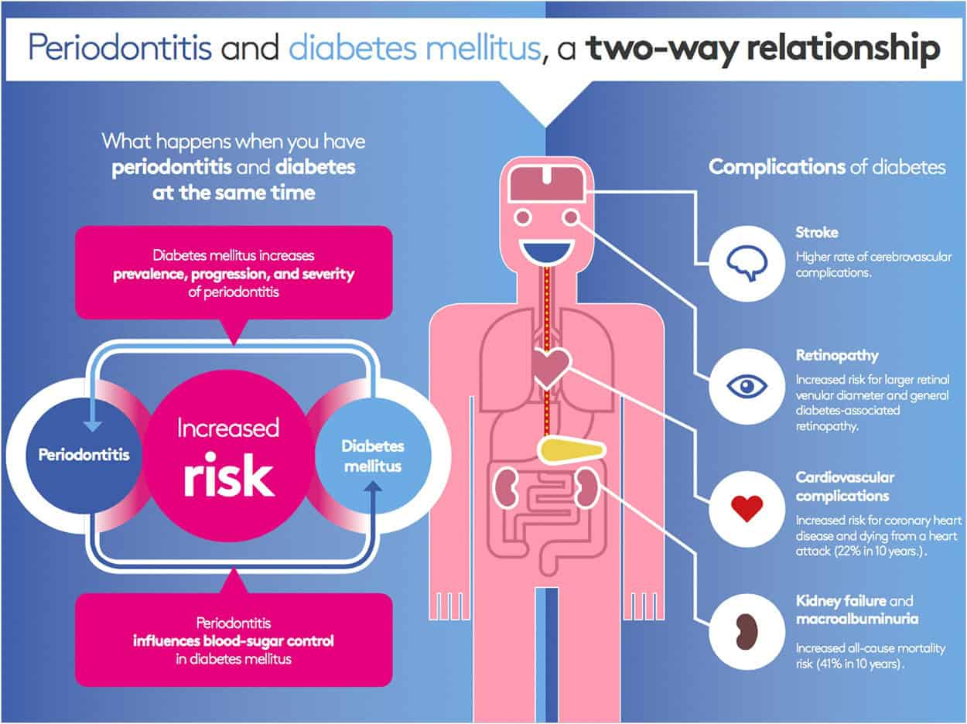
Notes:
The mouth is biologically connected with the rest of the body, enabling bi-directional relationships with some health issues, for example, diabetes.

Slide 4
Diabetes & Gum Disease – Inseparable?
How Diabetes Affects Gums
  High sugar levels in saliva
  Reduced blood flow to gums due to thickening of blood vessels
  Weakened defense against mouth infections (impairs white blood cells)
  Mouth dryness caused by diabetes medications
How Gum Disease Affects Diabetes
  Severe gum disease is a chronic infection that triggers body-wide inflammation
  This inflammation releases molecules that make it harder for the body to use insulin
  Active gum infection causes blood sugar levels to rise, making diabetes more difficult to manage
Notes:
A 2022 meta-analysis found that treatment of gum disease could improve hemoglobin A1C by 0.5 percentage points. Yet generic diabetes medications such as metformin decrease HgA1C by 1.2 percentage points and a GLP1 agonist by an additional 1-2 percentage points.

Slide 5
What opportunities is The MAC dental subcommittee focusing on?
Intellectual & Developmental Disabilities (IDD)
Pregnant Women
Emergency Department Use for Non-trauma Dental Care

Slide 6
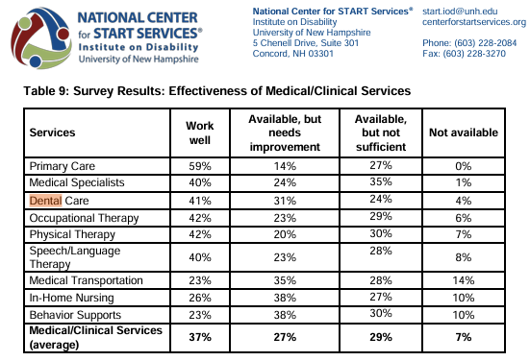
Intellectual & Developmental Disabilities (IDD)
An estimated 107,000 people in Louisiana have an intellectual and/or developmental disability (I/DD)
About 16,000 adults with IDD are eligible for dental care through the Medicaid Adult Waiver Program
Source: Louisiana Developmental Disabilities Coalition
Source: Louisiana Department of Health (National Center for START Services)

Slide 7
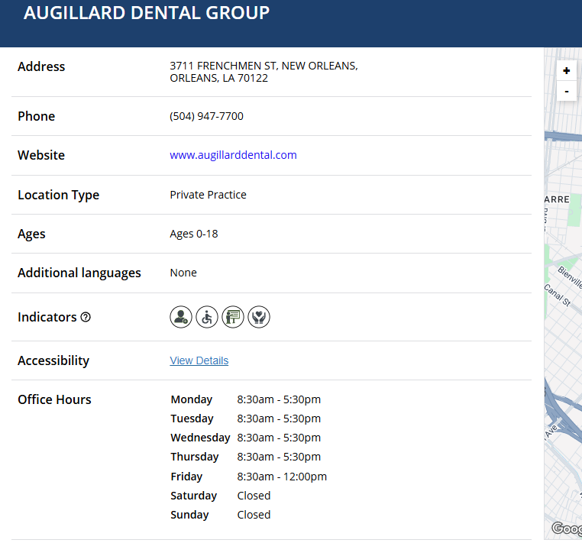
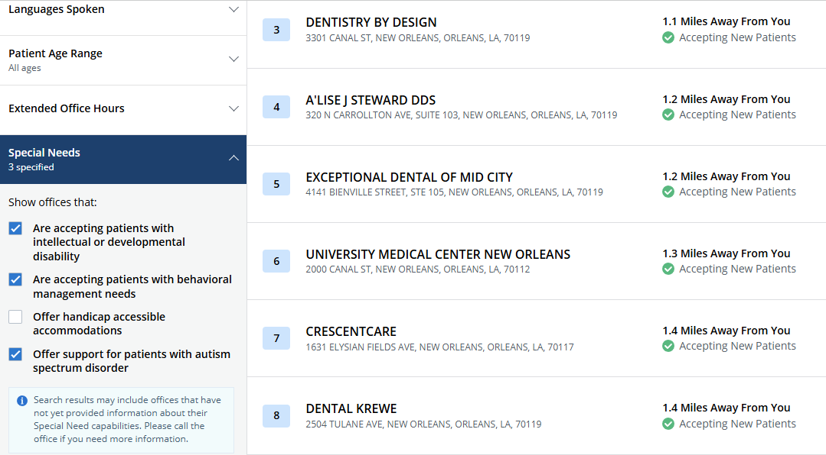
MCNA Providers https://locator.mcna.net/
MEDICAID DENTAL BENEFIT MANAGERS – Provider Search Filters

Slide 8
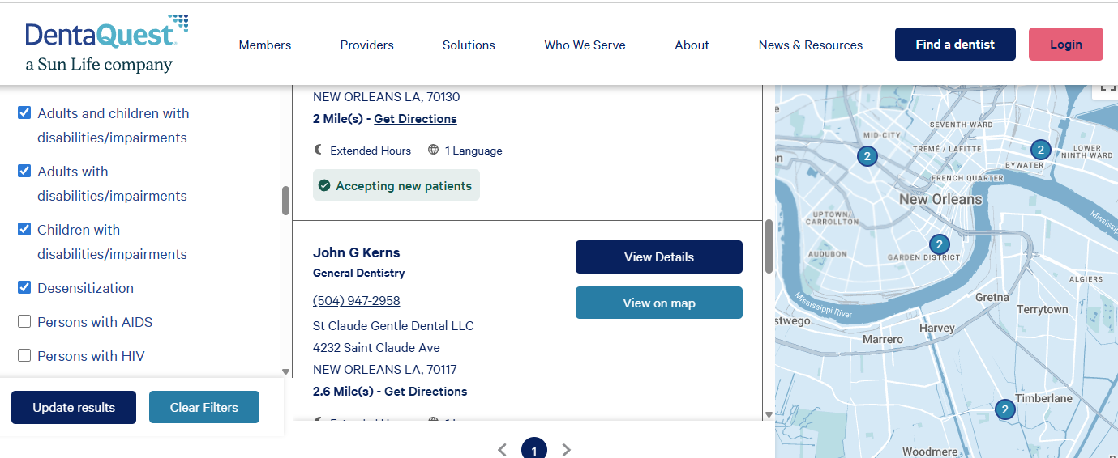
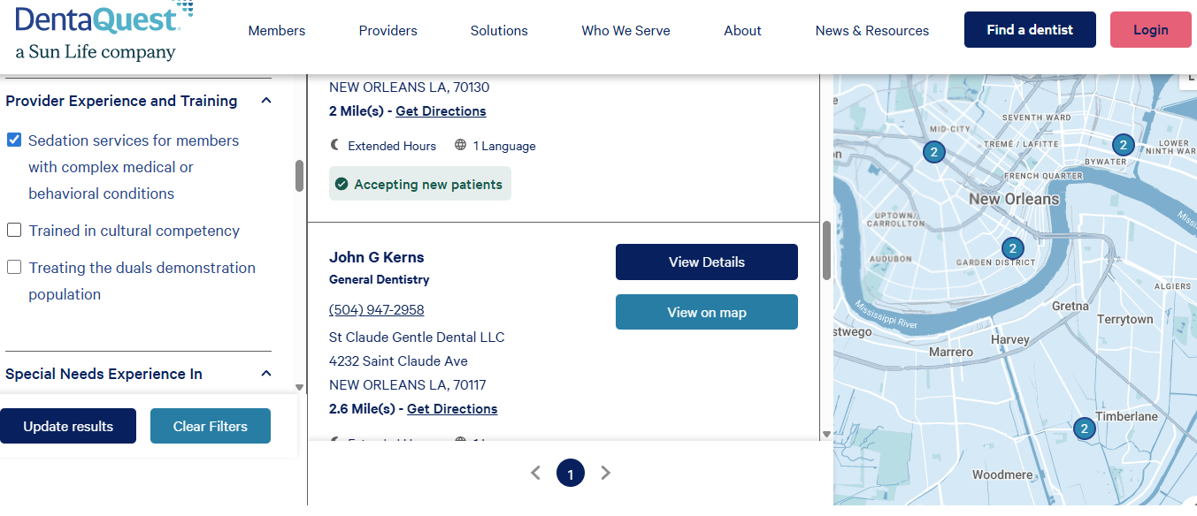
DentaQuest Providers https://www.dentaquest.com/en/find-a-dentist
MEDICAID DENTAL BENEFIT MANAGERS – Provider Search Filters

Slide 9
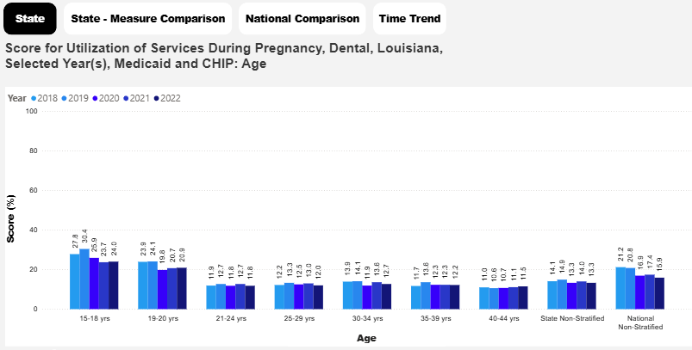
Quality Measure: Any Dental Service Use During Pregnancy

Slide 10
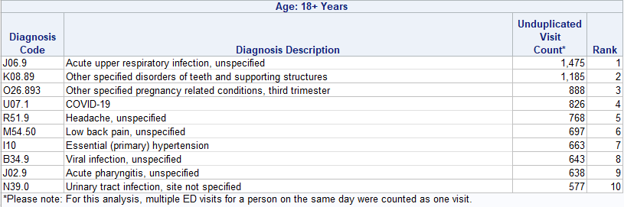
Top 10 Adult Emergency Department Visits, CY 2024
For CPT 99283: Emergency department visit for the evaluation and management of a patient, which requires a medically appropriate history and/or examination and low-level medical decision making.
Source: Louisiana Department of Health October 2025

Slide 11
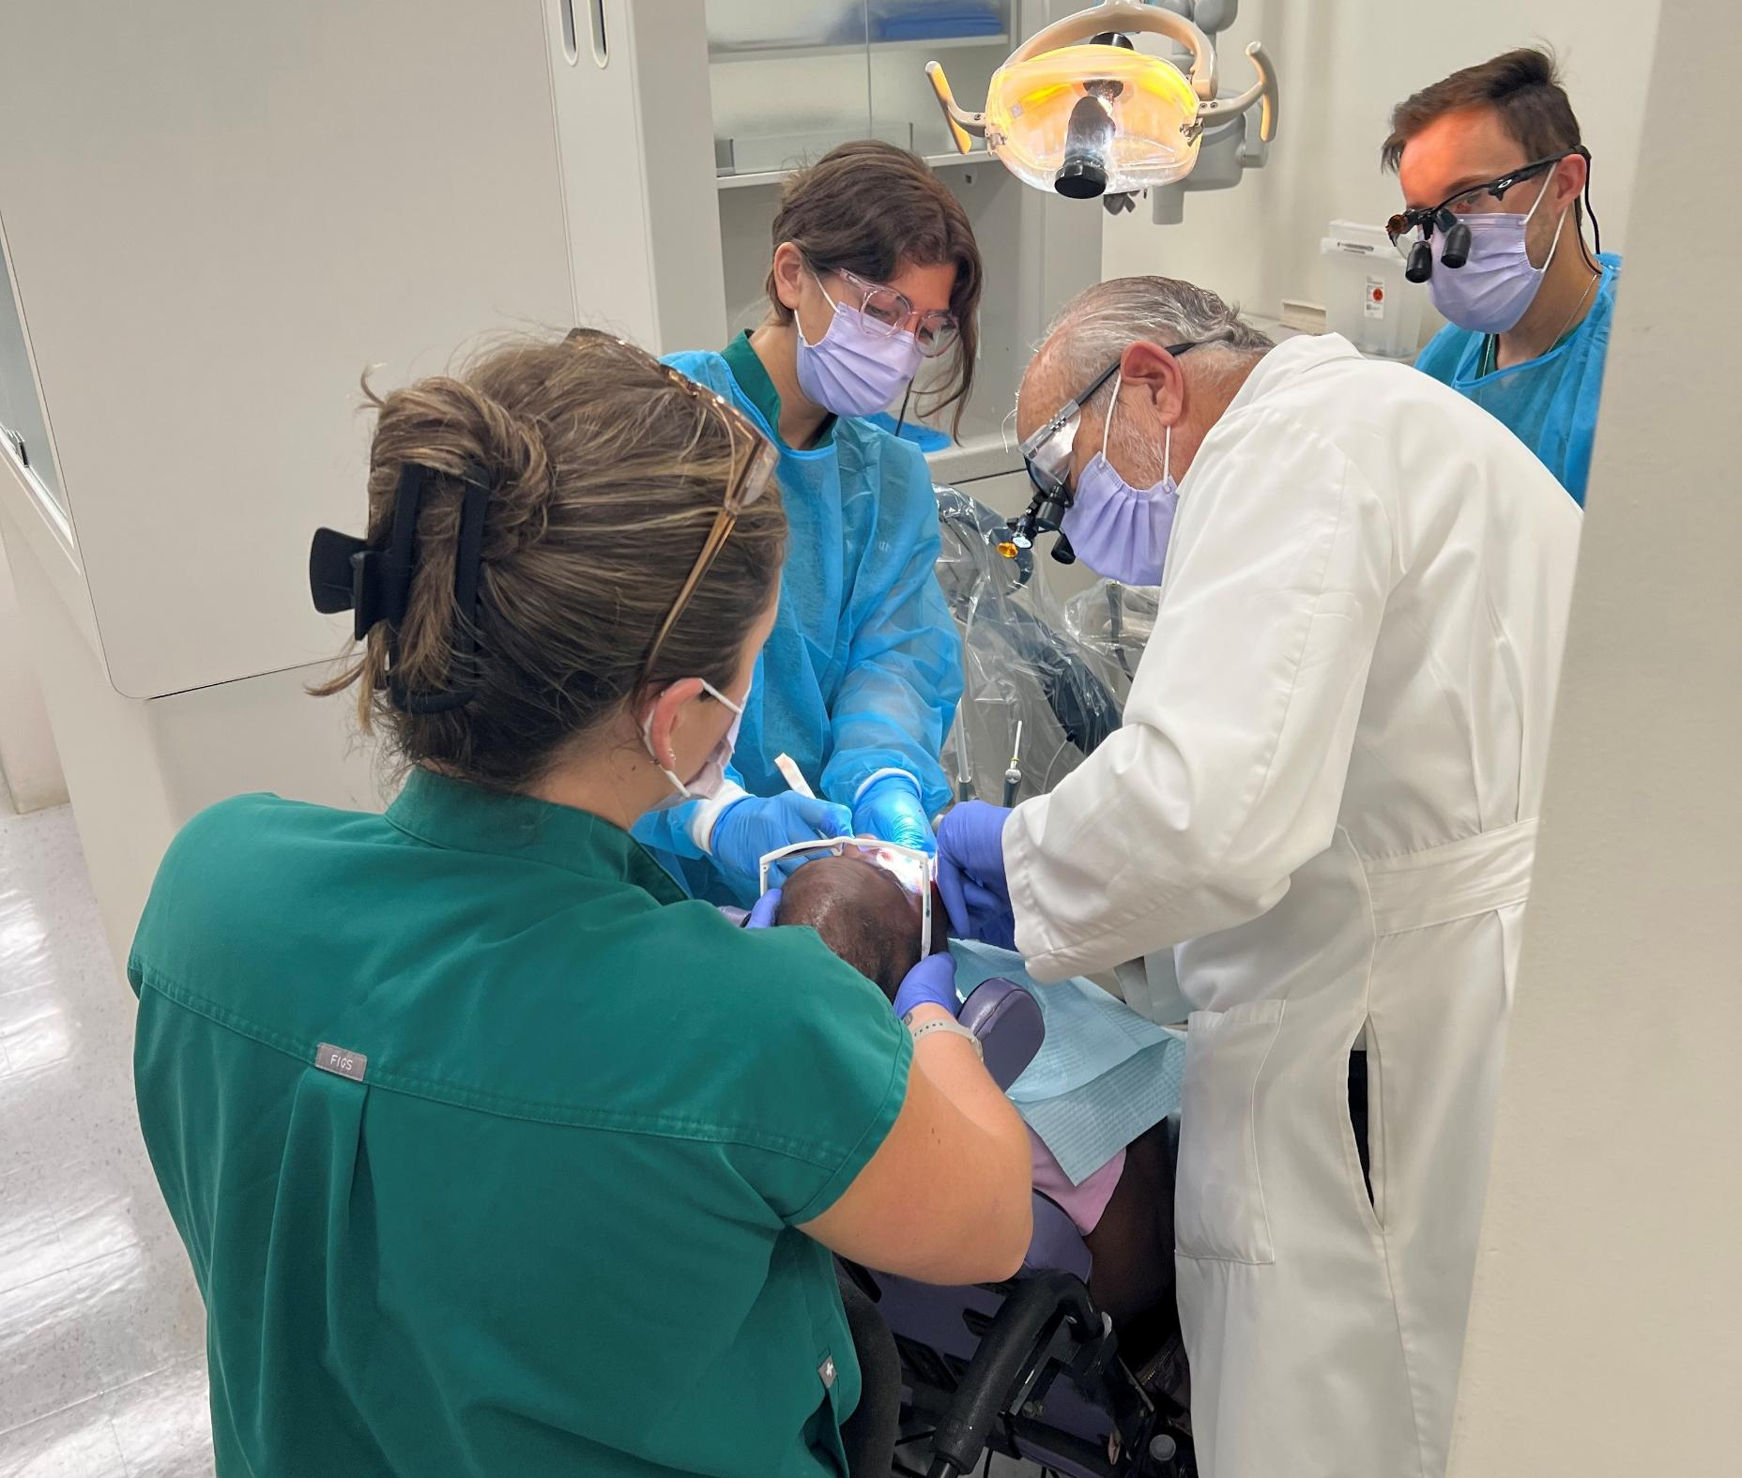
How Can We Best Meet Your Dental Needs?
Nick Mosca, DDS, DrPH
Email:
nmosca@lsuhsc.edu

