Slide 1
External Quality Review
Organization's Role
May 13, 2025

Slide 2

Agenda
HSAG Leadership Team
The HSAG Louisiana Contract Management Team
Why is there an External Quality Review Organization?
Balanced Budget Act of 1997
Mandatory and Optional EQR Activities
HSAG Medicaid Contracts
HSAG – What We Do
Enhanced Federal Match Through EQR
Contracted EQR Activities in Louisiana
Functional Approach to Manage LDH’s Contract
Deliverables to LDH

Slide 3
HSAG Leadership Team
Mary Ellen Dalton, PhD, MBA, RN
  Chief Executive Officer
Rick Potter, CPA, MBA
  Executive Vice President
Gretchen Thompson, MBA, CPHQ
  Vice President and Chief Operating Officer, State & Corporate Services (S&CS)
Tim Laios, MBA, MPH
  Chief Data Officer

Slide 4
The HSAG Louisiana Contract Management Team
Amy Lewis, BSN, RN, CPHM
  Executive Director, S&CS
Heidi Oliver, MPA
  Project Manager, S&CS
Karina Gonzalez, BSB
  Project Coordinator S&CS
HSAG Reports and Communications Team

Slide 5



Why is there an External Quality Review Organization?
The Federal Managed Care Regulations (Balanced Budget Act of 1997)
 | Control the growth of spending for Medicare and Medicaid Programs
 | Ensure development of a “Quality Strategy” for state Medicaid programs
 | Ensure access, availability, capacity, and coordination of care and services for managed care enrollees

Slide 6
Balanced Budget Act (BBA) of 1997
Requires:
MCOs, PIHPs, PAHPs, and PCCMs to comply with both state and federal standards
Independent EQR of Medicaid managed care programs
EQROs to verify Medicaid managed care enrollees have timely and appropriate access to high-quality healthcare services
  Timely—impacts and improves the effectiveness of care
  Access—the ability to make services available and accessible to the entire Medicaid population
  Quality—the ability to increase the desired health outcomes for members through the provision of effective healthcare services
MCOs = Managed care organizations, PIHPs = Prepaid inpatient health plans, PAHPs = Prepaid ambulatory health plans, PCCMs = Primary care case management entities, EQR = External Quality Review, EQRO = External Quality Review Organization

Slide 7
Mandatory and Optional EQR Activities
Mandatory
Validation of performance improvement projects (PIPs)
Validation of performance measures
Review of compliance with Medicaid and CHIP managed care regulations
Validation of network adequacy
Optional
Validation of encounter data
Administration or validation of quality-of-care surveys
Calculation of additional performance measures
Implementation of additional PIPs
Conduct focus studies
Assist with evaluation activities related to quality strategies, state directed payments, and in lieu of services or settings
Rating of managed care plans
Annual EQR technical report
CHIP = Children’s Health Insurance Program

Slide 8

HSAG Medicaid Contracts
Minnesota
Wisconsin
VT
Oregon
Michigan
NH
Nebraska
Iowa
Illinois
Nevada
Utah
Colorado
Virginia
California
Tennessee
North Carolina
Arizona
New Mexico
Georgia
Louisiana
Alaska
Florida
= EQR Contracts
= Other Medicaid Contracts
Hawaii

Slide 9
HSAG – What We Do
EQR for All Managed Care Types
  As an EQRO, HSAG evaluates managed care organizations (MCOs), prepaid inpatient health plans (PIHPs), prepaid ambulatory health plans (PAHPs), and primary care case management (PCCM) programs as required by the code of federal regulations 42 CFR Part 438, Subpart E, and aggregates information on the timeliness, access, and quality of healthcare services furnished to Medicaid enrollees.
  The EQR process currently consists of four mandatory activities and seven optional activities, in addition to producing an annual EQR technical report and providing technical assistance, as needed. HSAG follows the corresponding EQR protocol when performing each EQR activity.

Slide 10
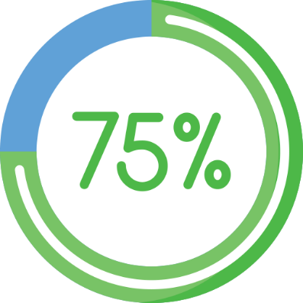
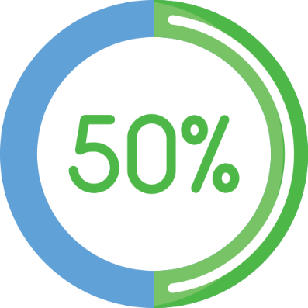
Enhanced Federal Match Through EQR
75% Match EQR of MCOs performed by a qualified EQRO is eligible for 75% federal funding Mandatory activities Optional activities | 50% Match EQR is eligible for 50% federal funding for: PAHPs PIHPs PCCMs
*42 CFR §438.370 Federal financial participation

Slide 11
Contracted EQR Activities in Louisiana
Consumer surveys
Maintain secure web portal
Monthly progress meeting
Ad hoc requests
Compliance reviews
Validation of network adequacy
EQR annual technical report
Quality rating system
Network adequacy and availability validation
Quality strategy evaluation
Focus study
Conduct and facilitate PIPs
Developing and monitoring corrective action plans
Producing additional reports at the request of LDH
Quality companion guide
Behavioral health member satisfaction survey
Case management performance evaluation
Dental surveys
Adult and child fee-for-service and CHIP CAHPS surveys
Mandatory
Optional
Other
Contract management work plan
Performance evaluation and improvement
Performance improvement project (PIPs) validation

Slide 12
Functional Approach to Manage LDH’s Contract
Communication Protocol
Monthly Progress Meetings and Progress Reporting
Contract Management Work Plan

Slide 13

Deliverables to LDH
The Contract Management Work Plan details the tasks and timelines associated with completing each contractually required EQR activity.
Each EQR activity has a deliverable that LDH approves.
The work plan includes the process and timelines for submitting draft documents and/or reports, obtaining and incorporating LDH’s feedback, and submitting final documents and/or reports to LDH.
HSAG is dedicated to producing highly professional, accurate, timely, and useful reports, as required for each activity deliverable and as requested by LDH.

Slide 14

Questions?

Slide 15
Thank you!
Amy Lewis, BSN, RN, CPHM
Executive Director, State & Corporate Services
Cell: 602.527.3535
alewis@hsag.com
Heidi Oliver, MPA
Senior Project Manager, State & Corporate Services
Cell: 480.901.4904
holiver@hsag.com

