Slide 1
Accessing & Updating Provider Information
OAAS-TNG-24-003
Issued March 18, 2024

Slide 2
Provider Locator Tool (PLT)
The Office of Aging and Adult Services’ (OAAS) Freedom of Choice (FOC) for waiver service providers is accessed through Medicaid’s website on the provider locator tool:
https://www.lamedicaid.com/apps/provider_demographics/provider_map.aspx
Issued March 18, 2024
OAAS-TNG-24-003
Slide 2 of 19

Slide 3
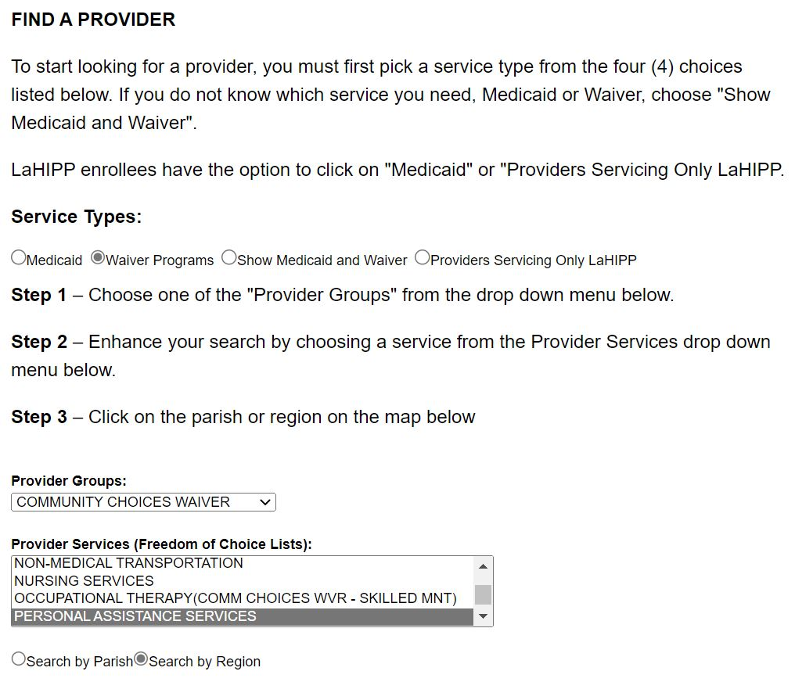
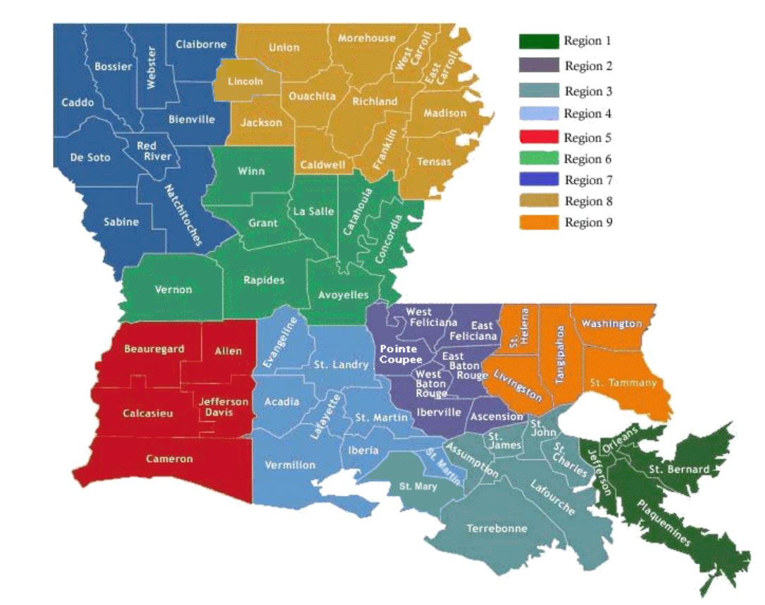
Finding Providers by Region
Service Type: select Waiver Programs
Provider Groups: select Community Choices Waiver
Provider Services: scroll and select Personal Assistance Services
Select Search by Region
Select the Region (on the map)
Issued March 18, 2024
OAAS-TNG-24-003
Slide 3 of 19

Slide 4
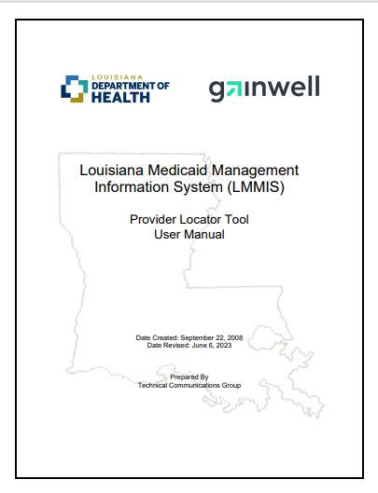
PLT User Manual
Instructions to update the 'additional contact information screen‘ are located in the PLT User Manual here.
Issued March 18, 2024
OAAS-TNG-24-003
Slide 4 of 19

Slide 5
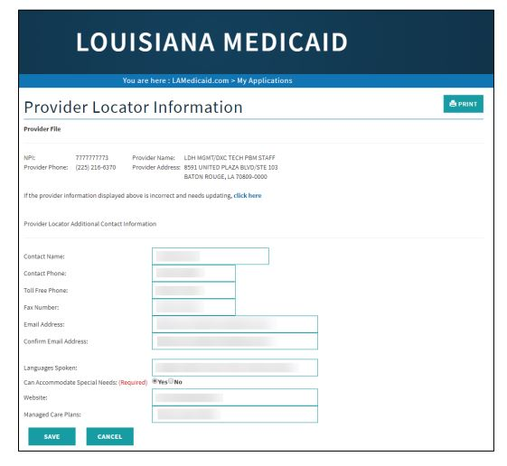
Provider Locator Information
The Provider Locator application allows Louisiana Medicaid providers to update and maintain the information presented to users on the PLT site.
  Public users can search for providers who accept LA Medicaid by service type and region/location.
Issued March 18, 2024
OAAS-TNG-24-003
Slide 5 of 19

Slide 6
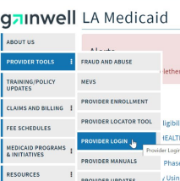
Accessing the Application
Providers access the Provider Locator application through the Provider Login section of the Louisiana Medicaid website www.lamedicaid.com:
  Select > Provider Tools then select >Provider Login
Issued March 18, 2024
OAAS-TNG-24-003
Slide 6 of 19

Slide 7
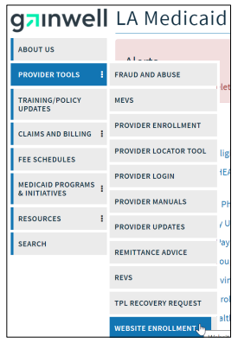
Provider Accounts
The Louisiana Department of Health (LDH) determines authorized users and define all user access capabilities.
Directions for establishing a valid online provider account are available on the Louisiana Medicaid website at www.lamedicaid.com:
  Select > Provider Tools then select > Website Enrollment.
Issued March 18, 2024
OAAS-TNG-24-003
Slide 7 of 19

Slide 8
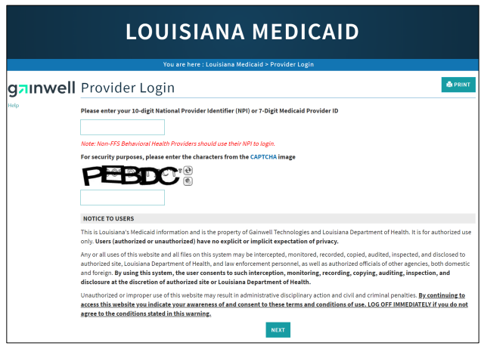
Provider Log In
  On the Provider Login page, users must:
    Enter the 10-digit National Provider Identifier (NPI) or 7-Digit Medicaid Provider ID in the field provided.
    Enter the characters from the CAPTCHA image.
    Review the Notice to Users section before proceeding (selecting the Next button).
Issued March 18, 2024
OAAS-TNG-24-003
Slide 8 of 19

Slide 9
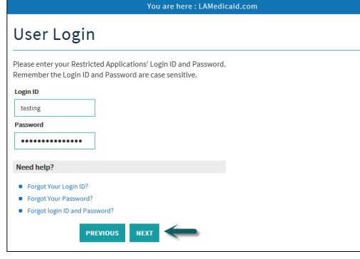
User Log In
Issued March 18, 2024
OAAS-TNG-24-003
Slide 9 of 19
Notes:
At the User Login screen, users must input their Login ID and Password before clicking the Next button to continue

Slide 10
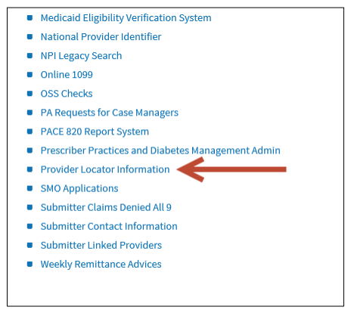
Select the Provider Locator Information link to continue.
Provider Locator Information
Issued March 18, 2024
OAAS-TNG-24-003
Slide 10 of 19
Notes:
Note: The list of applications shown here is comprehensive; therefore you may not see as many options on the Provider Applications page.

Slide 11
Updating Provider Information on PLT
Users should select the text box requiring the update and type in the new information for the following fields:
  Contact Name, Contact Phone, Toll Free Phone, Fax Number, Email Address, Languages Spoken, Website and Managed Care Plans.
Users are required to choose the Yes or No radio button for ‘Can Accommodate Special Needs.’
Issued March 18, 2024
OAAS-TNG-24-003
Slide 11 of 19
Notes:
Remember: Providers can update the existing contact information that the public user will be provided with when using the Provider Locator application.
The website field can direct potential recipients to where they will find extra information regarding your services.

Slide 12
Notifying Health Standards Section (HSS) of Changes
Issued March 18, 2024
OAAS-TNG-24-003
Slide 12 of 19

Slide 13
HSS Changes
Providers licensed by Health Standards Section (HSS) must notify the appropriate HSS department of any changes regarding key personnel, facility name, facility email address, facility phone or facility fax number.
Notification shall be in writing, on facility or agency letterhead and sent to:
    Health Standards Section
    Attn: Program Desk (insert name for the particular program)
    P.O. Box 3767
    Baton Rouge, LA 70821
HSS may require fees to be paid when updating your license.
Issued March 18, 2024
OAAS-TNG-24-003
Slide 13 of 19
Notes:
This is for updated required on the provider license and does not include the contact person and contact person contact info that is on the public facing FOC.

Slide 14
Change of Key Personnel
A change in key personnel such as the Administrator requires that the provider notify HSS.
  Notification shall be made using the HSS Key Personnel Change form:
  HSS Key Personnel Change Form
Change of Address
Providers with a change of address MUST submit a Letter of Intent with the date that the change of address will be effective to HSS.
Note: For specific questions, call HSS : 225.342.0138 or 225.342.3204
Issued March 18, 2024
OAAS-TNG-24-003
Slide 14 of 19
Notes:
Key personnel updates allow all communications regarding the agency to be directed to the appropriate Administrator.

Slide 15
Provider Enrollment
Once the provider license is updated with HSS, providers MUST complete the provider ‘File Update Form’ to send to Provider Enrollment (Gainwell).
Reminders when sending to Gainwell:
  Mail original form to PO Box 80159 Baton Rouge, LA 70898-0159.
  Provider enrollment prefers the form to be completed in Blue Ink.
Note: For specific questions, call Gainwell Provider Enrollment at (225) 216-6370.
Issued March 18, 2024
OAAS-TNG-24-003
Slide 15 of 19

Slide 16
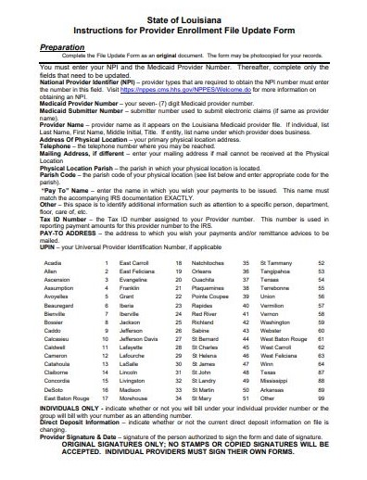
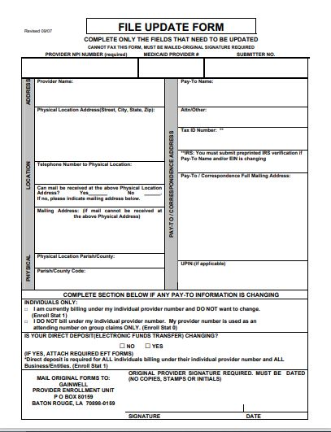
File Update Form
Issued March 18, 2024
OAAS-TNG-24-003
Slide 16 of 19

Slide 17
File Update Form
Page 1 includes instructions.
Page 2 is the form to be completed/submitted.
  Complete only the fields that need to be updated.
This form CANNOT be sent via fax- ORIGINAL SIGNATURES ONLY.
  No stamps or copied signatures will be accepted.
  Individual providers must sign their own forms.
Issued March 18, 2024
OAAS-TNG-24-003
Slide 17 of 19

Slide 18
References:
ProviderLocatorInformationUserManual.pdf (lamedicaid.com)
File Update Form.doc (lamedicaid.com)
https://www.lamedicaid.com/apps/provider_demographics/provider_map.aspx
https://ldh.la.gov/page/hss-change-of-address-key-personnel-or-name
Issued March 18, 2024
OAAS-TNG-24-003
Slide 18 of 19

Slide 19
Questions?
Issued March 18, 2024
OAAS-TNG-24-003
Slide 19 of 19

