Slide 1
OAAS Fair Hearing/Appeal Rights of Participants
OAAS-TNG-24-002
Issued March 14, 2024

Slide 2
Agenda
Introduction
Rights of Participants
LDH Requirements
Guidance
Issued March 14, 2024

Slide 3
State & Federal Laws
Federal law governing fair hearings may be found at CFR, Title 42, Chapter IV, Part 431, Subpart E-Fair hearings for Applicants and Beneficiaries (42 CFR §§ 431.200 - 431.250), available at:
https://www.ecfr.gov/current/title-42/chapter-IV/subchapter-C/part-431/subpart-E
State law governing fair hearings may be found at Louisiana Revised Statutes 46:107, 49:955, and 49:956 and in the Louisiana State Plan under the Title XIX of the Social Security Act Medical Assistance
Right to an Appeal/Fair Hearing is REQUIRED for ALL adverse determinations/actions
Denial of services
Reduction of services (involuntary)
Termination/Discharge from services
Anything that changes a participant’s services/RUG allocation
Issued March 14, 2024
Notes:
Denials/Terminations Reasons:
Not meeting NFLOC
Not meeting Program Requirements
Waiver: Not a safe and legal environment, not cooperating, etc.
LT-PCS: Not having at least one ADL at limited assistance or greater.
ITC: for initials only
Reductions (involuntary): reduction in LT-PCS hours because of change in ADL index (LT-PCS) or a change in RUG Category (Waiver).

Slide 4
Rights of Participants
Right to a Fair Hearing
“Due Process”
Hearing before Administrative Law Judge (ALJ)
Advance Notice
Appear with a Representative of their choosing (legal, relative, friend, etc.)
>Examine Documents >Present testimony
>Question/Refute the Department without interference
>Bring Witnesses
Decision based on legal rules and evidence at the hearing
Issued March 14, 2024
Notes:
ALL information presented in writing and/or verbal to the participant must be in a manner that they can understand.

Slide 5
LDH Requirements
Advance Notice
Notice in writing that explains the reason for decision and adverse action (rules/regulations/policies)
Appeal Requests
Participants appeal to the Division of Administrative Law (DAL) by mail, fax, telephone, DAL website, or in person.
Summary of Evidence Request
A request from DAL to submit a written summary that explains the reason for OAAS’ action.
The SOE must include all evidence that OAAS used in making the decision. (rules, regulations, policies, assessments, plans of care, etc.)
Provide instructions on how to appeal.
Must appeal within 14 calendar days to keep their services (Federal law says 10 calendar days)
OAAS notifies SRI if a PA needs to be extended (within 3 business days of the appeal requests)
Must appeal within 30 calendar days.
OAAS must submit the SOE and Packet within 7 business days of the appeal request.
Issued March 14, 2024

Slide 6
LDH Requirements Continued
Appeal Hearing
DAL notifies OAAS of the hearing date.
Final Decisions
The final official written recommendation report from the ALJ that contains the findings of fact and conclusions of law.
Motions
In front of an impartial Administrative Law Judge (ALJ).
Hearings are typically via teleconference or zoom.
OAAS emails SRI if PA Action is needed (3 business days from the final decision)
Affirmed=> Terminate or reduce services as noted.
Overturned => Consult with Legal; reinstate previous services
Participants have a right to review the evidence, present evidence/testimony, call witnesses, and refute the Department.
Written request to the ALJ to resolve a legal issue.
Example: Motion to Dismiss; withdrawal
Overturned appeals must be signed off and certified by the LDH Undersecretary before being final.
Issued March 14, 2024

Slide 7
Opportunities to Appeal
Decisions/Actions
Initial Eligibility
Resource Allocation
Continued Eligibility
(Reassessments/Review)
LT-PCS: ADL Index
NFLOC (LOCET & iHC)
Program Specific Requirements
CCW: iHC RUGs
Medicaid Eligibility
NFLOC (iHC)
Program Specific Requirements
Resource Allocation
Approved
Denied
Approved
Approved
Reduction in Services
Denied/Discharged
Issued March 14, 2024

Slide 8
Methods to Appeal
Method of Appeal Request: | Date to Use for Appeal Request:
Mail | Postmark date showing the date the individual mailed the request.
Fax | The date the individual faxed the document.
Telephone | The date the individual called DAL.
Online through the DAL website | The date the individual submitted the request online to DAL.
In person | The date the individual went to DAL.
NOTE: If the appeal request deadline falls on a Saturday, Sunday, or state holiday, the individual has until the end of the next day which is not a Saturday, Sunday, or state holiday to request an appeal.
The Division of Administrative Law (DAL) has 90 calendar days from the date of the appeal requests to hold a hearing and make a decision.
Issued March 14, 2024

Slide 9
Timeliness of Appeals & Continuation of Services
Appeal request is within 30 calendar days?
No
Complete Motion To Dismiss (MTD)/Close Appeal
Yes
Appeal request is within 14 calendar days
No
Yes
PA EXTENDED
SOE and SOE Packet Completed and Submitted to DAL
PA to continue services NOT EXTENDED
SOE and Packet Completed and Submitted to DAL
OAAS has 7 business days to complete the SOE & SOE packet and submit to DAL
OAAS has 3 business days to extend the PA to continue services
Issued March 14, 2024

Slide 10
Things that OAAS does to prepare for appeal hearings:
Makes sure the correct exhibits are included and reflect the rules and polices and procedures in effect at the time of the assessment/adverse decision.
Includes any documents or information used to make the decision.
Ex. Police reports, DSW reports, SCA letters, DSW progress notes, SRP decisions, physician letters.
Reviews the current assessment.
Makes sure it is valid and there are no miscorrelations or notebook entries that may need clarification.
Reviews the previous assessment vs. current assessment.
Be prepared to answer questions relative to this during the hearing. (i.e. start of services, date of service change)
Issued March 14, 2024
Notes:
Review the SOE Packet
Making sure that you have documents attached to support the decision. If not it will just be "he said she said" Relevant documents: police reports, dsw reports, SC letters and conversations, DSW progress reports, etc.

Slide 11
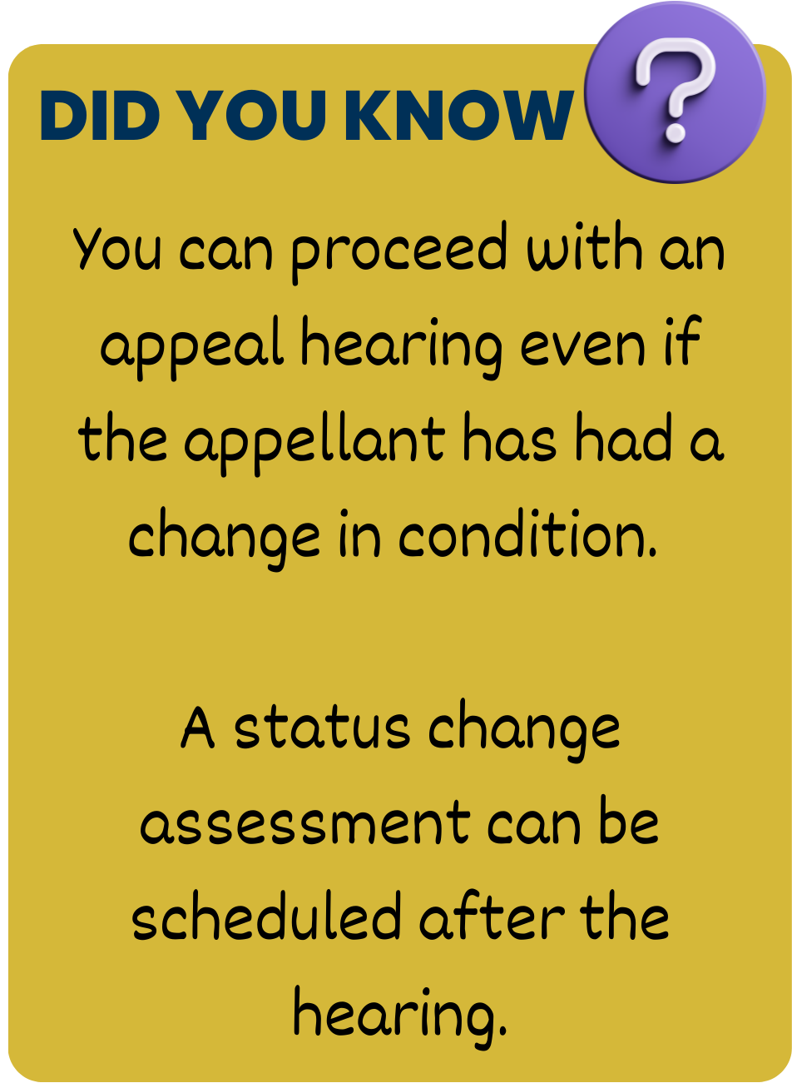
Issued March 14, 2024

Slide 12
When OAAS completes a MTD?
Do a MTD
Untimely
Approved for LT-PCS max of 32 hours (LT-PCS SERVICES ONLY)
DO NOT do a MTD
A new LOCET is performed
An appellant withdrew their appeal
Rescind Original Decision & Do a MTD
New iHC completed in favor of appellant
Programmatic reason based on a review of the current assessment & new assessment is scheduled**
Restore previous hours/budget
Duplicate appeal
Appellant died
Medicaid ineligible
Must have verification from Medicaid that there is no pending Medicaid appeal
Expedited CCW Request & not at 32 hours max of LT-PCS
** MUST BE APPROVED BY OAAS PROGRAM MANAGER AND/OR POLICY
Issued March 14, 2024
Notes:
The appellant had a new iHC completed and/or a new iHC is scheduled.
If an appeal is pending,
1. Rescind the decision that is being appealed and
2. File a MTD.
If an appeal is not pending, OAAS does not need to rescind the previous decision or issue a rescind notice.

Slide 13
Provider Guidance
Issued March 14, 2024
OAAS-TNG-24-002
Page 13 of 20

Slide 14
SCAs role in Appeals
Review assessments to ensure coding and notebook entries are correct and correlate.
Email OAAS Regional Office for reductions and denials/discharges.
Ensure the Adverse Action is selected on the Electronic Plan of Care (EPOC) when there is a reduction in the participant’s budget allocation.
Be prepared to answer questions and provide assessment documentation or other documentation that OAAS will need in making a decision.
Be prepared to participate in an appeal hearing.
Explain to the participant their rights to a fair hearing and how to appeal.
PROVIDERS ARE NOT ALLOWED TO APPEAL. THIS IS A RIGHT OF A PARTICIPANT.
If the SCA has concerns please contact the Regional Office Staff.
Issued March 14, 2024

Slide 15
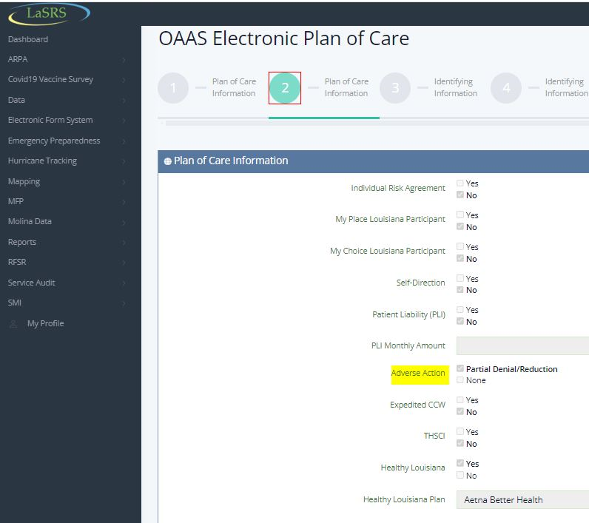
Issued March 14, 2024

Slide 16
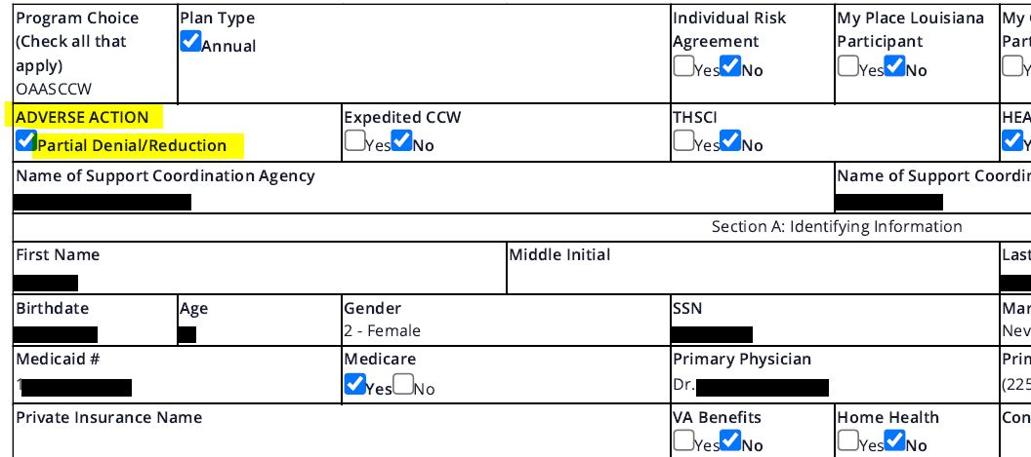
Issued March 14, 2024

Slide 17
SC Reminders Reduction & Denials/Discharge
Leave OPTS, interRAI-HC assessment in submitted status
Email OAAS RO within the required timeframes before the POC Expiration date.
For Reductions: Enter revised POC into EPOC and select adverse action.
OAAS RO will review the iHC for accuracy, complete the decision notice and mail to the participant along with fair hearing rights.
Issued March 14, 2024

Slide 18
DSP or DSW role in Appeals
Be prepared to provide documentation (ex. daily logs) as requested by OAAS or the SCA.
DSWs and DSPs only participate at the request of the participant.
Issued March 14, 2024

Slide 19
Questions?
Contact OAAS RO and/or OAAS Provider Relations
Issued March 14, 2024

Slide 20
Tara DeLee, LCSW
Policy Development Division
Tara.Delee@la.gov
225-342-6491 (office)
Issued March 14, 2024
OAAS-TNG-24-002
Page 20 of 20

