Slide 1

Community Choice Waiver (CCW)
Assistive Devices
and
Medical Supplies
Telecare
OAAS-TNG-24-006
Issued June 3, 2024

Slide 2

Assistive Devices and Medical Supplies
Telecare is a delivery of care services in their home by means of telecommunications and/or computerized devices to improve outcomes and quality of life, increase independence and access to health care, and reduce health care costs.
Telecare services include the following:
● Health Status Monitoring
● Medication Dispensing and Monitoring
Notes:
**These two highlighted services will soon be available via Connect America under “Telecare” which is sub service of “Assistive Devices & Med Supplies.” OAAS is in the process of getting a demo of the medication dispensing service to verify validity.
Health status monitoring in CCW is NOT the same as the following services:
- Activity Sensor Monitoring in CCW which is a computerized system that monitors the beneficiary’s in-home movement and
activity for health, welfare, and safety purposes. The system is individually calibrated based on typical in-home movements/activities.
- Health Status Monitoring in ADHC waiver which is a per diem billable service automatically available for ADHC centers ONLY and is not required to be on the POC budget pg. The purpose of ADHC Health Status Monitoring (HSM) is for ADHC providers to contact participants via telephone on days when a participant is unable or does not attend the ADHC center on the specific scheduled day(s) outlined in their approved POC. During this telephone call, the ADHC provider will check in on the participant and provide follow-up on any need identified during this telephone contact.

Slide 3
Telecare
Monthly telecare services consist of the following:
1. Delivering, furnishing, maintaining, and repairing/replacing equipment;
2. Monitoring of specific service activities by qualified staff;
3. Training in the use of the equipment;
4. Cleaning and storing equipment;
5. Providing remote teaching and coaching as necessary; and
6. Analyzing data, developing and documenting interventions by qualified staff based on information/data reported.

Slide 4
Connecting Health & Home
Telecare is the next-generation, digital health and safety platform that helps aging, at-risk, and chronic populations live well at home.

Slide 5
Benefits of Telecare services
Access to care outside of conventional clinical setting.
Education via qualified healthcare professional.
Promotes proactive interventions with steady ongoing monitoring/reporting.
Empowers participants to feel more engaged in their treatment plan by having access to daily results.

Slide 6
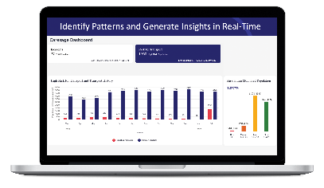
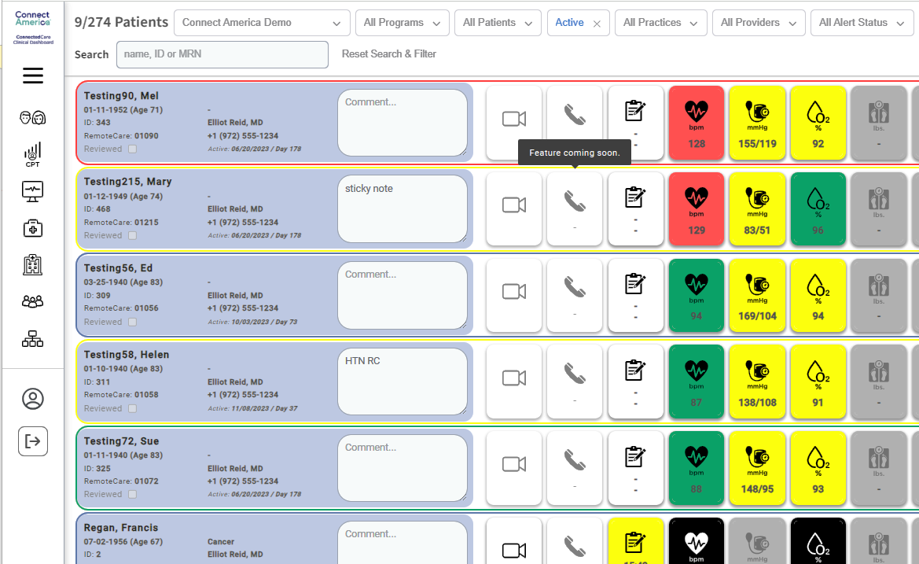



MONITOR
IDENTIFY
Proactive engagement via Health Status Monitoring
OUTREACH
Patient at Home
Program Support
INTERVENE
ESCALATE
Care Team / Providers
Notes:
Connect America monitors the patient at home via device readings that are connected via Bluetooth. Upon identifying inconsistent results, danger blood sugar levels etc, Connect America support team nurse consultant OR health coach can contact the participant OR the participant can contact Connect America via the device to get in touch with these support staff members. If necessary or upon request, connect America staff can contact or send info directly to the PCP who may choose to intervene with the participant.

Slide 7
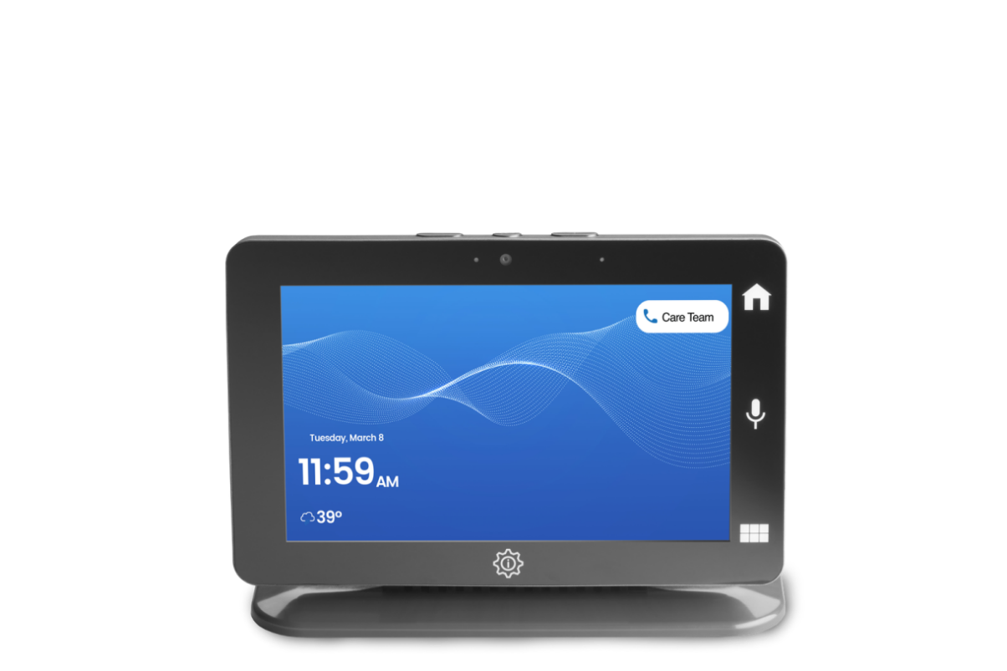
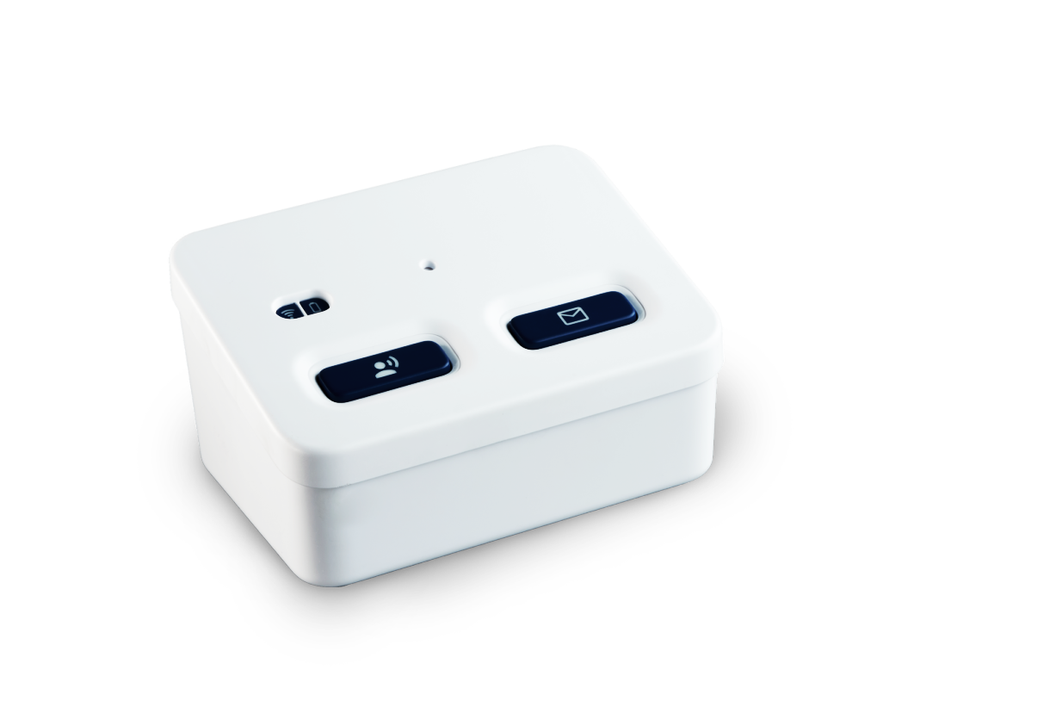


Communication Hubs
Remote Patient Monitoring
Collect Vital Signs.
Direct to Nurse Call Button available .
Remote Patient Monitoring LIVE with Video Visits
Collect vital signs & symptoms; Provide Education;
Video/Virtual Visit Capability;
Direct to Nurse Call Button available on device.
Notes:
These are the two devices available for the ‘health status monitoring’ services with the provider that is on the FOC. Only real difference is one has a video call option and the other does not and the device with no video comes with an optional PERS.

Slide 8
Remote Care-
Patient Monitoring
Remote Care Live!
Enhanced audio capability
  Voice centric conversational AI
Bluetooth devices for connectivity: BP monitor, pulse oximeter, glucometer, spirometer, scale and thermometer
  Devices are paired prior to shipping
Optional PERS button comes with this device
Works on a cellular network - no WiFi needed
Enhanced video for senior and provider
  Large 7" touchscreen with clear two-way voice communication
Bluetooth support for telehealth devices
  Devices are paired prior to shipping
Dynamic patient-specific content for reminders and notifications
Works on a cellular network - no WiFi needed
Notes:
Amazon's Alexa is an example of conversational AI. A person can turn off the ‘conversational Al’ feature if they would like but the feature just asks the person how they are feeling today, have they taken their blood pressure yet etc.
The Connect America rate for either of these devices are $160 per month (+the one time install)

Slide 9
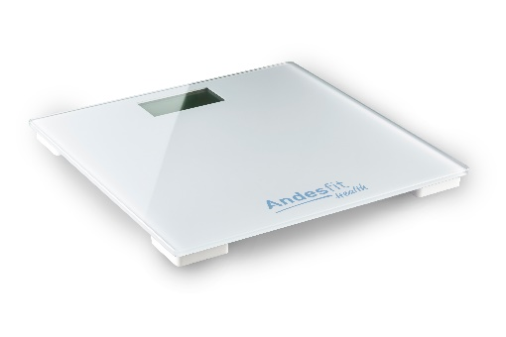
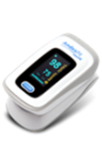
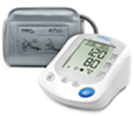

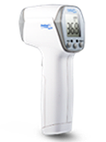
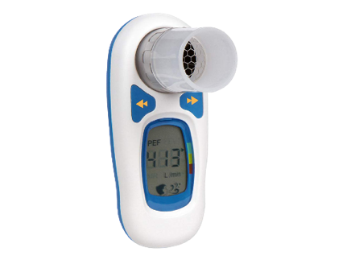
Peripheral Devices
Weight Scale
Standard & Bariatric
Blood Pressure Universal, XS, XL cuffs
Pulse Oximeter
SPO2 & Heart Rate
Glucometers
Contour, FORA
Thermometer
Body / Surface Temperature
Spirometer
Lung Function: PEF & FEV1
Notes:
It will depend on the person’s primary diagnosis on which devices they will send- there is no reason a person could not have it all.
“Health coaches” OR Nurse consultant will monitor the data coming in- they would call the participant if they notice changes in their results & will ask them to redo their reading etc. They can send info to the persons primary care physician, family etc.
The provider would need a list of diagnosis to start with then they will coordinate with the participant to determine which devices are selected upon their enrollment process with the participant.

Slide 10
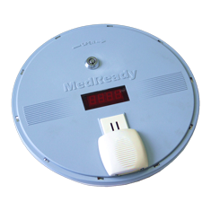

Medication Dispensing and Monitoring
MedReady is designed to help dispense the right medications, at the right time, and in the correct dosage by organizing an entire week’s worth of medications in one compact, automated dispenser.
Notes:
OAAS requested a sample of the Med Ready device and will be testing it.

Slide 11
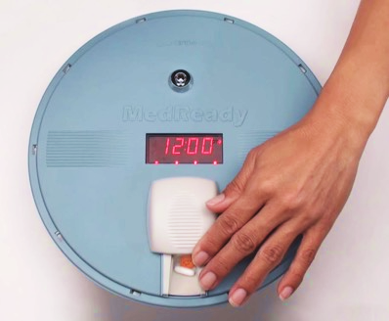
Med Ready
Operates on a traditional landline or cellular network
Holds up to 28 doses:
  4 doses per day for 7 days
  3 doses per day for 21 days
  2 doses per day for 14 days
  1 dose per day for 28 days
Plugs into an electrical outlet but has 48-72-hour back-up battery
Notifications to loved ones and/or caregivers can be sent via email, text, or phone upon missing a dose
Only the most recent dose is available
Tamper resistant- There is a lock on the device once medications are filled
Notes:
Upon referral, connect America intake team will coordinate with the participant on who they would like to be notified if meds are missed etc.

Slide 12

Documentation from Telecare Services
All telecare providers must make documentation collected from telecare services available to the support coordinator and OAAS upon request.
Notes:
The provider mentioned being able to give agencies access to their portal. We are not sure on the logistics on how this will work (i.e. log ins, HIPAA etc). But, they can send via email or fax upon request if needed too.

Slide 13
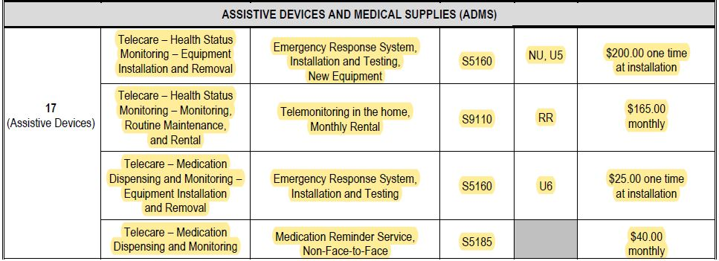
CCW Telecare Billing Codes for Services
Notes:
These highlighted services have been on our fee schedule for years………we finally have a provider available to provide the services.
Connect America currently does not provider ‘Activity Sensor Monitoring’ service available via Telecare.

Slide 14
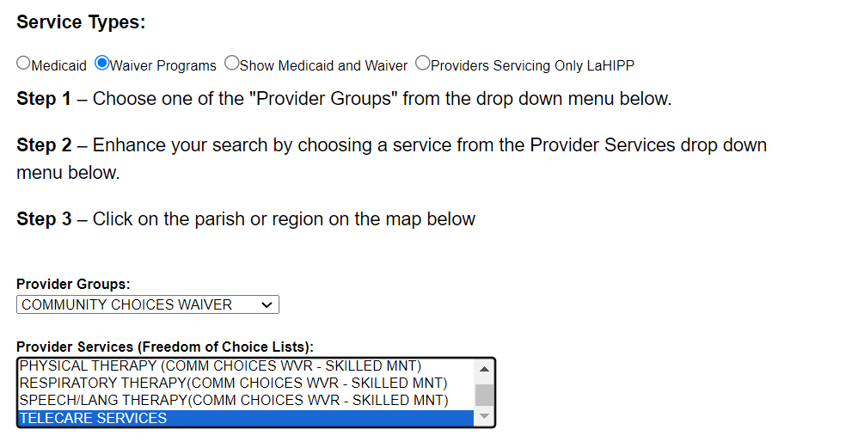
Telecare Services on the Provider Locator Tool (PLT)
Notes:
Remember: OAAS best practices for approving initial POCs- Add another service if the SC is having difficulty finding a PAS provider. These Telecare services may be added as an additional service in addition to Support Coordination to get the person initially approved for waiver.

Slide 15
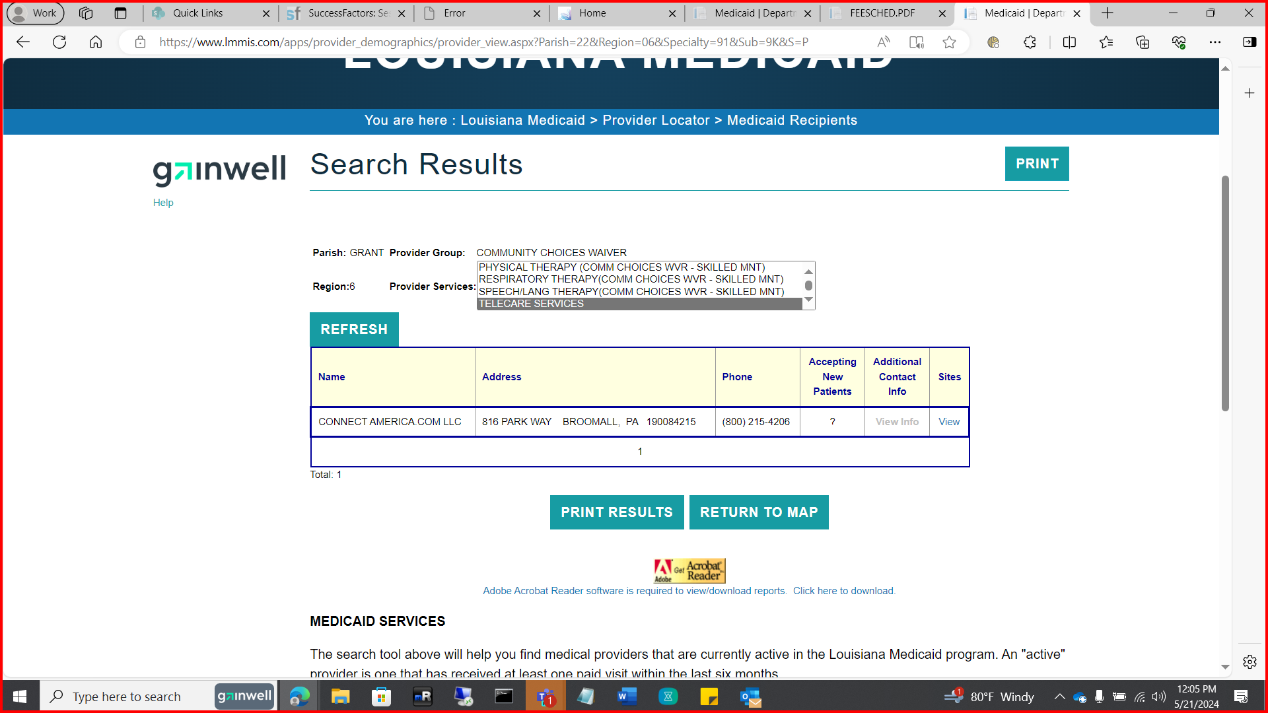
PLT Provider
*As of May 2024, Connect America is the only provider on the PLT for Telecare Services.

Slide 16
References:
https://www.lamedicaid.com/provweb1/providermanuals/CCW2_main.htm
https://ldh.la.gov/news/2923
https://www.lamedicaid.com/Provweb1/fee_schedules/OAAS_Fee.htm
https://www.lamedicaid.com/apps/provider_demographics/provider_map.aspx

Slide 17
Issued June 3, 2024
OAAS-TNG-24-006
Slide 17 of 17

