Slide 1
EarlySteps
Louisiana’s Early Intervention System
January 20, 2026

Slide 2


Team Members
Marquitta Young
Valarie Laday
Professional Development Coordinator
Marquitta.Young2@la.gov
Program Manager of Support Coordination
Valarie.Laday@la.gov

Slide 3
What is Early Intervention?
Individuals with Disabilities Education Act (IDEA) Part C is a federal grant program that assists states in operating a comprehensive statewide program of early intervention services for infants and toddlers, ages birth through 2, with disabilities, and their families.
Early Intervention services promote children’s growth and development and provide supports to families during the critical early childhood years.

Slide 4
Purpose and Philosophy IDEA Part C
In 1986, Congress established the program of early intervention for infants and toddlers with disabilities and in recognition of “an urgent and substantial need”
To enhance the development of infants and toddlers with disabilities;
To reduce the educational costs to our society by minimizing the need for special education and related services after infants and toddlers with disabilities reach school age;
To maximize the potential for individuals with disabilities to live independently in society;
To enhance the capacity of families to meet the special needs of their infants and toddlers with disabilities; and
To enhance the capacity of State and local agencies and service providers to identify, evaluate, and meet the needs of all children

Slide 5
Louisiana’s Early Intervention Program
EarlySteps is Louisiana's Early Intervention Program.
Services to families with infants and toddlers from birth through age 2
Children with developmental delays or medical conditions that likely result in a developmental delay
Services are provided in the child’s natural environment, such as home, child care, or any other community setting
Services are designed to improve the family’s capacity to enhance their child’s development
The child is experiencing developmental delays in the following areas:
Physical Development (crawling, walking, seeing, hearing)
Cognitive Development (learning skills or problem solving)
Social and Emotional Development (playing with others, showing feelings)
Adaptive Development (feeding, getting dressed)
Communication Development (listening, talking, expressing self)

Slide 6
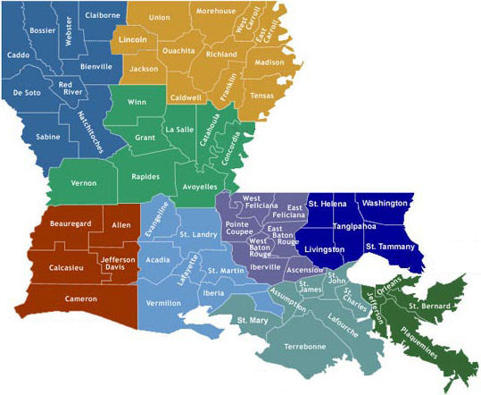
How are referrals made?
EarlySteps has ten System Points of Entry (SPOEs) set up across the state to perform intake and eligibility activities for children referred to EarlySteps. The person making the referral should determine which parish the child lives in and contact the SPOE for the parish.

Slide 7

Who is Eligible?
Must be birth to 2 years old (0-35 months)
Resident of Louisiana
EarlySteps eligibility criteria
Developmental delay in two or more developmental areas; or
Established medical condition (e.g. Down Syndrome; Cerebral Palsy; Autism; vision and/or hearing loss); or
Informed Clinical Opinion

Slide 8

Journey in EarlySteps
Transition/Exit
Individualized Family Service
Plan (IFSP)
Referral
Intake
Evaluation/ Eligibility

Slide 9
Early Intervention Services
Assistive Technology devices and services
Audiology Services
Family Training, Counseling and Home visits
Health services
Medical Services (for diagnostic & evaluation purposes only)
Nursing Services
Nutrition Services
Special Instruction
Speech and Language Pathology
Transportation
Translation/ Interpretation
Vision Services
Occupational Therapy
Physical Therapy
Psychological Services
Service Coordination
Social Work Services

Slide 10

What does Early Intervention Services look like?
EarlySteps services are provided in the home or any other community setting where children live and play. This is often referred to as the natural environment of the child, a setting which would be typical for a child between the age of birth and two.
Providing services in the natural environment reinforces the acquisition of developmental skills that can be practiced throughout the day during the typical routines of the child and family.
There may be out-of-pocket cost for a family, depending on the family’s incomes and services provided -Family Cost Participation

Slide 11

Parent Success Story
MY is a former recipient of Early Steps of Louisiana. MY was diagnosed with developmental and cognitive delays in early 2019. She utilized services through EarlySteps by way of speech therapy and occupational therapy.
Today, MY has made tremendous progress, with her highest achievement of being selected as Student of the Year in 2023.
She is now a thriving 8-year-old exceeding her Accelerated Reading scores, achieving the honor roll, and graduating to regular education.

Slide 12
For additional information
Please visit our website for additional information:
EarlySteps | Louisiana Department of Health
https://ldh.la.gov/page/early-steps

