Slide 1

GENERAL OVERVIEW
OF PROFESSIONAL SERVICES CONTRACTS

Slide 2




Introduction
Types of Professional Contracts – are listed on the right
Identify which type of contract to use through the procurement process
Contracts are prepared by the program offices with legal assistance and then undergo an internal approval process, followed by an external process through the LaGOV contract procurement system with OSP as the last approver. Technical consulting contracts are reviewed by OTS.
Support and Resources
A
PROFESSIONAL SERVICES
CONSULTING
SOCIAL SERIVICES
PERSONAL
INTERAGENCY
INTERGOVERNMENTAL
COOPERATIVE ENDEAVORS
B
R.S. 39: 1593 Method for Source Selection
R.S. 39: 1597 Sole Source
R.S. 39: 1598 Emergency Procurement
R.S. 39: 1617 Professional Service Contracts
R.S.39: 1619 Social Service Contracts
R.S.39: 1620 Personal Contracts
R.S.39: 1621 Consulting Service
C
D
LA DEPARTMENT OF HEALTH
OFFICE OF STATE PROCUREMENT
OFFICE OF TECHNICAL SUPPORT
LDH CONTACTS
DOA/OSP CONTACTS AND WEBSITRES

Slide 3
TYPES OF CONTRACTS:
PROFESSIONAL SERVICES
Contracts for professional services may be awarded without the necessity of competitive bidding or competitive negotiation.
LAWYERS
Professional service means work rendered by an independent contractor who has a professed knowledge of some department of learning or science used by its practical application to the affairs of others or in the practice of an art founded on it.
Independent contractor include:
DOCTORS
DENTISTS
CERTIFIED ADVANCE PRACTICE NURSE
PSYCHOLOGISTS
ENGINEERS
VETERINARIANS
LAND SURVEYERS
LANDSCAPE ARCHITECTS
ACCOUNTANTS
ACTUARIES
CLAIM ADJUSTTERS
ARCHITECTS
PHARMACIST, VISITING PROFESSORS, SCIENTIS

Slide 4

TYPES OF CONTRACTS:
CONSULTING SERVICES
Consulting service means work, other than professional, personal, or social service, rendered by either individuals or firms who possess specialized knowledge, experience, and expertise to investigate assigned problems or projects and to provide counsel, review, design, development, analysis, or advice in formulating or implementing programs or services, or improvements in programs or services, including but not limited to such areas as management, personnel, finance, accounting, planning, information technology, and advertising contracts, except for printing associated therewith.
R. S. 39:1621
Non-Competitive Exemptions
Less than $75,000 (per 12 month Period)
Sole Source
Emergency
Other Requirements
Procurement Support Team (PST) Review if Total Maximum amount of $225,000 or more
Resumes

Slide 5
TYPES OF CONTRACTS:
Social Services
A. Social services include:
(1) Rehabilitation and health supports include services rendered by a contractor with special knowledge or service available to assist individuals in attaining or maintaining a favorable condition of physical and mental health. These services include but are not limited to:
(a) Health-related counseling.
(b) Alcohol or drug abuse training and treatment.
(c) Training to support emergency medical services.
(d) Services to support family planning.
(e) Counseling, delinquency prevention.
(f) Genetic disease evaluation and counseling.
(g) Community-based medical support services.
(h) Evaluation and training for persons with physical or mental disabilities.
(i) Other services in support of same.
Social service means work rendered by any person, firm, corporation, organization, governmental body, or governmental entity in furtherance of the general welfare of the citizens of Louisiana, including but not limited to the objectives provided for in:
R.S. 39:1619(A)
(2) Habilitation and socialization include services rendered by a contractor with special knowledge to assist specified client groups to enhance their self-sufficiency or alleviate their dependency or isolation from the community. These services include but are not limited to:
(a) Day care.
(b) Work and training.
(c) Early intervention for persons with intellectual disabilities, developmental delays, or physical disabilities.
(d) Transportation for service access.
(e) Homemaker, home management, and housing improvement services.
(f) In-home and out-of-home respite care.
(g) Socialization services for low income and other special needs groups.
(h) Nursing home ombudsman.
(i) Nutritional, employment, case management, senior center activities, or other services to aid independent living by the elderly.
(j) Training and community planning services for same

Slide 6
Social Services, continued
(3) Protection for adults and children include services rendered by a contractor to provide therapeutic intervention for adults or children who are in danger or threatened with danger of physical or mental injury, neglect, maltreatment, extortion, or exploitation, including victims of family violence. These services include but are not limited to:
(a) Community planning for neglect/abuse.
(b) Adoption.
(c) Substitute care.
(d) Education and training.
(e) Crisis intervention type services.
(f) Emergency shelter for victims of rape/family violence or services in support of same.
(g) Training and evaluation services for same.
(4) Improvement of living conditions and health include services rendered by an authorized contractor with special knowledge or services available to assist individuals to attain or maintain favorable conditions in which to live. These services include but are not limited to:
(a) Distribution of foodstuffs either purchased or that are made available from government-owned commodities.
(b) Determining the needs of the poor, and development of programs to distribute the available resources.
(c) Determining the needs of the poor and identifying programs to alleviate these poverty conditions.
(d) Providing services to respond to the educational/employment needs of eligible individuals in the communities needing these services. The primary purpose of this service is to provide the participating individuals with the skills necessary for them to advance socially, academically, and occupationally.

Slide 7
Social Services, continued
(5) Evaluation, testing, and remedial educational services for exceptional nonpublic school students with physical or learning disabilities include services rendered by a contractor with special knowledge or services available to provide special educational and related services for exceptional students or students with disabilities voluntarily enrolled in approved nonpublic schools of Louisiana who are not otherwise provided with such services through either their local school program or through other services afforded to them by local school boards or other public agencies. These services include but are not limited to:
(a) Identification, assessment, appraisal, and evaluation of exceptional children and children with disabilities.
(b) Development of individualized educational programs.
(c) The providing of instructional and supportive services to such eligible students in accordance with the provisions of R.S. 17:1941 et seq. and P.L. 94-142 and their regulations.

Slide 8
Social Services, continued
Exemptions:
Less than $250,000 (per 12 month period)
Sole Source
Emergency
Quasi-public or nonprofit Corporation
Local matching funds greater than 10% of contract amount
The nature of the services being provided necessitates that a continuity of contractors be maintained as in but not limited to therapeutic and crisis support to clients and employment and training programs
Contract is with another governmental entity or governmental body
Funds are specifically designated by the federal government for a particular private or public contractor or political subdivision
Contract is with the same vendor under a contract in existence (continuous renewal) since November 30, 1985
Contracts for social services may be awarded without the necessity of competitive bidding or competitive negotiation only if the state chief procurement officer determines that any one of the following conditions is present. The using agency shall document the condition present and such documentation shall be part of the contract record submitted to the office of state procurement

Slide 9









TYPES OF CONTRACTS: Personal
Creative or Artistic Skills
Personal service means work rendered by individuals which requires use of creative or artistic skills, including but not limited to graphic artists, sculptors, musicians, photographers, and writers, or which requires use of highly technical or unique individual skills or talents, including but not limited to paramedicals, therapists, handwriting analysts, foreign representatives, and expert witnesses for adjudications or other court proceedings. A "foreign representative" shall mean a person in a foreign country whose education and experience qualify such person to represent the state in such foreign country
Musicians
Photographer
Graphic Artist
Writers
Sculptors
Highly Technical or unique individual skills or talents
Therapist
Foreign Representative
R.S. 39:1620
Contracts for personal services may be awarded without the necessity of competitive bidding or competitive negotiation
Paramedic
Handwriting Analyst

Slide 10
TYPES OF CONTRACTS:
Interagency/Intergovernmental
Interagency/Intergovernmental contracts which require expenditure of public funds for professional, consulting, personal, social services require
  Submission to OSP for review and approval, unless exempted by written delegation of authority granted by the OSP Director
Interagency contract" means any contract in which each of the parties thereto is a "governmental body" as defined in this Section
Governmental entity" means any governmental unit which is not included in the definition of "governmental body" in this Section
Governmental body" means any department, office, division, commission, council, board, bureau, committee, institution, agency, government corporation, or other establishment or official of the executive branch of state government. For purposes of procurement of personal, professional, consulting, and social services contracts, governmental shall not include the judicial branch of state government.

Slide 11
TYPES OF CONTRACTS:
Cooperative Endeavors
Executive Order JBE 2016-36 & JBE 2016-38
Louisiana Constitution Article VII, Section 14C
For a public purpose, the state and its political subdivisions or political corporations may engage in cooperative endeavors with each other, with the Untied States or its agencies, or with any public or private association, corporations or individual
Cooperative endeavor means any agreement including one of cooperative financing, other than a competitive bid or competitively negotiated contract, whether contracted pursuant to Chapter 10 of Title 38 or Chapter 17 of Title 39 of the Louisiana Revised Statutes of 1950 or pursuant to a request for proposals, request for qualifications, solicitation for offers, or other recognized process for competitively seeking qualified contractors, to which the state is a party and pursuant to which the state has obligated state resources, whether funds, credit, property, or things of value of the state to a nonpublic person for the accomplishment of a public purpose or in the public interest, but shall not include projects contained in the comprehensive state capital outlay budget, projects pursuant to the Governor's Economic Development Rapid Response Program, and integrated coastal protection programs and projects authorized in the annual coastal protection and restoration plan and administered by the Coastal Protection and Restoration Authority.
REQUIREMENTS
Executive Order JBE 2016-36
JBE-2016 36, Section 3, a plan for monitoring compliance with the terms of the co-op, assigning a particular person as a monitor
Executive 2016-38 Line Item Appropriation (LIA)
LIA are those sums of money that the LA Legislators appropriates to non-state entities, quasi-public and private agencies/entities for public purpose
Provide detailed description of the public purpose sought to be achieved through the LIA which must conform to the program described in the appropriations Bill, and if applicable, supplemental information submitted to the Legislature.
Procurement Rules
JBE 2016-36 Section 6
JBE 2016-36, Section 7 Fiscal finding clause
JBE 2016-36, Section 7 Ba-22 OR other appropriate budgetary form
Comprehensive budget, terms of project, goals and objectives including performance measures
Comprehensive budget and other sources of revenue and expenditures, duration of project, goals and objectives, including measures of performance, monitoring plan
All CEAs which are require an expenditure of public funds must be submitted to OSP for review and approval unless exempted by written delegation of authority granted by the OSP Director.
Appropriate CEA agreement format
If funds will be used for contract and professional services, then this information must be provided
Generally, in-kind services are required of 10% unless an exception applies

Slide 12



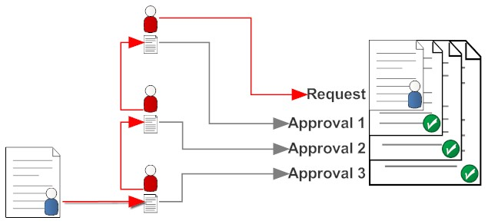
Contract Process and Approval Requirements
Contract Templates
CF-1
CF-6
Cooperative Endeavors Agreement CEA
Required Documents
Statement of Work
  HIPAA Business Associates Form
  BA-22
  Fee Schedule Cost Reimbursement Budget (if applicable)
  Board Resolution/Signature of Authority
  System for Award Management (SAM) (if applicable)
  Audit Requirements (LDH Policy 13.1)
  Multi Year Letter (if applicable)
  Late Letter (if applicable)
  Out of State Justification (if Applicable)
  Disclosure of Ownership (if Applicable)
  Certificate of Authority (If applicable)
  Resume (for Consulting and Personal only)
  License (Professional and Personal)
Contract Forms and Formats
Required Documents
Processing Application Systems
Approval Requirements
LaGov Procurement SRM
Internal and External Approvals for All Contracts
LDH Agency Head
LDH Budget
LDH Legal
LDH Undersecretary
  Pre-Approvals for all Sole Source, Emergency and JLCB Extension Request
LDH Statewide Program Manager
Office of State Procurement
Legal

Slide 13
Contract Forms and Formats
CF-1 TEMPLATE
Cf-6 TEMPLATE
Contract Templates
CF-1 – Standard Professional Template
CF-6 – Standard Amendment Template
Cooperative Endeavor - CEA
Cooperative Endeavor – CEA (LIA) Line Item Appropriation
Required Content for Every Contract
Maximum amount of contract and terms of pay
Start and End Dates
Description of work
  Goals and Objectives
  Deliverables
  Performance Measures
  Monitoring Plan
  When applicable:
    Travel Reimbursement terms – PPM49
    Cost Reimbursement – itemized budget is required
    A schedule for delivery of task and reports
    Advance payment justification R.S. 39: 1619
    Performance Evaluation
CEA TEMPLATE
CEA LIA TEMPALTE

Slide 14
Required Documents
    Additional Documents Required when Indicated
    HIPAA Business Associates
    Statement of Work
    BA-22
    Budget Form or Fee Schedule
    Audit Requirements
    Performance Evaluation – Due 60 days after completion of services
    :
Contract >$2000 | Certification letter
Contract exceeds 12 months | Multi-year explanation
Contractor is a corporation, either profit or non-profit | Board Resolution documenting who can sign contracts for the Corporation and should not be more than 2 years old
Contractor is a for-profit corporation whose stock is not publicly traded | Disclosure of Ownership affidavit is on file with the Secretary of State and indicates that the contractor is in good standing
Contractor is an out-of-state corporation | Certification of Authority to do business in Louisiana
Contract is a consulting contract | Resumes of individual consultants providing services
Outsourcing Contract | Key Internal Control documentation with the agency file
Contract or amendment is for Professional, Personal, Consulting or Social Services | Vendor Profile Data form as required by Act 589
Resumes | Consulting Contracts
License/Certificates | Professional and Personal Contracts
System of Award Management (SAM) | OSRAP Memo 15-18

Slide 15
Processing Application System
    Systems Required User Security Access
  All Vendors must be registered in LaGov Vendor Database managed by Office of State Reporting and Accounting Policy (OSRAP)
    LaGov Vendor Number - assign vendor number and activate
  LaGov eProcurement SRM
          Create Shopping Cart
        Create Purchase Order

Slide 16
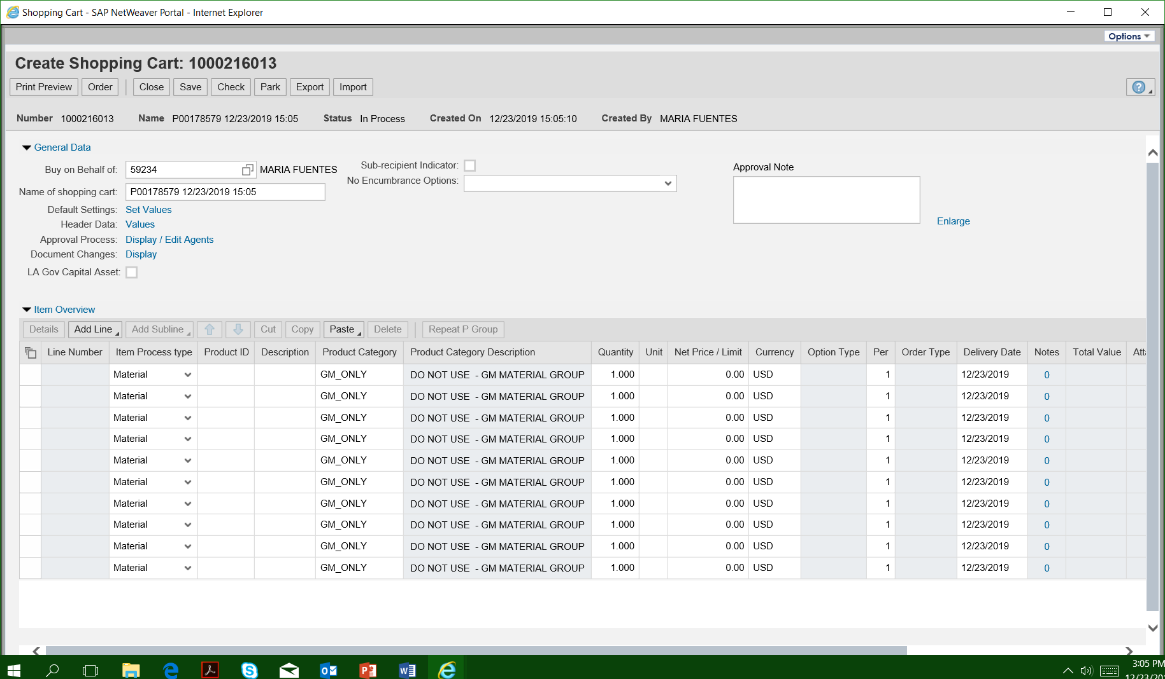
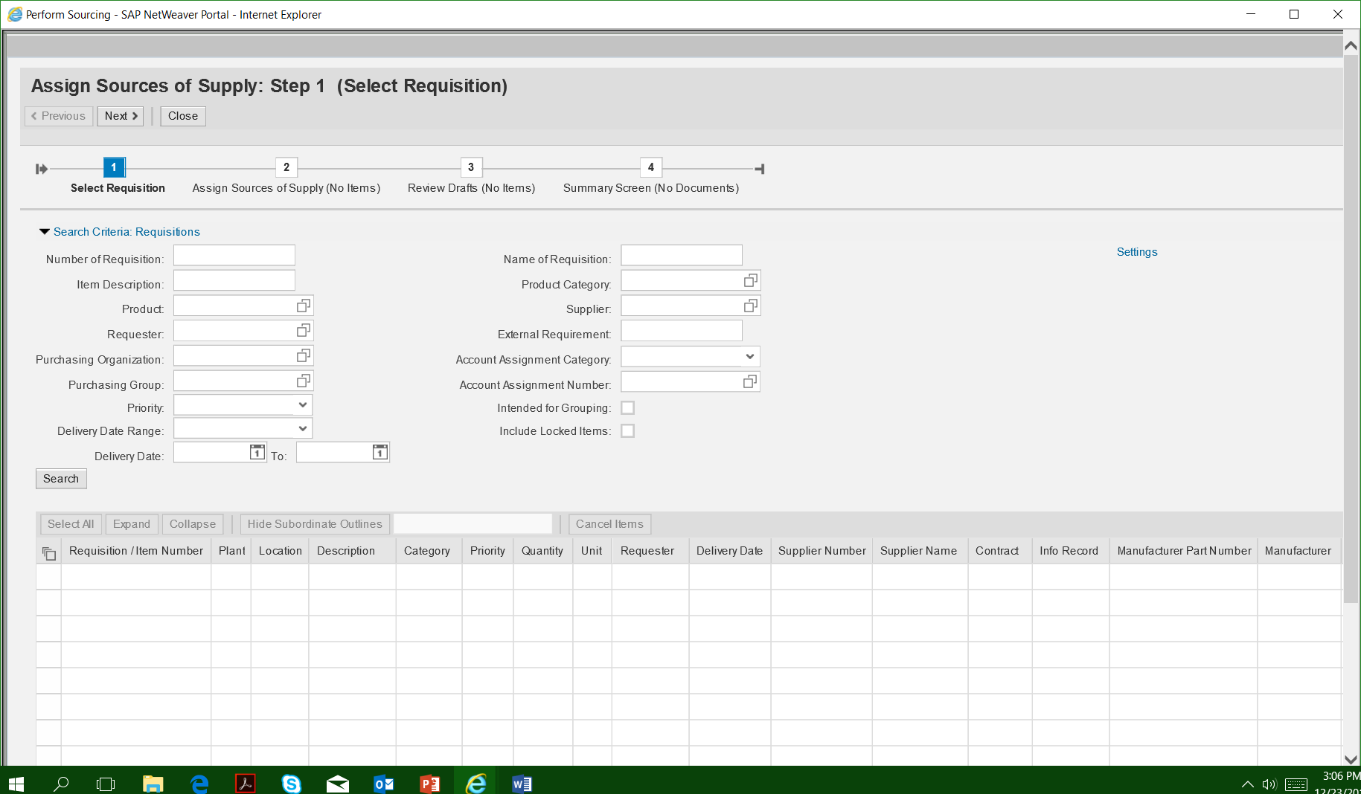
Professional Services Contract Approvals
LDH Approval Process
LaGov
  Shopping Cart
  Purchase Orders
  LDH Delegation of Authority
  Approve and Sign Contracts
  LDH Bureau of Legal Services
  Review and Approve all documents
  LDH Undersecretary
  Expenditure Freeze Form JBE 2016-03
  Pre-Approvals for:
    Emergency Contracts
    Sole Source Contracts
    JLBC Contract Extensions
    LDH Budget
    BA-22

Slide 17
Professional Services Contract Approvals
OSP Approval Process
LaGov
  Purchase Orders
            Submit for Approval from Planning and Budgeting, Depart of Revenue and Final OSP
    Additional Approvals may be required by Other State Agencies based on Contract Content
      Division of Administration,
      Attorney General’s Office (AG)
      Office of General Counsel (OGC)
      Civil Services (CS)
      All legal contracts must be reviewed and approved by the Attorney General’s Office and the Office of General Counsel. Amendments to legal contracts require approval from the Attorney General’s office but not approval from the Office of General Counsel.
      Civil Service Rule 3.1(o) requires the Director to review agencies’ proposed contracts for personal services to determine whether classified employees will be involuntarily displaced due to the personal service contract. If so, Rule 2.9(h) requires the Commission to approve the contract. In order to determine if a contract will involuntarily replace a classified employee, the Director has established the following procedures for agencies to submit their proposed contracts for review.

Slide 18
LINKS TO FORMS
CHECKLIST FOR SUBMITTING CONTRACT FOR REVIEW AND APPROVAL
Contract (Required)
  Complete CF-1 Form 1-15
  Statement of work
  Fee Schedule/Cost Reimbursement/Travel Language
  BA-22
  Certification letter (Contract Amount is greater than $5000)
  Multi-year Letter, contract exceeds 12 months
  Late Letter, contract submitted more than 60 days after start date
  Board Resolution, less than 2 years old (Corporation profit or non-profit)
  Disclosure of Ownership Affidavit which has been filed with the Secretary of State’s Office if contractor is a for profit corporation whose stock is not publicly traded
  Certificate of Authority to do business in Louisiana if contractor is an out-of–state corporation and in Louisiana for more than 30 days. Justification letter is required when contractor is in the state of Louisiana for less than 30 days.
  Resume for Consultants
  Audit Requirements (LDH Policy 13.1)
  Vendor Profile Data Form for Professional Service Contracts and Amendments. Last update status data of form must not be greater than 12 months.
  Contract (When Applicable)
  License or Certificates (Professionals and Personal Contracts)
  Advance Payment Justification ( R.S. 39:1613)
  Contract Amendments
    CF-6(From and To Changes)
    Revised Statement of Work (bold and strike through changes)
    Revised Fee Schedule/Cost Reimbursement
    Vendor Profile (updated)
Templates
CF-1 Contract
CF-6 Contract Amendments
BA-22 – Planning and Budget Form
Cost Reimbursement Form
Civil Services Form
Performance Evaluation Form

Slide 19
Contract Review and Approval Timeline
This timeline can be used as a guide in planning the contract approval process. Several steps are dependent on the agency activities in the process, including but not limited to, quality of the contract and its documents, complexity of the contract and agency responsiveness to LDH Legal and OSP-PC’s comments, questions and suggested revisions.
Legal Contract Review and Approvals | 1-3 days
PST (if applicable) | 3-4- weeks (Depending on Schedule)
OSP Review and Approvals | 3 Weeks

Slide 20
Support Services
Louisiana Department of Health
Louisiana Division of Administration, Office of State Procurement DOA-PCHELPDESK@LA.GOV 225-342-8010
DOA/OSP Website | https://www.doa.la.gov/Pages/osp/PC/agencies.aspx
LaGOV ERP eProcurement (SRM) | https://lagoverpsrm.doa.louisiana.gov/irj/poral
Louisiana Electronic Catalog (La eCat) | https://wwwcfprd.doa.louisiana.gov/OSP/LaPAC/eCat/dsp_eCat SearchLagovm
Louisiana Procurement and Contract Network (LaPAC) | https://wwwcfprd.doa.louisiana.gov/osp/lapac/pubMain.cfm
NAME | TITLE | EMAIL
LDH Contract Review | Contract Review Team | OMFContractReview@LA.GOV
Charles Daspit | Deputy General Counsel | Charles.Daspit@LA.GOV
Kristie Haydel | Attorney Supervisor | Kristie.Haydel@LA.GOV
William Fell | Attorney III | William.Fell@LA.GOV
Jeremy Woolard | Attorney IV | Jeremy.Woolard@LA.GOV
Haley Williams | Medicaid Procurement Attorney | Haley.Williams2@LA.GOV
Office of State Reporting and Accounting Policy
DOA-OSRAP-LAGOV@LA.GOV
(225) 342-1097
Louisiana Economic Development (Hudson Initiative Program)
https://www.doa.la.gov/pages/osp/se/secv.aspx
(225) 342-7000

