Slide 1
Application Center Monthly Contact
December 15, 2021
Valerie McManus, AC Program Monitor

Slide 2
Agenda Items
  Email Correspondence
  Paper Applications
  EMS Review
  Reminders

Slide 3
Email Correspondence
All Application Center correspondence should be submitted to the program email address: ApplicationCenter.Service@la.gov
In my absence, the program account is monitored.

Slide 4
Email Correspondence (continued)
The AC Help button on the AC Resource Library may also be used as it routes the Help Requests directly to the AC Program Account.

Slide 5
Paper Applications
Application Centers may submit paper applications if the Self Service Portal is down or not functioning as it should.
However, a BHSF Clearance form must be submitted. Indicate why a paper application is being submitted.

Slide 6
EMS Review
When possible, claims staff should consult with their associated Application Center prior to reaching out to Medicaid.

Slide 7
EMS Review (continued)
Trusted Users should ensure that the fax cover indicates the dates of service when faxing medical records.

Slide 8
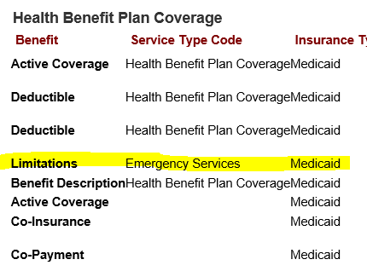
EMS Review (continued)
When reviewing MEVS/REVS, please ensure that you pay attention to the Health Benefit Plan Coverage section.
Limited coverage does not guarantee payment.
Our on staff doctors would have to review the medical records to see if the patient actually received life-sustaining services.

Slide 9
Reminders
AC Resource Library – Check it DAILY
Ensure you log into the PARTNER portal
Adhere to Medicaid guidelines
Trusted Users must conduct Face-to-Face interviews
For issues with newborns, email NEU@la.gov
EMS
  Submit medical bills and records immediately upon denial due to non-citizenship.
  For aged EMS claims, email MEDT@la.gov and cc Kathryn.Loechelt@la.gov
AC Meetings are conducted on your behalf. Please ensure you attend.

Slide 10
Application Centers (AC)
      ApplicationCenter.Service@la.gov
      (225) 342 – 6312
      Valerie McManus
Medical Eligibility Determinations Team (MEDT)
      MEDT@la.gov
      Shauna Meche
Newborn Eligibility Unit (NEU)
      NEU@la.gov
      337-447-4145
Optional State Supplement (OSS)
      OSS@la.gov
      (225) 342 – 1646
      Paige Logan
Outstation
      Outstation@la.gov
      (225) 342 – 1646
      Paige Logan
Medicaid Outreach
      MedicaidOutreach@la.gov
EPO Programs Manager
    Kathryn.Loechelt@la.gov
    (225) 219 – 0912

Slide 11
Questions

