Slide 1
Application Center Monthly Contact
February 16, 2022
Valerie McManus, AC Program Monitor

Slide 2
Agenda Items
  Assessing Eligibility
  Definition of Disability
  Situational Forms Tutorial
  Reminders

Slide 3
Your role is to:
  Submit Medicaid applications for individuals requesting assistance
  Assist the applicant with providing necessary verifications

Slide 4
Do Not:
  Screen for eligibility.
  Discourage application
  Communicate your assumptions to the applicant.

Slide 5
SSA’s Definition of Disability
The inability to engage in any substantial gainful activity (SGA) because of a medically determinable physical or mental impairment(s) that is either:
  Expected to result in death.
  Has lasted or is expected to last for a continuous period of at least 12 months.

Slide 6
Situational Forms
Required if the applicant alleges disability
    Appendix D
    BHSF Form MS or MS/C
    HIPAA 202L
    HIPPA 402P

Slide 7
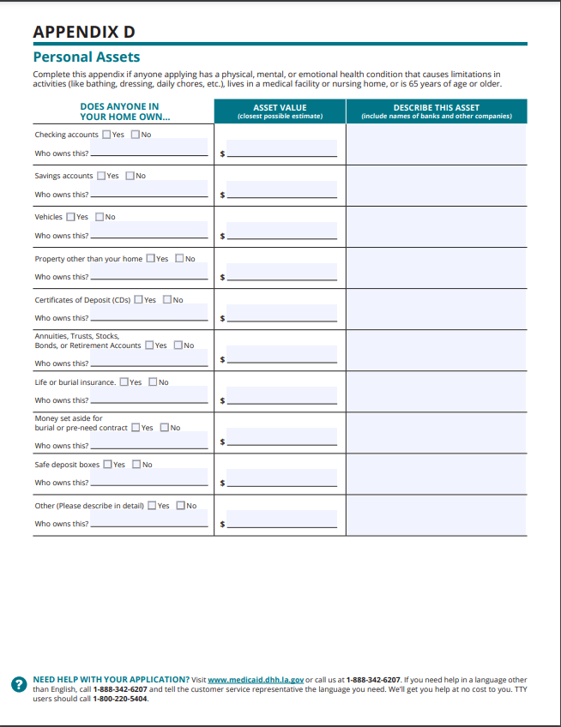
Situational Forms (continued)
Appendix D
Resources

Slide 8
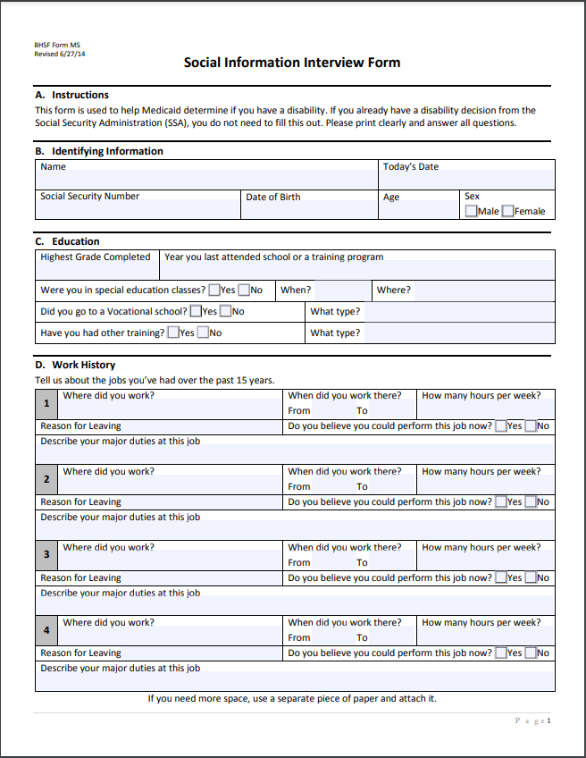
Situational Forms (continued)
BHSF Form MS (Social Information Interview Form - Adult)
Should be completed by the applicant or the person most knowledgeable.

Slide 9
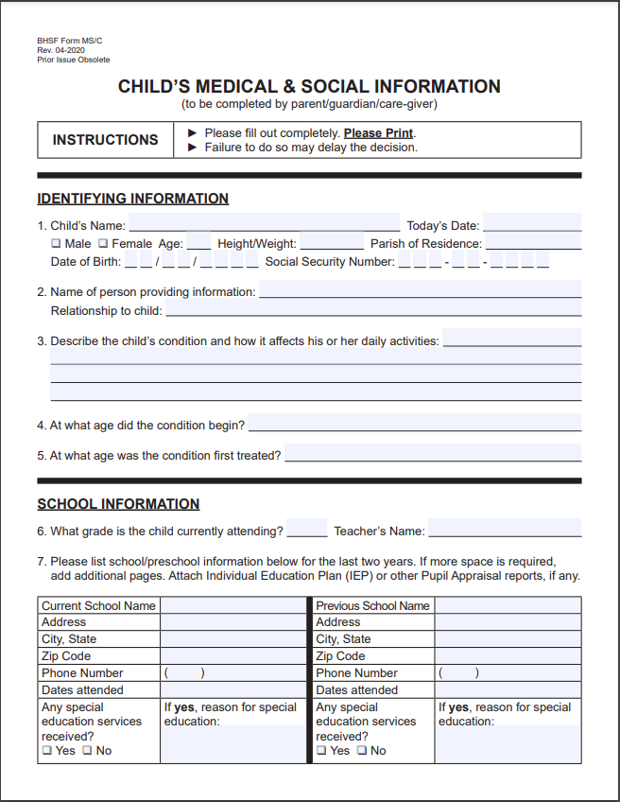
Situational Forms (continued)
BHSF Form MS/C (Social Information Interview Form – Child)
Completed by the parent/guardian/care-giver

Slide 10
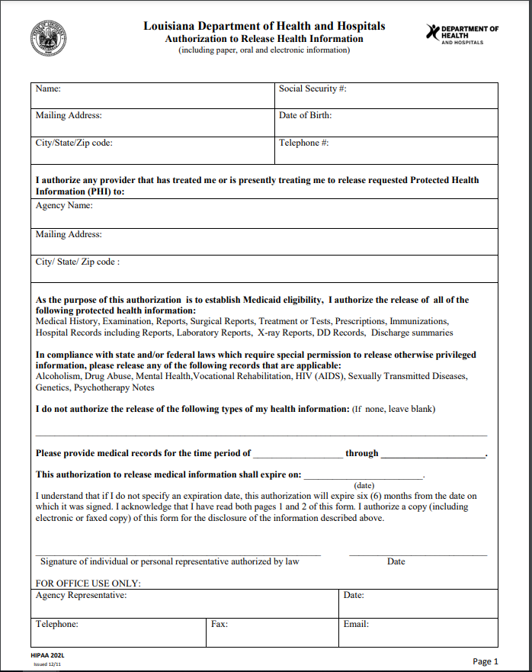
Situational Forms (continued)
HIPAA 202L
Used to request medical records on behalf of an applicant.
Submit a separate form for each provider listed.

Slide 11
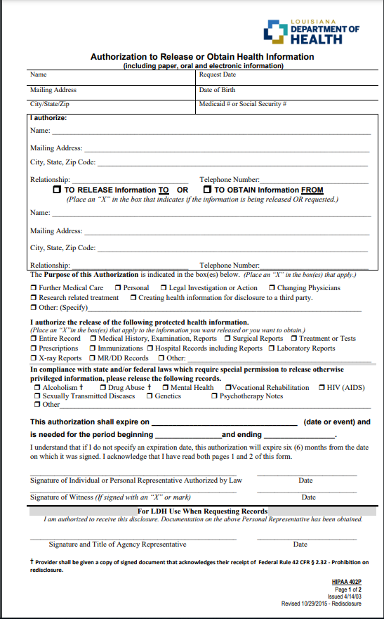
Situational Forms (continued)
HIPAA 402P
Used to request specific medical records on behalf of an applicant.
Submit a separate form for each provider listed.

Slide 12
Reminders
AC Resource Library – Check it DAILY
Ensure you log into the PARTNER portal and not the Public or Provider portal.
Adhere to Medicaid guidelines
Trusted Users must conduct Face-to-Face interviews
For issues with newborns, email NEU@la.gov
EMS
  Submit medical records immediately upon receiving the denial due to non-citizenship.
  For aged EMS claims, email the EMS Aged Claims Status Request form (found on the AC Resource Library) to Kathryn.Loechelt@la.gov .
AC Meetings are conducted on your behalf. Attendance is required and participation is encouraged.

Slide 13
Application Centers (AC)
      ApplicationCenter.Service@la.gov
      (225) 342 – 6312
      Valerie McManus
Medical Eligibility Determinations Team (MEDT)
      MEDT@la.gov
      Shauna Meche
Newborn Eligibility Unit (NEU)
      NEU@la.gov
      Antoinette Rubin
Optional State Supplement (OSS)
      OSS@la.gov
      (225) 342 – 1646
      Paige Logan
Outstation
      Outstation@la.gov
      (225) 342 – 1646
      Paige Logan
Medicaid Outreach
      MedicaidOutreach@la.gov
EPO Programs Manager
    Kathryn.Loechelt@la.gov
    (225) 219 – 0912

Slide 14
Questions & Answers
Does Medicaid refer applicants to Medicare? No, a person needs to contact Medicare to apply if they are interested.
How can I join Friends and Family Transportation? The program is now called Gas Reimbursement. Friends and Family may enroll through the member’s health plan or through Southeastrans if they are on Legacy Medicaid (Fee-for-Service)
What should I do if a COVID positive patient needs to apply for Medicaid? If they are unconscious, a responsible person can apply on their behalf. The patient is conscious, a three way call can be placed with CSU and a phone app can be completed.
There are two HIPAA forms- The HIPAA 202L and the HIPAA 402B. Which one should I use? The HIPAA 202L form is the preferred form for Application Centers, but the HIPPA 402B form can be used if only specific records are needed.

