Slide 1
Application Center Monthly Contact
September 21, 2022
Valerie McManus, AC Program Manager

Slide 2
Agenda Items
    In-Person Applications
    Application Signatures
    Authorized Representatives on Applications
    Submitting Medical Records
    Reminders

Slide 3
In-Person Applications
If you are unable to complete in-person applications due to COVID restrictions or for any other reason, please refer the interested applicants to the Louisiana Medicaid Customer Service Unit (CSU) at 1-888-342-6207.
We cannot make exceptions. CSU is the only department with capability to complete telephone applications since they require a telephonic signature.

Slide 4
Application Signatures
When signing applications, Trusted Users should select, “I am the applicant signing for myself” and input the applicant’s name in the space indicated.
If the applicant is deceased or incapacitated with no one to act on their behalf, the Trusted User can select, “I am signing on the applicant’s behalf” and input the name of the Trusted User.(AC Handbook page 15- “Required Signatures”)

Slide 5
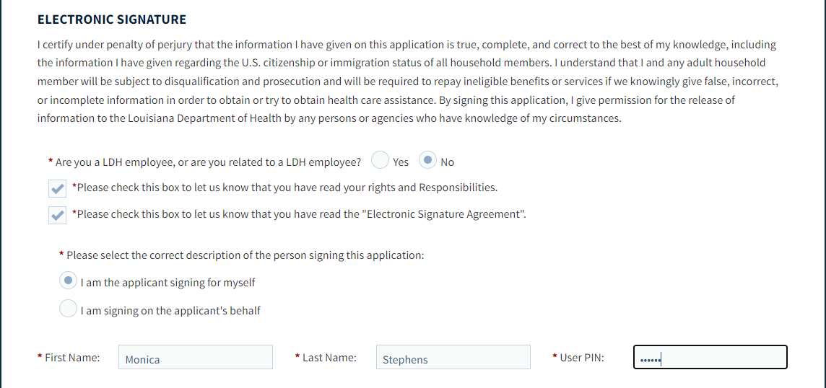
Application Signature Example

Slide 6
Authorized Representatives on Applications
Applicants are able to select an Authorized Representative (AR) on their application if they like and provide them with the desired level of access.
The AR can be a friend, family member or a Trusted User at the application center where the applicant applied.
Trusted Users should not list themselves as an AR without the applicant’s consent since they can check on the status of the applications they submit.

Slide 7
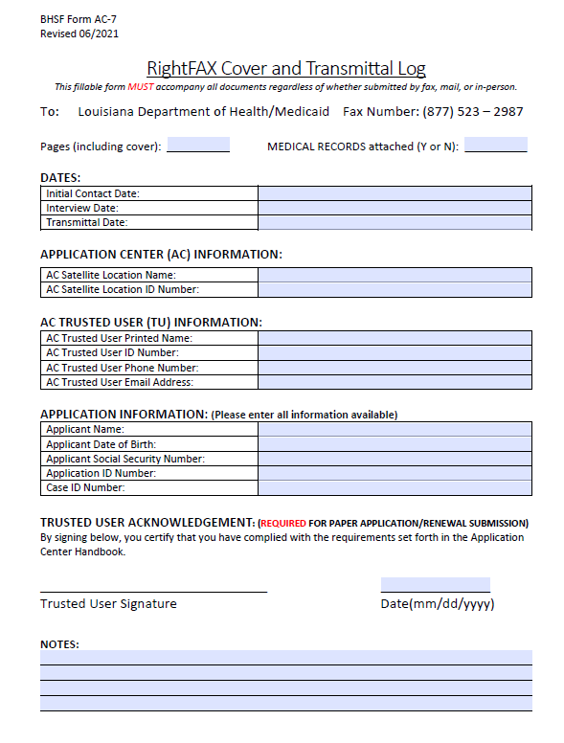
Submitting Medical Records
Please ensure that you are using the current version of the AC-7 RightFAX Cover and Transmittal Log rev. 06/2021.
Any copies that were printed prior to the revision date need to be destroyed.

Slide 8
Submitting Medical Records (con.)
Prior to faxing medical records/data, please ensure that the dates of service are listed on the AC-7.
Please refrain from emailing patient records or medical bills to the AC or MEDT accounts.

Slide 9
Reminders
AC Resource Library – Check it DAILY
Ensure you log into the PARTNER portal and not the Public or Provider portal.
Adhere to Medicaid guidelines
Trusted Users must conduct Face-to-Face interviews
For issues with newborns, email NEU@la.gov
EMS
  Submit medical records immediately upon receiving the denial due to non-citizenship.
  For aged EMS claims, email the EMS Aged Claims Status Request form (found on the AC Resource Library) to MEDT@la.gov.
AC Meetings are conducted on your behalf. Attendance is required and participation is encouraged.

Slide 10
Application Centers (AC)
  ApplicationCenter.Service@la.gov
  (225) 342 – 6312
  Valerie McManus
Medical Eligibility Determinations Team (MEDT)
      MEDT@la.gov
      Shauna Meche
Newborn Eligibility Unit (NEU)
      NEU@la.gov
Optional State Supplement (OSS)
      OSS@la.gov
      (225) 342 – 1646
      Paige Logan
Outstation
      Outstation@la.gov
      (225) 342 – 1646
      Paige Logan
Medicaid Outreach
      MedicaidOutreach@la.gov
EPO Programs Manager
  Darrell.Curtis@la.gov
  Darrell Curtis

Slide 11
Questions

