Slide 1
Application Center Monthly Contact
October 19, 2022
Valerie McManus, AC Program Manager

Slide 2
Agenda Items
    Discussion facilitated by Haley Williams, Bureau of Legal Services
    Health Plan Changes
    Retroactive Coverage
    Reminders

Slide 3
Guest Speaker
Haley Williams
Bureau of Legal Services
Key Discussion Points:
If the applicant is unavailable to provide verbal consent, Medicaid is only authorized to provide the TU with the current application status- pending, approved, or denied, as well as the verifications that are needed to make an accurate decision. The denied reason cannot be provided.
The applicant can contact the Customer Service Unit regarding any denial concerns. They will also be mailed a letter explaining the decision.

Slide 4
Health Plan Changes
Healthy Louisiana will not conduct Open Enrollment this year.
Some members will be auto-assigned to a plan different from their current one, due to the addition of a new plan- Humana Healthy Horizons in Louisiana.
Members will have the opportunity to make plan changes by contacting Healthy Louisiana at 1-855-229-6848.

Slide 5
Health Plan Changes (con.)
Members will receive a letter from Healthy Louisiana in November explaining any changes.
The current dental plans will remain in place.

Slide 6
Healthy Louisiana Plans- effective 1/1/2023
Aetna Better Health | AmeriHealth Caritas | Healthy Blue
Humana Healthy Horizons in Louisiana (NEW) | Louisiana Healthcare Connections | United Healthcare Community Plan

Slide 7
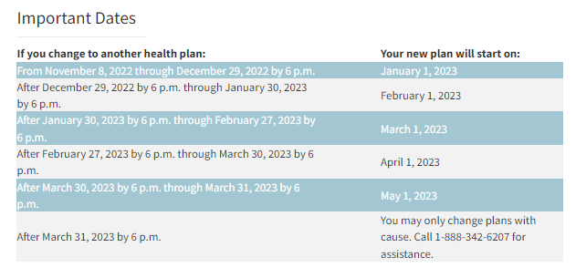
Health Plan Changes (con.)
https://ldh.la.gov/page/4560

Slide 8
Retroactive Coverage
If an applicant is in need of retroactive coverage, it should be requested on the application.
If it is not requested initially, but it needs to be considered, the applicant needs to contact the Customer Service Unit (CSU) to request the change.

Slide 9
Reminders
AC Resource Library – Check it DAILY
Ensure you log into the PARTNER portal and not the Public or Provider portal.
Adhere to Medicaid guidelines
Trusted Users must conduct Face-to-Face interviews
For issues with newborns, email NEU@la.gov
EMS
  Submit medical records immediately upon receiving the denial due to non-citizenship.
  For aged EMS claims, email the EMS Aged Claims Status Request form (found on the AC Resource Library) to MEDT@la.gov.
AC Meetings are conducted on your behalf. Attendance is required and participation is encouraged.

Slide 10
Contact Information
Application Centers (AC)
  ApplicationCenter.Service@la.gov
  (225) 342 – 6312
  Valerie McManus
Medical Eligibility Determinations Team (MEDT)
      MEDT@la.gov
      Shauna Meche
Newborn Eligibility Unit (NEU)
      NEU@la.gov
Medicaid Outreach
      MedicaidOutreach@la.gov
Optional State Supplement (OSS)
      OSS@la.gov
      (225) 342 – 1646
      Paige Logan
Outstation
      Outstation@la.gov
      (225) 342 – 1646
      Paige Logan
EPO Programs Manager
  Darrell.Curtis@la.gov
  Darrell Curtis

Slide 11
Questions

