Slide 1
Application Center Monthly Contact
November 16, 2022
Valerie McManus, AC Program Manager

Slide 2
Agenda Items
    Partner Portal Update
    Demonstration
    AVS Form
    MEVS/REVS Health Plan Display Issue
    Reminders

Slide 3
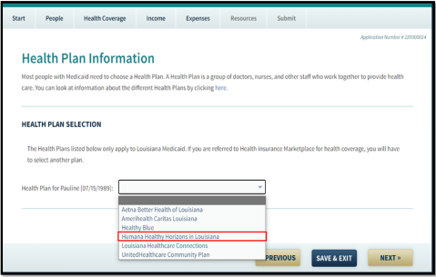
Partner Portal Update
During a recent system build meeting, LDH staff members were advised that Humana Healthy Horizons in Louisiana will appear as a health plan option on the online application beginning 12/28/2022.
The actual plan does not go into effect until January 1, 2023.

Slide 4
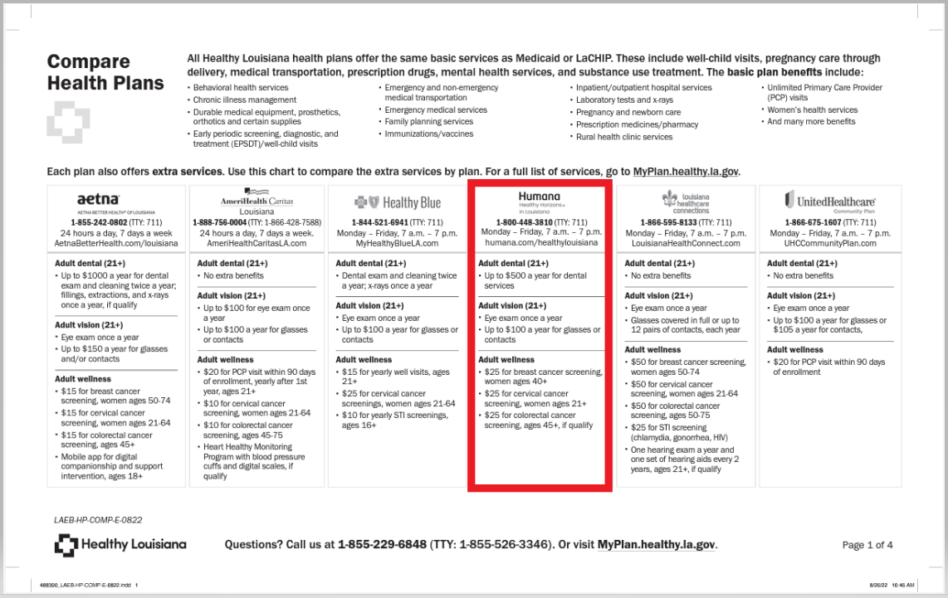
Partner Portal Update (con.)
The medical health plan comparison chart has been updated and can be found online at https://www.myplan.healthy.la.gov/en/compare-plans .

Slide 5
Demonstration-
Locating the Medical Health Plan Comparison Chart

Slide 6
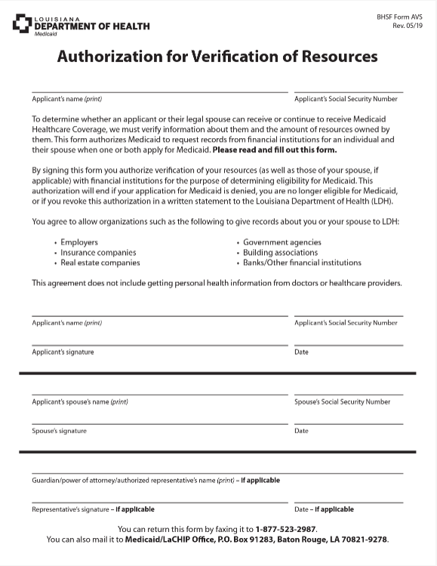
AVS Form
If an applicant receives an Authorization for Verification of Resources (BHSF Form AVS) form, they simply need to print and sign their name and include their SSN and date the form. This form gives Medicaid authorization to verify resources on behalf of applicants.

Slide 7
    MEVS/REVS Health Plan Display Issue
Several medical facilities recently reported that Healthy Louisiana Plans are not displayed in MEVS/REVS.
Gainwell’s Systems Department has advised that the issue has been resolved.
It can take 2-3 business days for the plan linkage to appear if a plan was selected at the time of application.

Slide 8
Reminders
AC Resource Library – Check it DAILY
Ensure you log into the PARTNER portal and not the Public or Provider portal.
Adhere to Medicaid guidelines
Trusted Users must conduct Face-to-Face interviews
For issues with newborns, email NEU@la.gov
EMS
  Submit medical records immediately upon receiving the denial due to non-citizenship.
  For aged EMS claims, email the EMS Aged Claims Status Request form (found on the AC Resource Library) to MEDT@la.gov.
AC Meetings are conducted on your behalf. Attendance is required and participation is encouraged.

Slide 9
Contact Information
Application Centers (AC)
  ApplicationCenter.Service@la.gov
  (225) 342 – 6312
  Valerie McManus
Medical Eligibility Determinations Team (MEDT)
      MEDT@la.gov
      Shauna Meche
Newborn Eligibility Unit (NEU)
      NEU@la.gov
Medicaid Outreach
      MedicaidOutreach@la.gov
Optional State Supplement (OSS)
      OSS@la.gov
      (225) 342 – 1646
      Paige Logan
Outstation
      Outstation@la.gov
      (225) 342 – 1646
      Paige Logan
EPO Programs Manager
  Darrell.Curtis@la.gov
  Darrell Curtis
  Healthy Louisiana
  1-855-229-6848

Slide 10
Questions

