Slide 1
Application Center Monthly Contact
January 18, 2023
Valerie McManus, AC Program Manager

Slide 2
Agenda Items
    Staff Changes
    AC Resource Library Updates
        MCO (Managed Care Organization) Auto-Enrollment
        New Plans Enrollment Flyer
    Health Plan Changes
    Submitting Additional Records for MEDT Review
    Reminders

Slide 3
Staff Changes
Mr. Darrell Curtis, our former manager recently accepted a job with another section.
Ms. Shantal Courville, our former Newborn Eligibility Unit Monitor recently vacated her role as well.
While we are still saddened by their departures, we wish them the very best in their future endeavors.
Our program accounts are considered priority, so please email the appropriate account instead of our personal email addresses. We want to ensure that emails are addressed promptly.

Slide 4
AC Resource Library Updates
The AC Resource Library was recently updated with new information regarding MCO Auto-Enrollment and the New Plans Enrollment Flyer.
MCO (Managed Care Organization) Auto-Enrollment
- This packet provides a wealth of information on the Healthy Louisiana plans and is a Toolkit for Partners and Providers. Topics include:
- What we can do to assist Healthy Louisiana members
- How members can make changes to their health plans
- New plan effective dates
- Helpful Resources
New Plans Enrollment Flyer
- Please print and post this flyer around your satellite locations in highly visible areas.

Slide 5
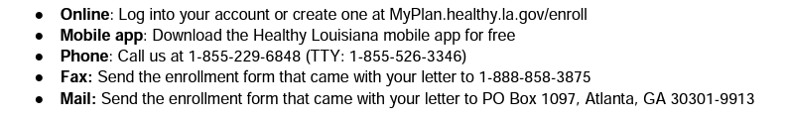
Health Plan Changes
It is highly probable that a newborn is enrolled in a health plan that is different from their mothers plan.
Interested mothers and other members can change their health plans using any of the following methods until March 31st without special reason:
After March 31st, a member can only change their plan if they have a special reason. If the reasoning is not accepted, the member will have to wait until Open Enrollment to make plan changes.

Slide 6
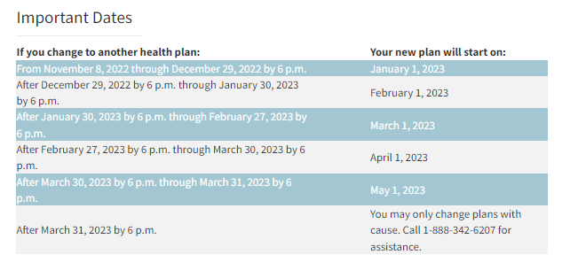
Health Plan Changes (con.)

Slide 7
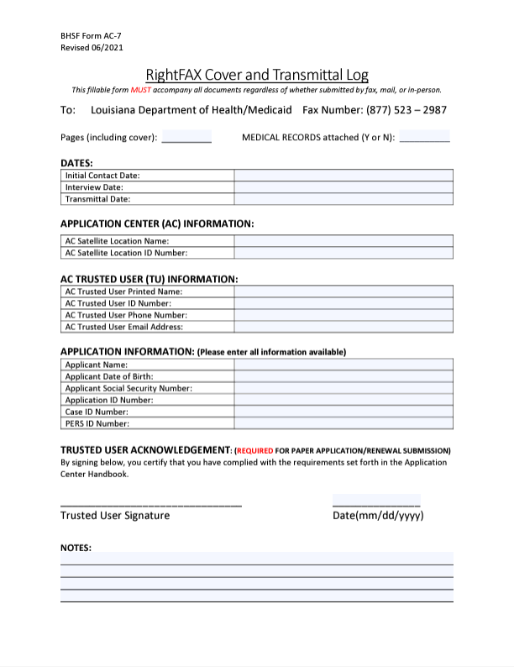
Submitting Additional Records for MEDT Review
If additional dates of service are being requested for MEDT review, please provide a copy of the additional records and indicate the dates of service that the records are for on the AC-7 RightFAX Cover and Transmittal Log.
The most recent version of the AC-7 RightFAX Cover and Transmittal Log, revised 06/2021 is available under the AC Forms and Publications section of the AC Resource Library.

Slide 8
Reminders
AC Resource Library – Check it DAILY
Ensure you log into the PARTNER portal and not the Public or Provider portal.
Adhere to Medicaid guidelines
Trusted Users must conduct Face-to-Face interviews
For issues with newborns, email NEU@la.gov
EMS
  Submit medical records immediately upon receiving the denial due to non-citizenship.
  For aged EMS claims, email the EMS Aged Claims Status Request form (found on the AC Resource Library) to MEDT@la.gov.
AC Meetings are conducted on your behalf. Attendance is required and participation is encouraged.

Slide 9
Contact Information
Application Centers (AC)
  ApplicationCenter.Service@la.gov
  (225) 342 – 6312
  Valerie McManus
Medical Eligibility Determinations Team (MEDT)
      MEDT@la.gov
      Shauna Meche
Newborn Eligibility Unit (NEU)
      NEU@la.gov
Medicaid Outreach
      MedicaidOutreach@la.gov
Optional State Supplement (OSS)
      OSS@la.gov
      (225) 342 – 1646
      Paige Logan
Outstation
      Outstation@la.gov
      (225) 342 – 1646
      Paige Logan
  Healthy Louisiana
  1-855-229-6848

Slide 10
Questions

