Slide 1
Application Center Monthly Contact
April 19, 2023
Valerie McManus, AC Program Manager

Slide 2
Agenda Items
    CourseMill Issues
    NEU Issues
    Text Message and Recorded Notifications
    AC Resource Library Updates
    Outreach
    Reminders

Slide 3
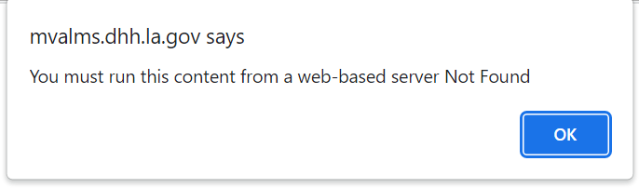
CourseMill Issues
The CourseMill training site is not functioning properly, so it is not being used a this time. The following message appears when one of the courses are selected.
We will work to remedy this issue as soon as possible.

Slide 4
CourseMill Issues (con.)
A temporary process has been put in place to ensure that there are no delays in the training and certification process.
- At this time pdf copies of the required trainings are emailed along with a SSP Certification Requirement form when the request is received.
- When the signed form is returned, the Trusted User Enrollment Request is processed and a Trusted User ID number is issued.

Slide 5
NEU Issues
There are some technical issues involving the NEU Dashboard at this time.
- This may result in longer processing times.
Our Help Desk is working to address the issues so they can be resolved as soon as possible.

Slide 6
Text Messages and Recorded Notifications
Text and recorded messages are being sent to remind members to update their contact information in preparation for the Medicaid Unwind.
The number displayed on the text messages is 72147. Members have the option to opt out of text messages by texting STOP, but are encouraged to remain subscribed so they don’t miss out on important information about their health insurance.

Slide 7
Text Messages and Recorded Notifications (con.)
The phone number displayed on the recorded messages is 1-888-342-6207, which is the phone number for Medicaid Customer Service.
Sample message:
“Make sure your contact information is correct. It is important to keep your address and phone number up to date so you don't miss updates about your Medicaid coverage. Visit ldh.la.gov/myinfo to update your contact information.”

Slide 8
Text Messages and Recorded Notifications (con.)
Members can visit www.ldh.la.gov/myinfo for more information and to update a phone number, cell phone number, email address, and mailing address.

Slide 9
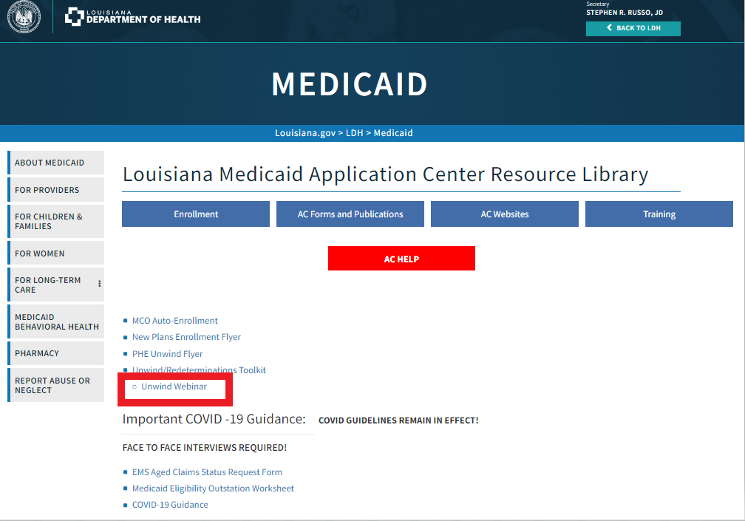
AC Resource Library Updates
There is a really helpful presentation on the AC Resource Library that thoroughly explains the Medicaid Unwind process.
It is under the heading, Unwind Webinar.

Slide 10
AC Resource Library Updates (con.)
There are also other great resources on the homepage of the AC Resource Library, such as,
- The New Plans Enrollment Flyer
- PHE Unwind Flyer
- and the Unwind/Redeterminations Toolkit.
Please review these materials at your leisure and familiarize yourselves with the contents, so we can continue to provide excellent service to the citizens of Louisiana.

Slide 11
Outreach
Medicaid is currently participating in Outreach events across the state in preparation for the Unwind.
During the events, Medicaid employees answer questions, discuss programs, and promote the need for Medicaid enrollees to keep their contact information up to date.

Slide 12
Reminders
AC Resource Library – Check it DAILY
Ensure you log into the PARTNER portal and not the Public or Provider portal.
Adhere to Medicaid guidelines
Trusted Users must conduct Face-to-Face interviews
For issues with newborns, email NEU@la.gov
EMS
  Submit medical records immediately upon receiving the denial due to non-citizenship.
  For aged EMS claims, email the EMS Aged Claims Status Request form (found on the AC Resource Library) to MEDT@la.gov.
AC Meetings are conducted on your behalf. Attendance is required and participation is encouraged.

Slide 13
Contact Information
Application Centers (AC)
  ApplicationCenter.Service@la.gov
  (225) 342 – 6312
  Valerie McManus
Medical Eligibility Determinations Team (MEDT)
      MEDT@la.gov
      Shauna Meche
Newborn Eligibility Unit (NEU)
      NEU@la.gov
Medicaid Outreach
      MedicaidOutreach@la.gov
Optional State Supplement (OSS)
      OSS@la.gov
      (225) 342 – 1646
      Paige Logan
Outstation
      Outstation@la.gov
      (225) 342 – 1646
      Paige Logan
  Healthy Louisiana
  1-855-229-6848
  Louisiana Medicaid Customer Service
  1-888-342-6207

Slide 14
Health Plan Phone Numbers
Aetna Better Health: 1-855-242-0802
AmeriHealth Caritas: 1-888-756-0004
Healthy Blue: 1-844-521-6941
Humana Healthy Horizons: 1-800-448-3810
Louisiana Healthcare Connections: 1-866-595-8133
UnitedHealthcare: 1-866-675-1607

Slide 15
Questions

