Slide 1
Application Center Monthly Contact
May 17, 2023
Valerie McManus, AC Program Manager
Meeting Facilitator: Shauna Meche, Program Manager 1B

Slide 2
Agenda Items
    Staff Changes
    Reporting a Change
    Ways to make Contact Updates
    Renewals
    Reminders

Slide 3
Staff Changes
      Shauna Meche-
      Promoted to the role of Medicaid Program Manager 1B, which is Mr. Darrell Curtis’ former role.
      K’Maya Franklin-
      Will assist the MEDT program with paperwork, cases, and various other tasks.
      Congratulations Shauna
      and
      Welcome K’Maya!!!

Slide 4
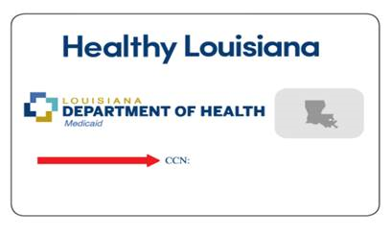
Reporting a Change
To report a change online in the Partner Portal, the member would need to present their Legacy Medicaid card to the Trusted User. The card contains a 16 digit Card Control Number (CCN).
Sample:

Slide 5
Ways to make Contact Updates
Log on to: MyMedicaid.la.gov (account log in and password required)
Email: MyMedicaid@la.gov
Call your health plan at:
  Aetna Better Health: 1-855-242-0802
  AmeriHealth Caritas: 1-888-756-0004
  Healthy Blue: 1-844-521-6941
  Humana Healthy Horizons: 1-800-448-3810
  Louisiana Healthcare Connections: 1-866-595-8133
  United Healthcare: 1-866-675-1607
Or call Medicaid Customer service at 1-888-342-6207, between the hours of 8 a.m. and 4:30 p.m.
https://ldh.la.gov/page/4454 – LDH website - Update My Information page

Slide 6
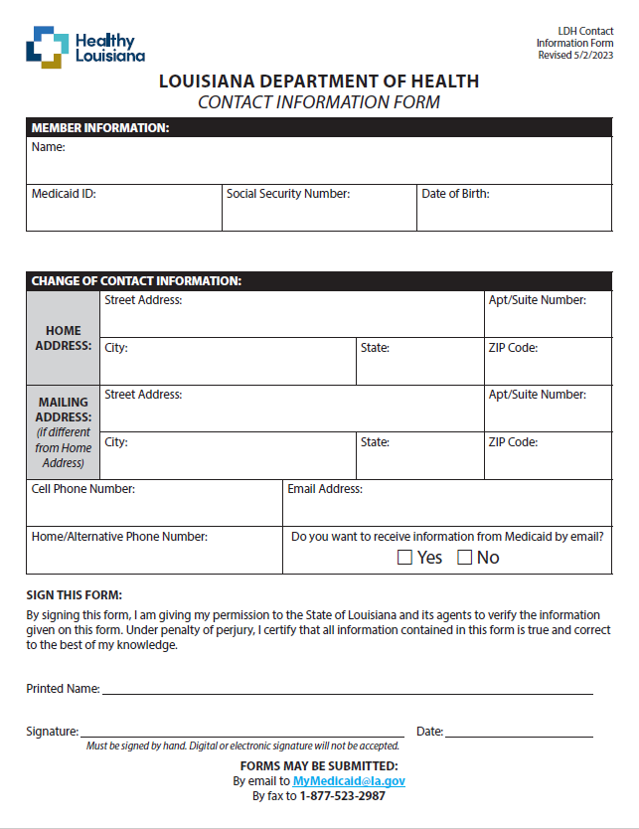
Ways to make Contact Updates (con.)
The Contact Information Form can be found at this link. https://ldh.la.gov/assets/HealthyLa/Resources/ContactInformationForm.pdf
It can be emailed to MyMedicaid@la.gov or faxed to 1-877-523-2987 upon completion.
The form will be added to the AC Resource Library soon.

Slide 7
Renewals
Renewal letters and forms are mailed two months prior to the clients’ renewal dates, so it is imperative that members update their contact information as soon as it changes.
The paper renewal forms that are mailed to members are much shorter than an application. Trusted Users can assist in completing the renewal forms if the member requests assistance.

Slide 8
Renewals (con.)
If the member has received their renewal form and would like it to be completed electronically, an application can be completed in the Partner Portal. It will be considered as renewal as long as the renewal is within 60 days.

Slide 9
Renewals (con.)
If a member has not received their renewal form, it may be too early to complete the renewal.
In cases where a renewal date is more than 60 days away, the application would be considered a duplicate instead of a renewal.

Slide 10
Reminders
AC Resource Library – Check it DAILY
Ensure you log into the PARTNER portal and not the Public or Provider portal.
Adhere to Medicaid guidelines
Trusted Users must conduct Face-to-Face interviews
For issues with newborns, email NEU@la.gov
EMS
  Submit medical records immediately upon receiving the denial due to non-citizenship.
  For aged EMS claims, email the EMS Aged Claims Status Request form (found on the AC Resource Library) to MEDT@la.gov.
AC Meetings are conducted on your behalf. Attendance is required and participation is encouraged.

Slide 11
Contact Information
Application Centers (AC)
  ApplicationCenter.Service@la.gov
  (225) 342 – 6312
  Valerie McManus
Medical Eligibility Determinations Team (MEDT)
      MEDT@la.gov
      Shauna Meche
Newborn Eligibility Unit (NEU)
      NEU@la.gov
Medicaid Outreach
      MedicaidOutreach@la.gov
Optional State Supplement (OSS)
      OSS@la.gov
      (225) 342 – 1646
      Paige Logan
Outstation
      Outstation@la.gov
      (225) 342 – 1646
      Paige Logan
  Healthy Louisiana
  1-855-229-6848
  Louisiana Medicaid Customer Service
  1-888-342-6207

Slide 12
Health Plan Phone Numbers
Aetna Better Health: 1-855-242-0802
AmeriHealth Caritas: 1-888-756-0004
Healthy Blue: 1-844-521-6941
Humana Healthy Horizons: 1-800-448-3810
Louisiana Healthcare Connections: 1-866-595-8133
United Healthcare: 1-866-675-1607

Slide 13
Questions

