Slide 1
Application Center Monthly Contact
February 24, 2021
Valerie McManus: Application Center Program Monitor

Slide 2
Agenda Items
DOA Registration
Application Signatures
Reminders

Slide 3
DOA Registration
The Division of Administration (DOA) will convert to a new payment system effective July 1, 2021, so DOA registration is vital. There may be several changes to the current process, but we will keep you abreast of any changes.
Each Application Center satellite location needs to be registered in the LaGov Supplier Portal; however, this is not the only step in the DOA Registration process. OSRAP will also need an IRS W-9 and ISIS EFT form for each location. These forms are available on the AC Resource Library as well as the Office of Statewide Reporting and Accounting Policy (OSRAP)’s webpage https://www.doa.la.gov/Pages/osrap/IndexOLD2.aspx .

Slide 4
DOA Registration (continued)
The completed EFT Form should be faxed to 225-342-0964 and the completed W-9 form should be faxed to 225-342-0960 or emailed at DOA-OSRAP-LAGOV@la.gov.
If your facility registered with DOA in the past, you will need to ensure that DOA has accurate contact and banking information. Please contact DOA at 225-342-6356 for assistance with resolving conflicts such as duplicate registrations.

Slide 5
DOA Registration (continued)
The Application Center Managers can ask the billing/payment staff to assist them with tracking receipt of their payments. If your center has not received payment recently, that could be a clear indication that there is an issue with your facility’s registration.

Slide 6
Application Signatures
When signing applications, Trusted Users should select, “I am the applicant signing for myself” and input the applicant’s name in the space indicated.
If the applicant deceased or incapacitated with no one to act on their behalf, the Trusted User can select, “I am signing on the applicant’s behalf” and input the name of the Trusted User.(AC Handbook page 15- “Required Signatures”)

Slide 7
Reminders

Slide 8
Check the AC Resource Library daily.
  Make it a habit to access useful links from the Library.
  Review the updates and announcements

Slide 9
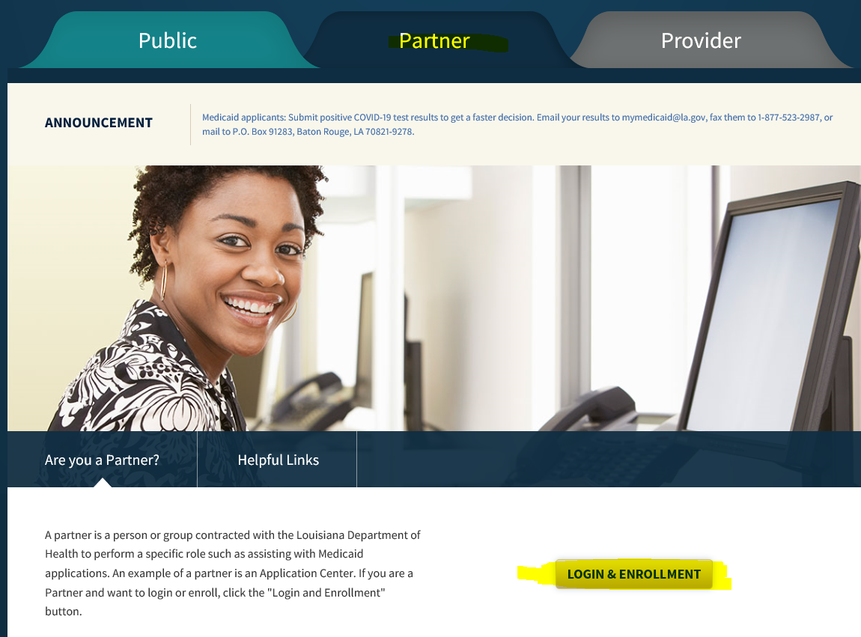
  Ensure you are in the Partner Portal
    Click on the word partner; and
    Use the LOGIN & Enrollment option at the bottom of the page.
Make sure you select your AC satellite location prior to starting an application to ensure that the appropriate facility is reimbursed.
Managers must ensure the Partner Portal is updated as items change.
  Contact Info;
  Remittance Advice, etc

Slide 10
If disability is alleged:
  Complete and upload/fax situational forms as required.
  Upload/fax medical bills
    Month of application
    Up to 3 months prior
  Upload/fax medical records

Slide 11
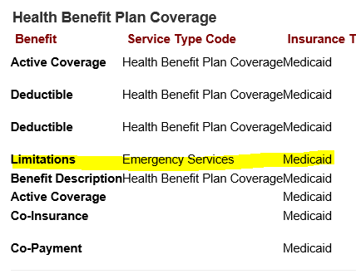
Emergency Medical Services (EMS) during the Public Health Emergency (PHE):
  Citizenship is a requirement of Medicaid. While pregnant and qualified non-citizens may qualify for LaCHIP phase IV, non-citizens are typically only eligible for EMS.
  Normally EMS certs are open /closed
  Until the PHE ends, however, the EMS certs remain open.
  Claims submitted are sent by manual file to our MEDT manager for processing.
    This file is extensive so it is taking longer than expected.
    Send in bills and medical records for non-citizens who received emergency medical services at your facility.
    Inquiries may be submitted to MEDT@la.gov

Slide 12
We will be conducting cold-calls to applicants when deemed necessary in order to:
  confirm that the interview occurred in person; and/or
  verify whether the responses were as the applicant provided; and/or
  ensure the rights and responsibilities were read, etc.

Slide 13
Application Center Monthly Zoom Meetings:
      Third Wednesday of each month
      Registration required
        Links will be posted on the AC Resource Library by the Monday before
        Each session will require registration.
        Invites will no longer be emailed.
        The PowerPoint presentations used in previous contact meetings can be located in the Application Center Forms library under the heading “Application Center Monthly Contact Presentations”.

Slide 14
CONTACT INFO
EPO Programs

Slide 15
Application Center Program Monitor
Valerie McManus
        ApplicationCenter.Service@la.gov
        (225) 342 - 6312

Slide 16
Medicaid Eligibility Determinations Manager
Miranda Winters
        MEDT@la.gov
        (225) 219 - 7873

Slide 17
Newborn Eligibility Program Monitor
Shauna Meche
        NEU@la.gov
        337-447-4145

Slide 18
Optional State Supplement Program Manager
Paige Logan
        OSS@la.gov
        (225) 342 - 1646

Slide 19
Medicaid Outreach Program Manager
Paige Logan
        MedicaidOutreach@la.gov
        (225) 342 - 1646

Slide 20
Outstation Program Manager
Paige Logan
        Outstation@la.gov
        (225) 342 - 1646

Slide 21
Eligibility Programs Team Manager
Kathryn “Kate” Loechelt
        Kathryn.Loechelt@la.gov
        (225) 219 – 0912

Slide 22
Questions

