Slide 1
Application Center Monthly Contact
March 17, 2021
Valerie McManus: Application Center Program Monitor

Slide 2
Agenda Items
Trusted User Training
LaGOV Registration
SSP Updates
COVID Guidelines
Reminders

Slide 3
Trusted User Training
In the past, Trusted User Trainings were completed in the Course Mill training system; however, the Adobe Flash Player is no longer supported as of January 12, 2021, so PDF copies of the required trainings are being issued.
As a result, Trusted User Training certificates are no longer issued. A Trusted User’s certification can be validated using the Trusted User Enrollment email that is received after their certification.
We are in the process of planning other methods of delivering the Trusted User Training.

Slide 4
LaGOV Registration
    The Division of Administration (DOA) will convert to a new payment system effective July 1, 2021.
    LaGOV Supplier Portal registration is VITAL.
    Instructions are posted to the AC Resource Library.
    Each Application Center satellite location MUST be registered in order to receive payment.
    Application Center Managers may coordinate with accounting to complete the registration.
    If your Satellite has not received payment recently, you may need take further action!
    You may receive a call from Medicaid staff in regards to your registration.

Slide 5
SSP Updates
AC Managers shall:
      ensure that contact information is updated for all satellite locations.
      ensure Trusted User information is up to date for all satellite locations.
      email ApplicationCenter.Service@la.gov if a Trusted User needs to be unlinked from your satellite.

Slide 6
COVID Guidelines
COVID-19 Guidelines are still in effect.
The guidelines will remain effective until the end of the PHE.
Failure to follow the guidelines may result in a Notice of Action issued by the LDH and decertification of the Medicaid Application Center.
Online applications are still the preferred application method. Paper applications should only be completed during extraordinary circumstances.
Trusted Users are required to conduct Face to Face interviews:
      If you are unable to conduct face to face interviews, applicants must be referred to the Louisiana Medicaid Customer Service Unit (CSU) to complete a telephone application.
      CSU Representatives will be available to complete applications from 8:00am – 4:30pm Monday through Friday at 1-888-342-6207.

Slide 7
Reminders

Slide 8
AC Resource Library
Trusted Users are expected to check the AC Resource Library regularly. We recommend daily.
Make it a habit to access the SSP from the useful links on the library.
Review the updates and announcements
Stay informed

Slide 9
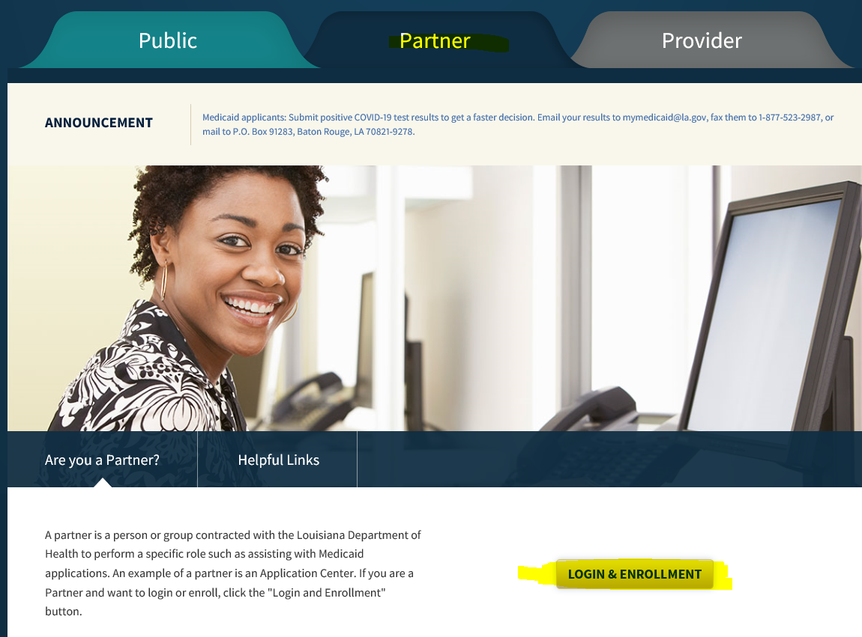
  Ensure you are in the Partner Portal
    Click on the word partner; and
    Use the LOGIN & Enrollment option at the bottom of the page.
Make sure you select your AC satellite location prior to starting an application to ensure that the appropriate facility is reimbursed.
Managers must ensure the Partner Portal is updated as items change.
  Contact Info;
  Remittance Advice, etc

Slide 10
Applicant Alleges Disability
If disability is alleged: TRUSTED USERS SHOULD NOT COACH
  Read the applicant the definition of disability according to the SSA:
    To meet SSA’s definition of disability, you must not be able to engage in any substantial gainful activity (SGA) because of a medically determinable physical or mental impairment(s) that is either:
    Expected to result in death.
    Has lasted or is expected to last for a continuous period of at least 12 months
  If the applicant still alleges they meet the SSA definition of disability:
    Complete and upload/fax situational forms as required.
    Upload/fax medical bills
      Month of application
      Up to 3 months prior
    Upload/fax medical records

Slide 11
Emergency Medical Services (EMS)
during the Public Health Emergency (PHE)
  Citizenship is a requirement of Medicaid. While pregnant and qualified non-citizens may qualify for LaCHIP phase IV, non-citizens are typically only eligible for EMS.
  Normally EMS certs are open /closed. Until the PHE ends, however, the EMS certs will remain open.
  Claims submitted are sent by manual file to our MEDT manager for processing.
    This file is extensive so it is taking longer than expected.
    Send in bills and medical records for non-citizens who received emergency medical services at your facility.
    If you have already submitted a claim, please do not resubmit it.
    Inquiries regarding aging claims may be submitted to MEDT@la.gov

Slide 12
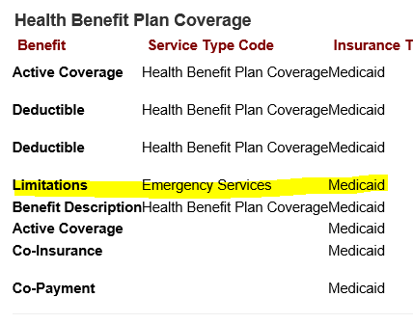
Emergency Medical Services (EMS) during the Public Health Emergency (PHE):
How to identify on MEVS/REVS

Slide 13
Trusted Users must comply with Medicaid Guidelines
We will be conducting cold-calls to applicants when deemed necessary in order to:
  confirm that the interview occurred in person; and/or
  verify whether the responses were as the applicant provided; and/or
  ensure the rights and responsibilities were read, etc.

Slide 14
Required Monthly Zoom Meetings
AC Managers and Trusted Users shall attend one AC Monthly zoom meeting each month.
      2 sessions will be held on the third Wednesday of each month:
        9:00 AM
        1:30 PM
      Meeting Registration Links are posted on the AC Resource Library. After registering, you will receive a link to access the meeting you selected.
      Monthly Meeting Reminders will no longer be emailed.
      PowerPoint presentations are currently housed in the Application Center Forms Library under the heading “Application Center Monthly Contact Presentations”.

Slide 15
CONTACT INFO
EPO Programs

Slide 16
Application Center Program Monitor
Valerie McManus
        ApplicationCenter.Service@la.gov
        (225) 342 - 6312

Slide 17
Medicaid Eligibility Determinations Manager
Miranda Winters
        MEDT@la.gov
        (225) 219 - 7873

Slide 18
Newborn Eligibility Program Monitor
Shauna Meche
        NEU@la.gov
        337-447-4145

Slide 19
Optional State Supplement Program Manager
Paige Logan
        OSS@la.gov
        (225) 342 - 1646

Slide 20
Medicaid Outreach Program Manager
Paige Logan
        MedicaidOutreach@la.gov
        (225) 342 - 1646

Slide 21
Outstation Program Manager
Paige Logan
        Outstation@la.gov
        (225) 342 - 1646

Slide 22
Eligibility Programs Team Manager
Kathryn “Kate” Loechelt
        Kathryn.Loechelt@la.gov
        (225) 219 – 0912

Slide 23
Questions

