Slide 1
Application Center Monthly Contact
November 17, 2021
Valerie McManus, AC Program Monitor

Slide 2
Agenda Items
  LaCHIP Rightfax Cover
  Sending Medical Records
  Bi-Annual Site Inspections
  Staff Changes
  EMS Q&A

Slide 3
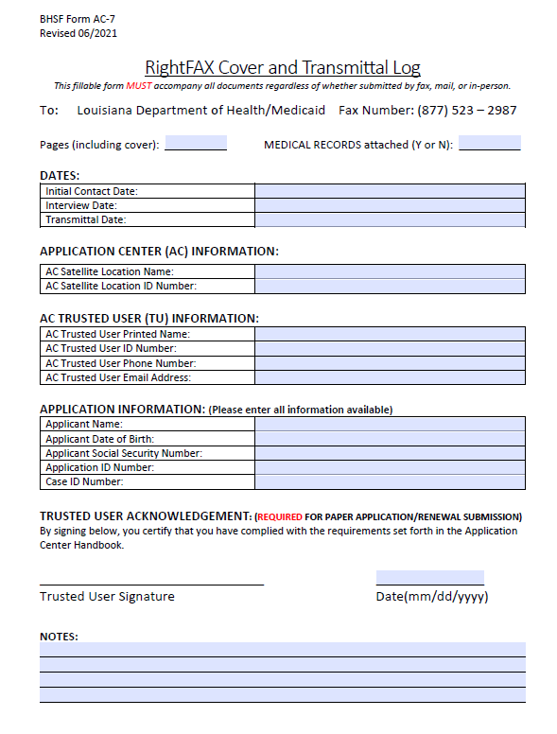
AC-7 Right Fax Cover-
Please ensure that you are using the current version of the AC-7 RightFAX Cover and Transmittal Log rev. 06/2021.
Any copies that were printed prior to the revision date need to be destroyed.

Slide 4
Sending Medical Records
Trusted Users should ensure that the fax cover indicates the dates of service when faxing medical records.
The records should be faxed to the LaCHIP RightFAX number- 1-877-523-2987.
Please refrain from emailing patient records or medical bills to the AC or MEDT accounts.

Slide 5
Bi-Annual Site Inspections
The bi-annual site inspections will resume in the near future.
They may be facilitated by the Medicaid Area Managers in your region or the facility’s Outstation Analyst.
Please ensure that the AC is adhering to the current Application Center guidelines.

Slide 6
Staff Changes
AC Managers should report changes including facility information or staff changes within ten days.
AC mangers may update facility information such as telephone, fax, and email address in the Partner Portal.
Please email ApplicationCenter.Service@la.gov if former Trusted Users need to be unlinked from the AC.

Slide 7

EMS Q&A

Slide 8
Reminders
AC Resource Library – Check it DAILY
Ensure you log into the PARTNER portal
Adhere to Medicaid guidelines
Trusted Users must conduct Face-to-Face interviews
For issues with newborns, email NEU@la.gov
EMS
  Submit medical bills and records immediately upon denial due to non-citizenship.
  For aged EMS claims, email MEDT@la.gov and cc Kathryn.Loechelt@la.gov
AC Meetings are conducted on your behalf. Please ensure you attend.

Slide 9
Application Centers (AC)
      ApplicationCenter.Service@la.gov
      (225) 342 – 6312
      Valerie McManus
Medical Eligibility Determinations Team (MEDT)
      MEDT@la.gov
      Shauna Meche
Newborn Eligibility Unit (NEU)
      NEU@la.gov
      337-447-4145
Optional State Supplement (OSS)
      OSS@la.gov
      (225) 342 – 1646
      Paige Logan
Outstation
      Outstation@la.gov
      (225) 342 – 1646
      Paige Logan
Medicaid Outreach
      MedicaidOutreach@la.gov
EPO Programs Manager
    Kathryn.Loechelt@la.gov
    (225) 219 – 0912

Slide 10
Questions

