Slide 1
Non-Emergency Medical Transportation (NEMT) American Rescue Plan Act (ARPA) Overview

Slide 2
Program Overview
The Centers for Medicare and Medicaid Services (CMS) approved the use of funds provided under the American Rescue Plan Act of 2021 (ARPA) for bonus payments to providers of non-emergency medical transportation (NEMT) services.
NEMT providers that are fully credentialed in the Medicaid Program may be eligible to receive a bonus payment under the Louisiana Department of Health’s (LDH) ARPA.
The bonus payments and guidelines are thoroughly explained in the next slides.
Providers will submit invoices, provider trip logs, and attestations to their assigned MCO on a monthly basis.
MCOs will issue payments on a quarterly basis.

Slide 3
Timeline for 2024 Quarter 2
July 5, 2024
Provider Invoice Due for June
May 1-31, 2024
Provider Outreach/Training
June 5, 2024
Provider Invoice Due for May
July 31, 2024
MCO Payment Due for 2024 Q2 Invoices

Slide 4
Eligibility Criteria
Fully credentialed NEMT providers who meet all eligibility requirements are entitled to a monthly disbursement of $500 per vehicle, for up to three vehicles per month, totaling a maximum payment of $1,500 per month per transportation provider.
This will be paid on a quarterly basis by the assigned MCO.
The NEMT Provider must complete at least one non-emergency medical round trip, consisting of a minimum of two (2) legs, per calendar day for an enrolled Medicaid beneficiary for a minimum of twenty (20) days per previous calendar month.
The managed care organization (MCO) will determine eligibility for monthly payments based on the NEMT provider’s ongoing compliance for all provider, driver, and vehicle requirements set forth by the Medicaid Program and the LDH ARPA NEMT Program.

Slide 5
Eligibility Criteria
In order to receive payments under the LDH ARPA NEMT Program, the NEMT provider shall do the following:
Accede to all provisions of the LDH ARPA NEMT Program and maintain a contractual agreement with the MCO or MCO’s Transportation Broker, for the duration of the ARPA program;
Maintain ongoing compliance for all provider, driver, and vehicle requirements set forth by the Medicaid Program;
Submit invoice and provider trip logs for qualified vehicles and drivers each month;
Submit a monthly attestation to the MCO which certifies the accuracy of the submitted supporting and credentialing documentation; and
Failure to meet both LDH and the MCO’s time requirements shall result in loss of the monthly bonus payment.

Slide 6
Eligibility Criteria
NEMT providers may not submit a transport that results in one of the following for any leg of the round trip:
The provider is a no-show;
No NEMT vehicle is available;
No NEMT driver is available; or
The NEMT provider is late which causes the beneficiary to miss his or her scheduled Medicaid covered service.
The list above contains trip outcomes that disqualify the transport for the ARPA Bonus Payment. If a NEMT provider submits a transport resulting in a no-show, the inability of the provider to produce a vehicle or driver, which results in a member missed trip, or a NEMT provider is late resulting in the member missing the transport or treatment time, the NEMT provider’s entire month’s ARPA submission is disqualified because the daily roundtrip requirement will not be fulfilled after the transport resulting in one of the above is removed from the trip log.

Slide 7
Provider Assignment
The MCO will be responsible for administering all payments for the LDH ARPA NEMT Program.
The MCO will provide a monthly report to LDH containing all active, fully credentialed NEMT providers. The monthly report will be due to LDH on the 15th of each month.
LDH will assign each active NEMT provider to an affiliated MCO. The NEMT provider will submit their invoice and required documentation to their assigned MCO in order to receive the ARPA bonus payment.
The NEMT provider assignment will be distributed to each MCO monthly.
NEMT providers will remain assigned to the same MCO throughout the NEMT ARPA program as long as the NEMT provider remains contracted with the MCO’s transportation broker throughout the length of the program.
The NEMT provider assignment will identify the NEMT provider and its assigned MCO. The NEMT provider assignment is used for the NEMT ARPA monthly bonus payments. Each month, LDH will distribute an updated list to each MCO for the following billing period.
LDH advises each NEMT provider to remain with their assigned MCO throughout the duration of the ARPA program to decrease confusion.

Slide 8
Invoicing
The NEMT provider is required to submit an invoice, a provider trip log, and an attestation to the MCO by the 5th calendar day of each month.
The monthly invoice and provider trip logs must be typed. No handwritten submissions allowed.
The required attestation will certify the accuracy of the monthly invoice and monthly provider trip log.
NEMT providers submitting the invoice, provider trip log, and attestation after the due date are not eligible for reimbursement.
Medical Transportation Provider Resources | La Dept. of Health

Slide 9
Software Needs
Access to an Email Account
Microsoft Excel
Microsoft Word
Adobe (if using electronic signatures)
Scanning Option (if using handwritten signatures)

Slide 10
Invoice Template

Slide 11
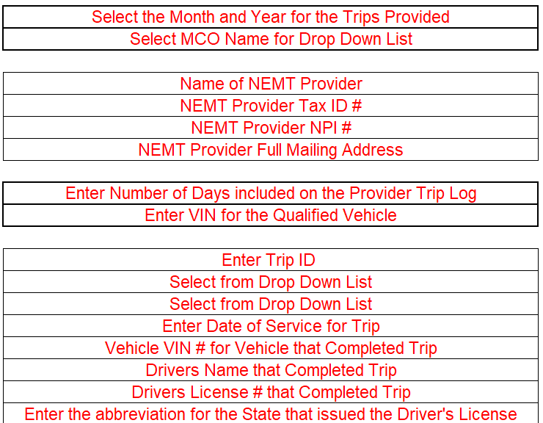
Provider Trip Log Template
Providers should add daily trips from its assigned MCO for each of the 20 days of the month. Providers may use trips for other MCOs only if the provider did not complete a trip for its assigned MCO or if the completed trip for the assigned MCO does not meet the ARPA requirements.
There will be 3 distinct provider trip log templates available within the excel document. Providers should use a different trip log for each qualifying vehicle.

Slide 12
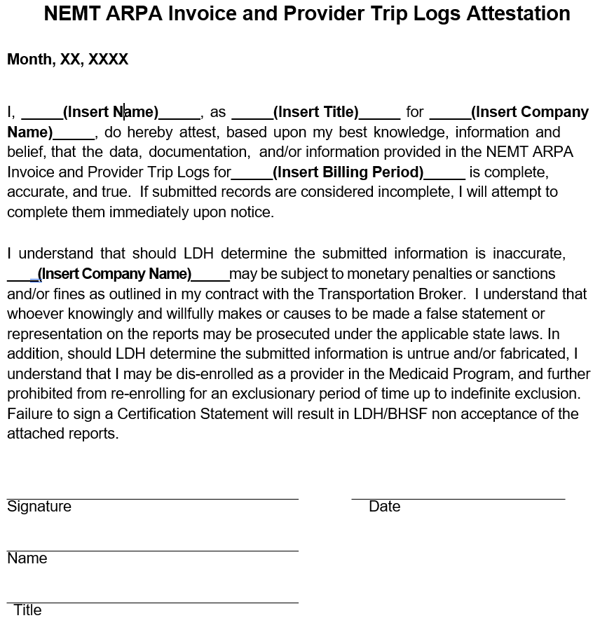
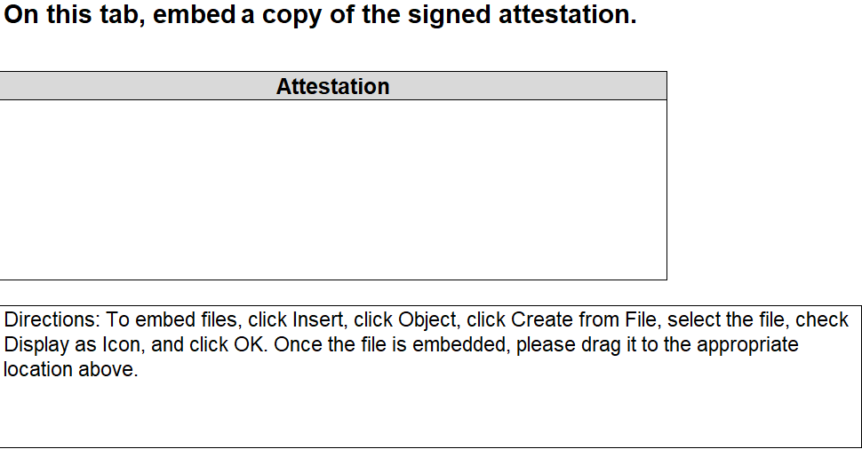
Attestation Template
Providers will change the date and insert the name and title of the person completing the attestation. The company name and the billing period will also need to be updated on the attestation.
Once the necessary updates are complete, the providers can print and sign OR save the attestation in a PDF format and sign electronically.
The attestation must be attached to the attestation tab that is included on the invoice and provider trip log template.

Slide 13
Payments
Upon receipt of the monthly invoice, provider trip log, and attestation, the MCO will review and determine if the NEMT provider met all requirements for both the LDH ARPA NEMT Program and the Louisiana Medicaid NEMT Program.
Upon determination of all program requirements being met, the MCO will distribute a single lump sum payment of $500 per vehicle, for a maximum of three (3) vehicles, totaling a maximum payment of $1,500 each month.
The MCO will make LDH ARPA NEMT payments by the last calendar day of each month following the end of the quarter.
If the provider fails to meet both LDH and the MCO’s time requirements, it shall result in loss of the monthly bonus payment.

Slide 14
Payment Reconciliation
In accordance with Federal regulations, directed payments must be based on actual credentialing and delivery of services. As such, the MCO will perform a reconciliation and provide to LDH using a mutually agreeable reconciliation report template.
NEMT providers must meet criteria that is outlined in this presentation to receive payments.
MCOs reserve the right to recoup any bonus payments paid to providers, if warranted.

Slide 15
NEMT ARPA Provider Incentive
Aetna Better Health of Louisiana Medicaid Plan
Type of Request | Aetna
Submitting invoices and other required documentation | MediTrans ARPA Mailbox arpa@meditrans.com
 | arpa@meditrans.com
General Questions/Concerns on the NEMT ARPA Program | MediTrans ARPA Mailbox
 | arpa@meditrans.com
Escalation Contact | MediTrans Operations Mailbox
 | director@meditrans.com
ABHLA Contact: Nanette Silver, Director of Regulatory Affairs Email: silvern@aetna.com Phone: (504)667-4576
©2023 Aetna Inc.

Slide 16
AmeriHealth Caritas Louisiana Contact Information Kenya Foster – kfoster@amerihealthcaritasla.com Javier Muniz - jmuniz@amerihealthcaritas.com
If you are assigned to AmeriHealth Caritas Louisiana, please send all ARPA submissions to the following email address:
Steve Buckner and Tammie Sanford – LAprm@verida.com

Slide 17
Healthy Blue Contact Information
Meditrans Credentialing Questions or Concerns?
Email: arpa@meditrans.com
Submission of Invoices, Provider Trip Logs, and Attestations
Email: arpa@meditrans.com
NEMT ARPA Questions or Concerns?
Email: arpa@meditrans.com
Meditrans Escalation Point of Contact
Email: director@meditrans.com
Healthplan Escalation Point of Contact - David Ealy, Operations Process Expert
Email: david.ealyjr@healthybluela.com

Slide 18
Contact Information
MediTrans Credentialing Questions or Concerns?
Email: arpa@meditrans.com
Submission of Invoices, Provider Trip Logs, and Attestations
Email: arpa@meditrans.com
NEMT ARPA Questions or Concerns?
Email: arpa@meditrans.com
Humana Escalation Contact
Email: acoleman9@humana.com
Alicia Coleman
Associate Director, Provider Contracting

Slide 19
Contact Information
MTM Credentialing Questions or Concerns?
Email: LAProviderSupport@mtm-inc.net
Submission of Invoices, Provider Trip Logs, and Attestations
Email: LHCC_NEMTARPA@louisianahealthconnect.com (LHCC_NEMTARPA)
NEMT ARPA Questions or Concerns?
Email: LHCC_NEMTARPA@louisianahealthconnect.com (LHCC_NEMTARPA)
Escalation Contact
Candace Kliesch, Compliance Director, Candace.H.Kliesch@louisianahealthconnect.com

Slide 20
UHC Contact Information
General Questions/Concerns on the NEMT ARPA Program - ARPA_Louisiana@modivcare.com
Submitting invoices, Trip Logs and Attestations - ARPA_LABilling@modivcare.com
Escalation Contact – Latransportation@UHC.com

Slide 21
Thank you!

