Slide 1
Louisiana Department of Health (LDH)
Louisiana Department of Health 2024 ASC PowerPoint Zandra Stewart, RN, BSN ASC Program Manager Revised 2/22/2024

Slide 2
HEALTH STANDARDS WEBSITE
http://ldh.la.gov/index.cfm/subhome/32
PROGRAMS
Ambulatory Surgical Center (ASC)
Definition of ASC
Licensing Requirements
State and Federal Regulations
Packets (Expedited)
OSFM and OPH Links
Emergency Preparedness (Guidance)
Contact Information
Waivers (found under Programs)
Post-Survey Information (Plan of Correction)

Slide 3
HEALTH STANDARDS WEBSITE
UNDER THEIR OWN PROGRAM
Change of Ownership (CHOW) &
Change of Ownership Information (CHOI)
Emergency Preparedness (Guidance)
Post-Survey Information (Plan of Correction)
Waiver Request for Facility Building Construction
Complaints

Slide 4
Federal and State Relationship

Slide 5
CMS
The Secretary of the Department of Health and Human Services (DHHS) has designated CMS to administer the Medicare and Medicaid programs.

Slide 6
CMS
CMS Central Office (Baltimore)
Survey and certification policies & procedures
Monitoring adherence to program requirements
Working with states to provide joint oversight of the Medicare and/or Medicaid programs
CMS also responds to questions
CMS Regional Office
Determines eligibility for participation in Medicare and/or Medicaid
Allocates funds to state agencies for certification activities
Works with state agencies to evaluate the performance of providers

Slide 7
Federal and State Relationship
Section 1864 of the Social Security Act established the framework and agreements for states to carry out the Medicare certification process.
Louisiana Department of Health (LDH) is contracted by CMS to perform survey & certification functions in Louisiana.
LDH is also referred to as State Agency.
Within LDH is the Health Standards Section (HSS).

Slide 8
Health Standards Section (HSS)
HSS is responsible for:
Certification/recertification functions
Records maintenance
Identifying potential participants in Medicare/Medicaid
Complaint investigations
Validation surveys
Licensing activities

Slide 9
HSS Regulated Programs
Adult Brain Injury
Adult Day Care
Adult Day Health Care
Adult Residential Care Provider (ARCP)
Ambulatory Surgical Centers (ASC)
Behavioral Health Service Provider
Case Management
CLIA (Clinical Laboratory Improvements Amendment
Community Mental Health Centers (CMHCs)
Comprehensive Outpatient Rehabilitation Facilities (CORFs)
Crisis Receiving Centers
Direct Service Workers
Elderly or Adult Abuse or Neglect
Emergency Preparedness
End State Renal Disease (ESRDs)
Facility Need Review
Forensic Supervised Transitional Residential & Aftercare Facilities
Free Standing Birthing Centers
Home & Community Based Providers (HCBS)
Home Health Agencies
Hospice Agencies
Ambulatory Surgical Centers
Hospitals
Mental Health Centers
Hospitals
Informal Dispute Resolution
Intermediate Care Facility for the Developmentally Disabled (ICF/DD)
Medication Attendant Certified (MACs)
Minimum Data Set (MDS) – Resident Assessment Instrument (RAI)
Nurse Aide (CAN) Training and Certification
Nurse Staffing Agencies
Nursing Homes
OASIS
Outpatient Physical Therapy
Pain Management Clinics
Pediatric Day Health Care Centers
Portable X-Ray
Psychiatric Residential Treatment Facilities
Rehabilitation Agencies
Rural Health Clinics
Sanction Collections
Therapeutic Group Homes

Slide 10
HSS Field Offices
As they relate to hospitals
HSS State Agency Field Offices
Field Office 1 New Orleans & Thibodeaux
Title 18 Supervisor:
Rickie Callegan
Rita Simon
Field Office 4/5 Monroe & Shreveport
Field Office 6 Alexandria
Field Office 3 Lafayette
Field Office 2 Mandeville & Baton Rouge

Slide 11
Budget and Workload

Slide 12
Budget and Workload
The Federal Fiscal Year (FFY) runs from October 1 through September 30.
The Federal Mission Priority Document identifies the priorities (tiers) of the state workload.
Tiers reflect statutory mandates and program emphasis.
States must assure that Tiers 1 and 2 will be completed as a pre-requisite to planning for subsequent Tiers.
Tier 1- IJs, Complaints & Validation Surveys
Tier 2- Survey 25% of all non-deemed ASCs

Slide 13
HOT TOPICS ! ! !

Slide 14
KEY PERSONNEL CHANGES… the importance of COMMUNICATION!
How does CMS communicate with ASC providers?
How does HSS communicate with ASC providers?
How does HSS complete license renewals?
All of the above and many other important communications are sent via EMAIL. It is vital that HSS has the correct email address on file for your facility to ensure that important and often time-sensitive communication is received by your facility.

Slide 15
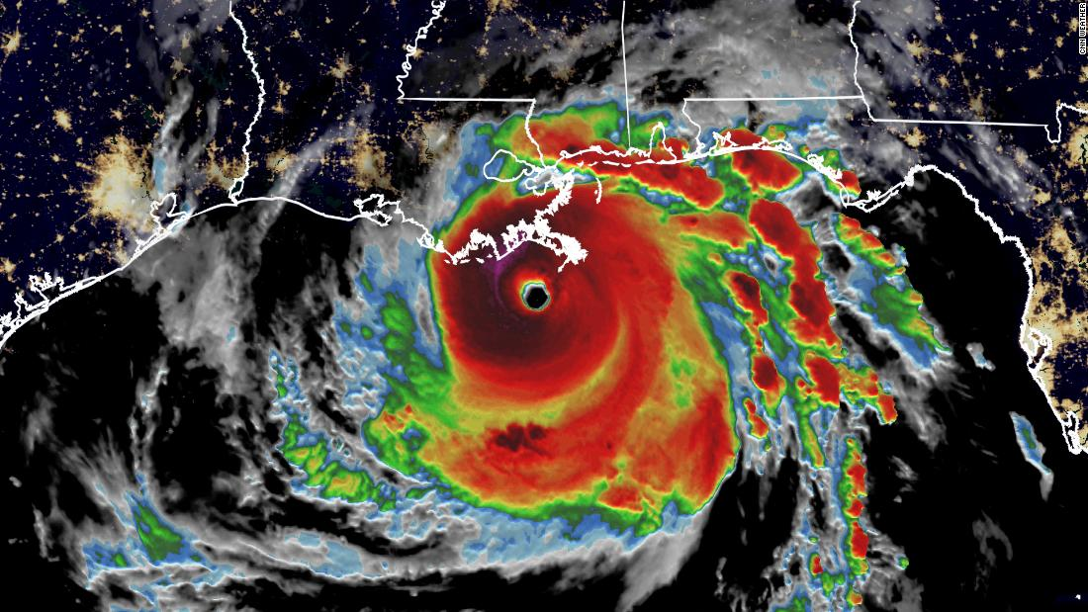
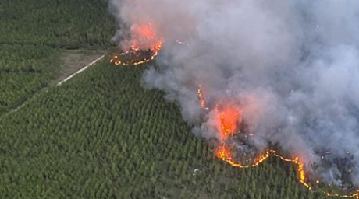
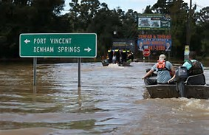

Slide 16
Emergency Preparedness
Form a relationship with your local Emergency Preparedness resources.
New Federal Regulations published in November 2016 with a November 2017 effective date.
To perform an “all hazards” risk assessment
Test their emergency plans by participating In a full scale operations based community wide drill if available, facility wide drill, or table top exercises at least twice per year. Classroom training for staff does not meet the testing requirement.
Analyze facility performance during the drill, update the emergency plan based on the analysis, and to document changes to the plan
Have a communication plan that includes the facility’s local emergency operations center (EOC)
Train employees upon hire and annually thereafter
GREAT NEWS!!!
The EP form is now incorporated into your license renewal application and your initial licensing application!

Slide 17
Quarterly Virtual Tabletop Drills
Contact for registration information:
Nicole Coarsey
Deputy Director of Programs
State of Louisiana Rural Health Officer
Office of Public Health
Phone: 225-342-1583
Email: Nicole.Coarsey@la.gov

Slide 18
DISASTER STRIKES
Post Disaster Re-Entry
Who needs to submit the Re-entry request form?
If you were on generator power for greater than 48 hours
If you lost municipal power for longer than 48 hours
If you had damages to the facility including flooding, structural damage, roof leaks, etc.
Who needs to get the form?
Please Email or Fax requests to re-open/re-occupy healthcare facility to:
HSSEP@LA.GOV
LA Dept. Health, Health Standards Section
Fax #: 225-342-5073
Please let us know if you have already contacted OPH or OSFM
so that work is not duplicated.

Slide 19
NOTE:
If an ASC’s license has been inactivated or suspended or provisional, the ASC may NOT undergo a Change of Ownership.
If an ASC’s license is inactivated or suspended or provisional, the ASC must continue to pay all applicable fees (Example: license renewal fees).

Slide 21
https://ldh.la.gov/page/workplace-violence

Slide 22
Surgical Smoke Plume Evacuation
Effective August 1, 2023
SB 29, Act 35
Link to Legislative Acts: https://ldh.la.gov/page/legislative-acts

Slide 23
Licensing Standards

Slide 24
ASC Licensure & Certification
Licensed Only
Not eligible to participate in Medicare and/or Medicaid Programs.
Certified
Once licensed … to be eligible to participate in Medicare and/or Medicaid programs, you must be certified as compliant with the federal Conditions of Coverage. You must seek initial certification through an Accrediting Organization (AO) as initial certifications OR Tier IV workload.
Deemed Status
Provider is deemed by the AO as meeting or exceeding the Medicare and/or Medicaid requirements. Deemed Status facilities fall under the jurisdiction of the AO unless CMS authorizes the State Agency to conduct a validation or complaint survey.

Slide 25
Plan Reviews, Inspections & Attestations
OSFM Inspection
Not an AR or DH Plan Review.
Office of Public Health (OPH)
Onsite inspection
Walk-through inspection
Report will say Inspection
Please forward a copy
DH Plan Review Attestation
Attestation for compliance with the plan review directives.
Acknowledges the cautionary codes and state/federal compliance.
AR Plan Review
Architectural Review performed by the OSFM
this is your Life Safety Code (LSC)
Desk review
DH Plan Review
Desk review performed by the OSFM for LDH.
PLAN REVIEW REPORT with DH# and status of RELEASED.
signed by Administrator (designee) and Architect.

Slide 26
DH Plan Review
DH Plan Review
All new construction other than minor alterations such as painting, patching, flooring, etc. requires a DH Plan Review.
Very likely to be required for changes to surgical services, operating rooms, procedures rooms, or sterilization area.
Please release the plan review(s) in the OSFM website for our review. The log-in, first name, last name will be HSSHospitals. Instructions are on application. We can access floor plans on this website as well if needed.

Slide 27
Packets & Surveys

Slide 28
Licensing Packets
Initial Licensing Packet
* ASC Online Initial Licensing Applications and License Renewals
Change of Ownership/Change of Information (CHOW/CHOI)
* Link under Programs
Name Change
ASC Closure
Service Actions (Revisions/Additions)
Relocation

Slide 29
Initial Licensing Packet
Application
Attestation for a Licensed & Certified Ambulatory Surgical Center (ASC)
DH Plan Review
DH Plan Review Attestation
AR Plan Review
OSFM onsite inspection
Office of Public Health (OPH)
Disclosure of Ownership
Diagram showing ownership
Copy of (Controlled Dangerous Substance) CDS Application
Secretary of State Certificate and or approval letter, Articles of Incorporation
Licensing Fee
Key Personal Qualifications/License/Resume
*Additional documents needed if you intend to be certified.

Slide 30
Initial Licensing Survey
Once a complete packet is received, the ASC will receive an authorization letter via email to schedule their initial licensing survey.
This is an announced survey.
EVERYTHING will be looked at during the survey-the physical environment, polices, training, etc.
EVERYTHING is expected to be complete as if ready to receive patients.
You cannot accept patients until you have completed this process.

Slide 31
Your License
Not assignable or transferable
Issued to a specific owner and to a specific geographic location
License immediately voided if the ASC:
ceases to operate
ownership changes
relocates
Display in a obvious place in the ASC at all times
The license number for older ASC’s is usually 1-3 digits. Newer ASC’s, or facilities that have an address change or CHOW, will have a 10 digit license number.
Your Facility ID or State ID will begin with AS00_ _ _ _ _

Slide 32
Initial Certification Survey

Slide 33
Initial Certification Packet
855B Approval Letter from Fiscal Intermediary (FI)
CMS 377-Request for Certification (Instruction at top of form)
CMS 370-Health Insurance Benefits Agreement

Slide 34
Initial Certification Survey
The Certification Survey cannot be conducted until the ASC is licensed.
The Certification Survey is conducted by an accrediting organization (AO).
The AO sends the results to your fiscal intermediary’s Provider Enrollment.
Provider Enrollment forwards the results to State Agency to review and make the recommendation for participation in Medicare and/or Medicaid services.
The ASC will get their Medicare number from Provider Enrollment.
ASC is deemed by the AO as meeting or exceeding the Medicare and/or Medicaid requirements.
NOTE: If the ASC has deficiencies on this survey, the recommended effective date of deemed status will be the date that an acceptable PoC was received, not the exit date.

Slide 35
ONCE DEEMED . . .
* Once deemed, the ASC is not under the jurisdiction of the State Agency
(unless authorized by CMS to conduct a validation or complaint survey).
* If the ASC drops their deemed status, they will fall under the State
Agency’s jurisdiction.

Slide 36
License Renewals
License must be renewed annually.
Renewal letters are sent out via email at least 75 days prior to the expiration of the license.
Very important to keep your email address current (CMS also communicates via email).
* Submit a Key Personnel Form
Please do not hold your license renewal packet while awaiting the fire or health inspections. If your inspection has not been completed, please include an email with your license renewal packet from the respective offices (OSFM or OPH) confirming that you are on the schedule for an inspection. We will continue with the license renewal process. Once the inspection has been completed, you will be required to submit the inspection form to HSS.
Do not submit changes on your License Renewal Packet. License renewals are completed using your current information. You may submit a packet for changes before or after your license renewal.
Note: the license cannot be renewed if your are undergoing a CHOW. You may receive a letter stating the ASC is in the CHOW process if needed.

Slide 37
LICENSE RENEWALS Contact Person: Char Brooks, Administrative Coordinator 3 Email: Charenquia.Brooks@la.gov Phone: 225-342-5782
LICENSING PACKETS
ASC Online
Via Email: HSS-ASC-BO-Licensing@la.gov
Or Mail to:
Louisiana Department of Health
Health Standards Section
P.O. Box 3767
Baton Rouge, LA 70821
LICENSING PAYMENTS
ASC Online
OR
Mail to:
LDH Licensing Fee
P.O. Box 734350
Dallas, TX 75373-4350

Slide 38
Expedited Licensing Process

Slide 39
Expedited Licensing Process
Helpful Links
Link to memo:
http://ldh.la.gov/assets/medicaid/hss/Expedited_Licensing_Processing_Memo12202018.pdf
Link to Rule:
http://ldh.la.gov/assets/medicaid/hss/Expedited_Licensing_Processing_12202018.pdf

Slide 40
PACKETS

Slide 41
CHOW vs. CHOI Packet
CHOW – Change of Ownership
CHOI – Change of Information
Refer to the CHOW website for most current information required
Unsure???....Contact your Program Manager or

Slide 42
Name Change Packet
Application & Checklist on website
Licensing fee ($25.00 to reprint license)
855B approval letter from Fiscal Intermediary (FI)

Slide 43
ASC Closure Packet
Checklist on website
Letter of Intent
Effective Date of Closure
Where medical records will be stored
Custodian of medical records
Contact information for custodian of medical records
855B approval letter showing closure

Slide 44
ASC Service Actions Packet
Checklist on website
Application
Floor plans (before and after)
AR Plan Review
DH Plan Review
Very likely to be required for changes to surgical services, operating rooms, procedures rooms, or sterilization area.
DH Plan Review Attestation
OSFM Inspection
OPH Inspection
Physical Environment Survey
Announced Survey
Very likely to be required for changes to surgical services, operating rooms, procedures rooms, or sterilization area.

Slide 45
Surveys

Slide 46
Types of Surveys
Licensing Surveys
Initial Licensing
Physical Environment
Certification Surveys
Re-Certification Surveys
Validation Surveys
Complaint Surveys

Slide 47
Initial Licensing Survey
Announced survey - You will receive a letter via email with contact information to schedule the survey. The survey will look at everything: physical environment, policies, staff training, and all State licensing requirements.
Multiple days
EVERYTHING will be looked at during the survey-the physical environment, polices, procedures, etc.
EVERYTHING must be complete as if ready to accept patients.
DIRECT LINE OF SIGHT is required from the nurses station to the recovering patient from the HOB to the FOB while maintaining patient privacy.
ASC may not accept patients until this survey is successfully completed

Slide 48
Physical Environment Survey
Announced survey focused on the physical environment of the ASC
Much shorter survey
Very likely to be required if adding to surgical services, operating rooms, procedures rooms, or sterilization area.
DIRECT LINE OF SIGHT is required from the nurses station to the recovering patient from the HOB to the FOB while maintaining patient privacy.

Slide 49
Certification/Re-certification Surveys
Initial Certification Surveys are conducted by an accrediting organization (AO).
Re-certification Surveys
Conducted by State Agency for non-deemed facilities
Number of re-certification surveys conducted each year for non-deemed facilities is determined by the Federal Mission Priority Document issued by CMS
Unannounced survey looking at all of the Conditions of Coverage
Life Safety Code Survey will also be conducted at this time by the OSFM
Re-licensing surveys and Re-certification surveys are usually conducted at the same time
Deemed facilities: Certification/Re-certification Surveys are conducted by your AO

Slide 50
Validation Survey
CMS may require a survey of a deemed facility to validate the accrediting organization’s (AO) process.
The Regional Office notifies the State Agency that a sample validation survey is to be conducted.
If selected for a validation survey, it will be conducted within 60 days of the AO survey.
Validation Surveys are unannounced.
A Life Safety Code survey will also be conducted by OSFM.
The State Agency conducts the survey as if the facility was not accredited for all the Conditions of Coverage.
Multi-day survey
ASC is notified of the validation survey results by CMS.

Slide 51
Complaint Survey
An unannounced survey that will be focused on the alleged non-compliance of the specific State licensing requirements and/or Conditions of Coverage related to the complaint.
Timeline for survey will vary based on the Conditions being investigated and the number of Conditions.

Slide 52
You have a Deficiency-What is next?
Standard Level Deficiency
ASC is still in substantial compliance with Conditions of Coverage
Surveyor will email the Statement of Deficiencies (SoD or 2567) with instructions to the administrator
ASC will submit a Plan of Correction (PoC) within 10 calendar days from the date of receipt of the SoD
Condition Level Deficiency
ASC is not in substantial compliance with Conditions of Coverage
ASC is placed on a 90 day termination track
State Office will email the SoD to the administrator along with a 90 day termination letter.
VERY TIME SENSITIVE

Slide 53
Health Standards Post-Survey Page
https://ldh.la.gov/index.cfm/page/3806

Slide 55
Timeline for 90 day Terminations
Fifteenth Working Day- State Agency sends the statement of deficiencies and a letter to the supplier indicating there is a determination of noncompliance and placing facility on 90 termination track. Supplier has 10 calendar days to complete plan of correction.
Thirty-Fifth Calendar Day- If supplier submits acceptable plan of correction, the State Agency conducts a revisit survey to determine compliance. Only 2 revisits permitted
Fifty-Fifth Calendar Day- If compliance has not been achieved, the State Agency certifies noncompliance. Supporting documentation sent to Regional Office.
Sixty-Fifth Calendar Day- Regional Office determines whether survey findings continue to support a determination of noncompliance
Seventieth Calendar Day- Regional Office sends an official termination notice to the supplier.
Ninetieth Calendar Day- termination takes effect if compliance is not achieved
***Please ensure the Administrator’s e-mail is accurate***

Slide 56
Professional Liability Insurance
§4507. Initial Licensure Application Process
c. professional liability insurance of at least $300,000 per occurrence/$300,000 per annual aggregate, or proof of self-insurance of at least $100,000, along with proof of enrollment as a qualified health care provider with the Louisiana Patient’s Compensation Fund (PCF):……
Should read- at least $100,000 per occurrence/$300,000 per annual aggregate

Slide 57
QUESTIONS ??

Slide 58
Contact Information
Zandra Stewart, RN
Program Manager
Phone: (225) 342-9348
Email: zandra.stewart@la.gov
William Whatley, RN
Non-long Term Care Supervisor
Phone: (225) 342-2471
Email: William.Whatley@la.gov

Slide 59
Thank you!!

