Slide 1
Vaccines for Older Adults

Slide 2
Vaccine Importance in the Older Adult
As we age, our immune systems do not respond as well.
Vaccines are the best way to protect yourself and loved ones from preventable diseases.
Vaccination provides protection not only against the diseases itself but also against the dangerous consequences that it can bring.
Routine vaccination is important for older adults as the protection from some vaccines can wear off over time.
The most important vaccinations older adults should discuss with their physicians include COVID-19, influenza, pneumococcal, shingles, and Tdap.
Consulting with a pharmacist is a great start since a large percentage of seniors are picking up their prescriptions from a pharmacy and immunizations are offered there.
Check with your local provider, commercial pharmacy (Walgreens, CVS, Walmart) or local health unit for vaccine availability.

Slide 3
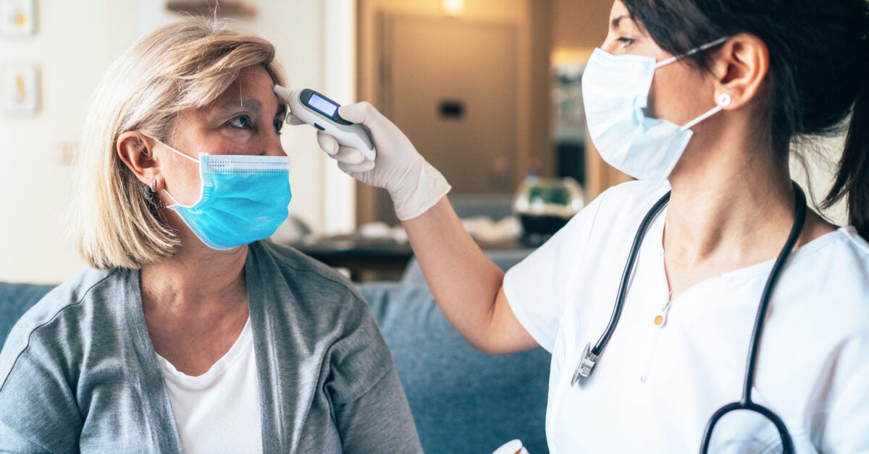
COVID-19
COVID-19 is a respiratory disease that disproportionately impacts older adults globally.
In 2020, adults age 65 years and older made up 81% of the total deaths due to COVID-19 in the US.
COVID-19 vaccines are highly recommended for all individuals to protect from serious illness and death.
In addition to the primary vaccination series, updated bivalent COVID-19 booster doses are now available for all age groups.
This new booster refortifies our immune systems to protect the body from newer COVID-19 variants.
Currently, less then 25% of adults age 65 and older have received a bivalent booster dose in Louisiana.
Notes:
COVID-19 is a respiratory disease that disproportionately impacts older adults globally
In 2020, adults age 65 years and older made up 81% of the total deaths due to COVID-19 in the US (That is 282,836 deaths due to COVID-19).
COVID-19 vaccines are highly recommended for all individuals to protect from serious illness and death
In addition to the primary vaccination series, updated bivalent COVID-19 booster doses are now available for all age groups
This new booster refortifies our immune systems to protect the body from newer COVID-19 variants
Currently, less then 25% of adults age 65 and older have received a bivalent booster dose in Louisiana while over 85% of older adults have completed their primary series.

Slide 4
Influenza (Flu)
Flu kills more than 18,000 older adults each year
70%-85% of flu related deaths occurs among adults age 65 years and older.
The risk of heart attack in older adults is increased by 3 to 5 times within the first 2 weeks of a flu infection.
The risk of stroke in older adults is increased by 2 to 3 times within the first 2 weeks of an infection.
Having influenza increases the risk of getting pneumococcal disease.
Older adults who receive the flu vaccine routinely are better protected against the severe symptoms that flu may cause.

Slide 5
Pneumococcal
An estimated 150,000 adults are hospitalized each year.
Pneumococcal kills thousands of people each year, majority being age 65 years and older.
Adults age 65 years or older are at a 6 times greater risk for developing pneumococcal pneumonia versus healthy adults ages 18-64.
Common symptoms include high fever, excessive sweating, shaking, chills, coughing, difficulty breathing, chest pain and shortness of breath.
Getting pneumococcal vaccines as recommended reduces the chance of contracting and dying from pneumococcal disease.

Slide 6
Zoster (Shingles)
1 out of 3 people will develop shingles in their lifetime.
The risk of getting shingles increases as you age.
Shingles may cause severe pain that may lead to further complications in persons with a weakened immune system.
The Shingrix vaccine has been found to be 97 percent effective at preventing shingles in individuals ages 50 to 69 and 91 percent effective in adults 70 and older.
All individuals age 50 years or older should be administered the shingles vaccine Shingrix. This vaccine is given in two doses 6 months apart.

Slide 7
Tdap (Tetanus, Diphtheria and Pertussis)
Tetanus causes painful stiffening in the body which may lead to difficulty swallowing and breathing
Diphtheria and Pertussis are both passed from person to person.
Diphtheria can cause heart failure, paralysis and possibly death.
Pertussis also known as “Whooping Cough” can cause uncontrollable violent coughing which make It difficult to breath.
Older adults are more susceptible to experiencing the most severe symptoms of these infections due to a weakened immune system.
Older adults who remain up to date with their Tdap booster, are better protected from Tetanus, Diptheria and Pertussis.

Slide 8
ACIP Immunization Schedule
*
*

Slide 9
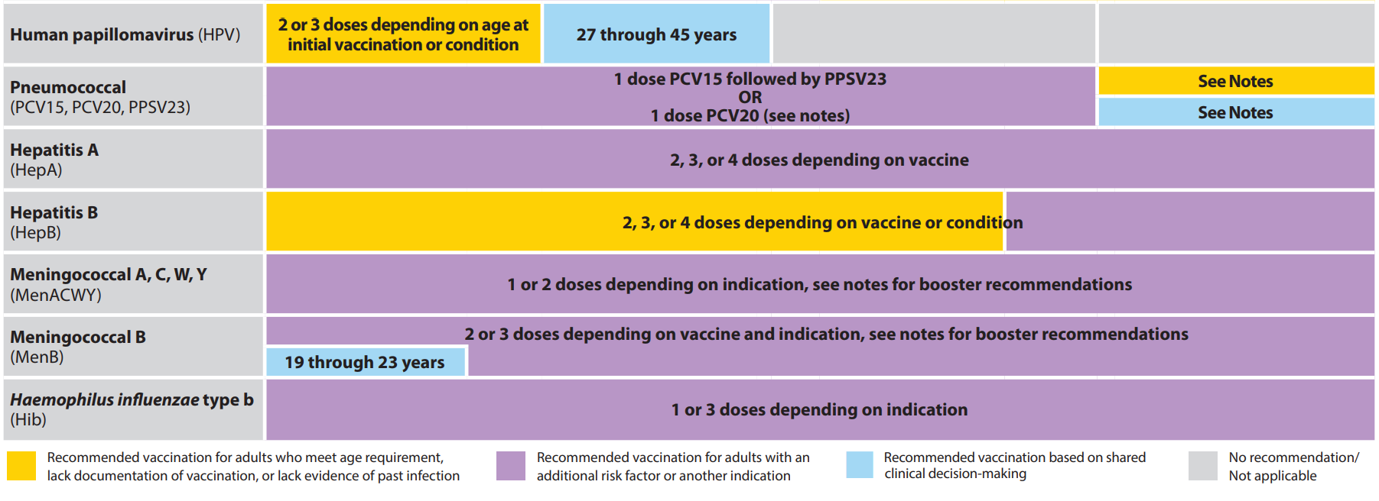
ACIP Immunization Schedule (cont.)
*
*
*
*

Slide 10
References
- Centers for Disease Control and Prevention. COVID Data Tracker. Atlanta, GA: US Department of Health and Human Services, CDC; 2023, March 23. https://covid.cdc.gov/covid-data-tracker
- Centers for Disease Control and Prevention. COVID-19 Immunization Schedule Summary. Atlanta, GA: US Department of Health and Human Services, CDC; 2023. https://www.cdc.gov/vaccines/covid-19/images/COVID19-vaccination-schedule-most-people.png
- National Institute on Aging. Vaccinations and Older Adults. Bethesda, MD: National Institute of Health; 2022, June 14. https://www.nia.nih.gov/health/vaccinations-older-adults
- Tejada-Vera B, Kramarow EA. COVID-19 mortality in adults aged 65 and over: United States, 2020. NCHS Data Brief, no 446. Hyattsville, MD: National Center for Health Statistics. 2022. DOI: https://dx.doi.org/10.15620/cdc:121320
- Influenza and Older Adults. (2019, September 4). National Foundation for Infectious Diseases. https://www.nfid.org/infectious-diseases/influenza-and-older-adults/
- Centers for Disease Control and Prevention. (2022, November 14). Vaccine information statement. Centers for Disease Control and Prevention. Retrieved March 26, 2023, from https://www.cdc.gov/vaccines/hcp/vis/current-vis.html
- Centers for Disease Control and Prevention. (2019, October 30). Pneumococcal polysaccharide vaccine information statement. Centers for Disease Control and Prevention. Retrieved March 26, 2023, from https://www.cdc.gov/vaccines/hcp/vis/vis-statements/ppv.html
- Senior Immunizations. Www.johnmuirhealth.com. https://www.johnmuirhealth.com/health-education/health-wellness/Immunizations/senior-immunizations.html

