Slide 1
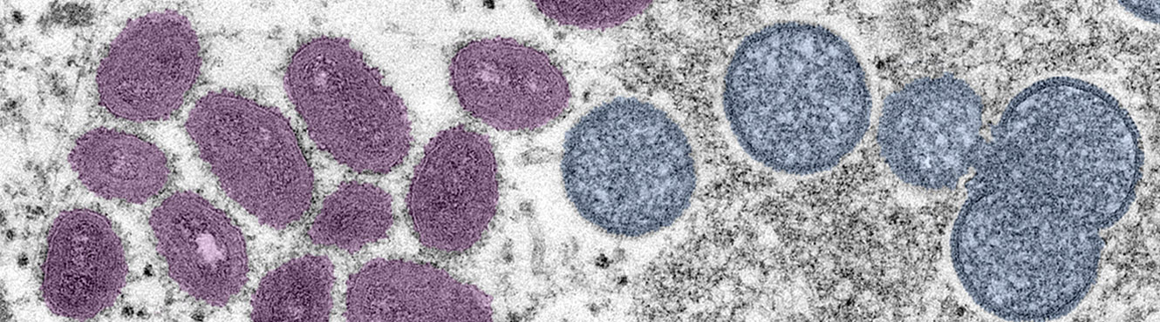

MONKEYPOX VACCINE IN LINKS

Slide 2
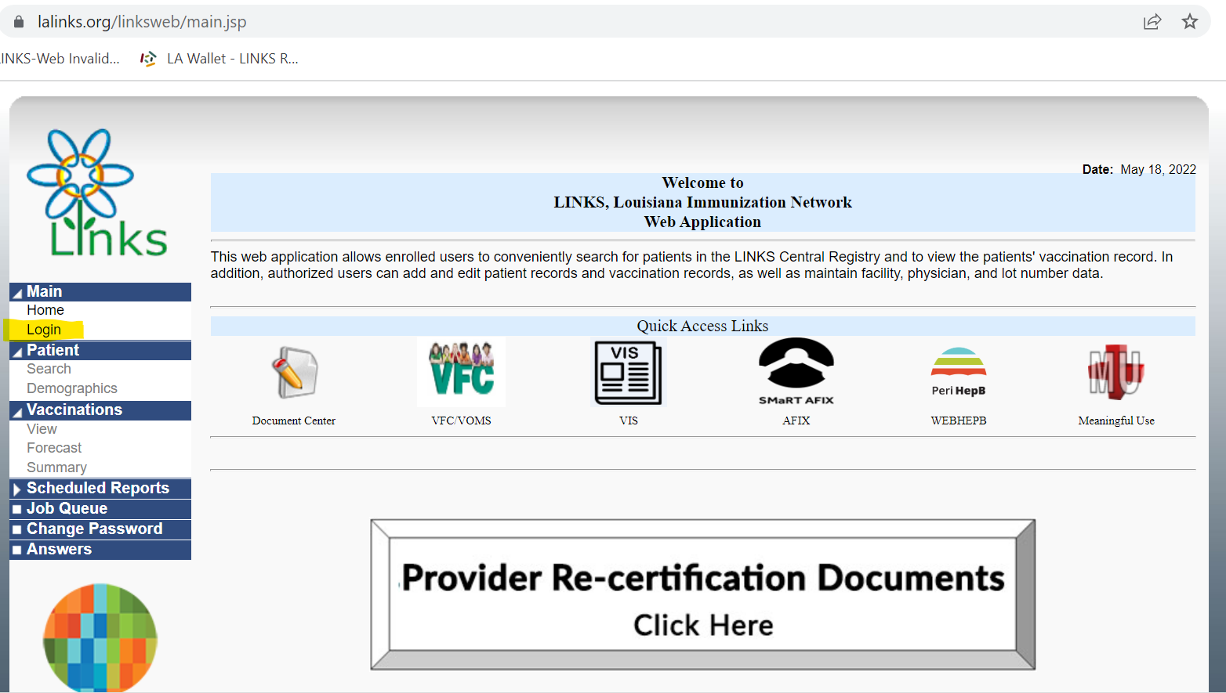
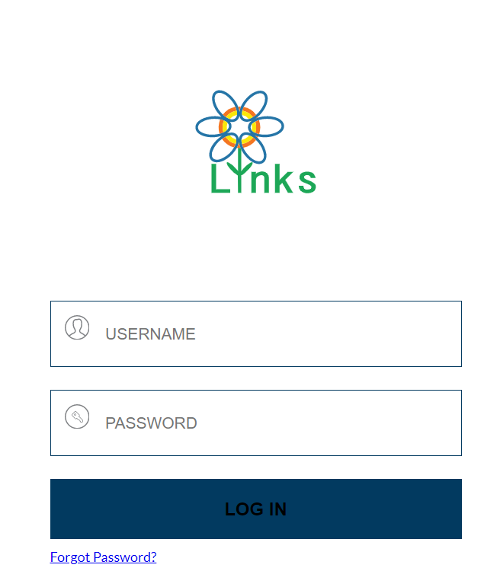
Step 1: LOGIN
In the left column, select LOGIN with the username and password provided by LDH
*If you do not have LINKS access, please fill out an individual user agreement form and complete the LINKS LMS training – link below: (https://louisianalms.stchealth.us/)
Once completed, send certificate and agreement form back to us in order to receive your login information.

Slide 3
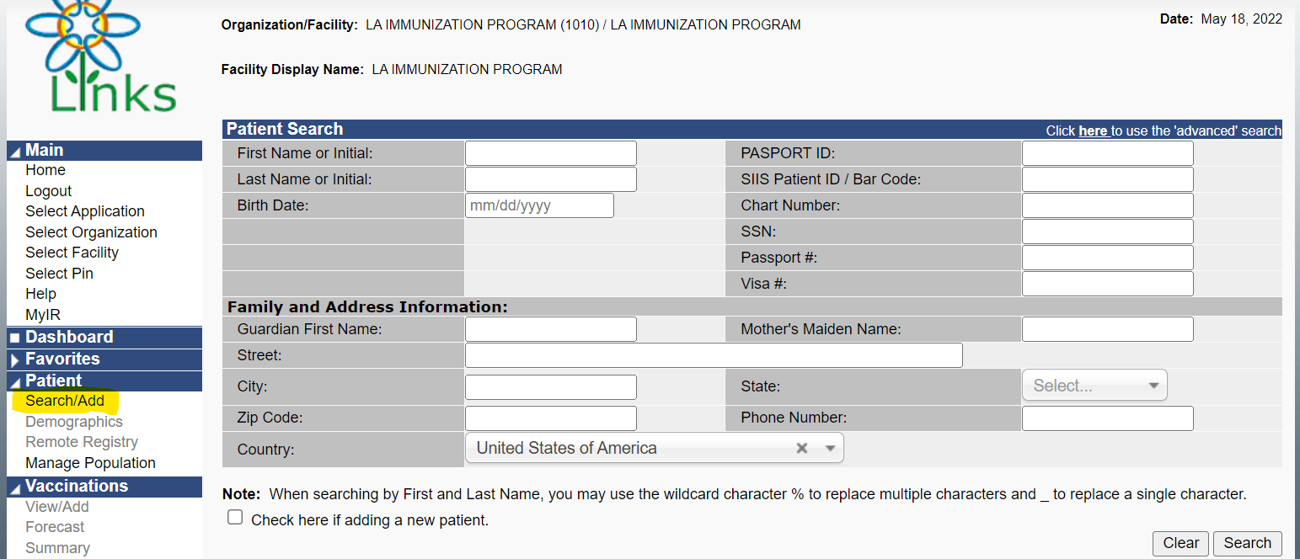
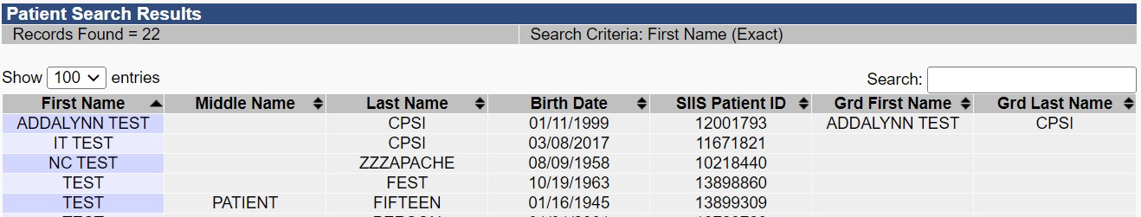
Patient Search
To search for patient:
Search using the first initial of the first name ONLY and date of birth OR SIIS Patient ID/Bar Code. Select the correct patient.
NEXT You will be directed to Patient Demographics.
** You can access the “Patient Search/Add” page from the left hand column under the “Patient” tab.

Slide 4
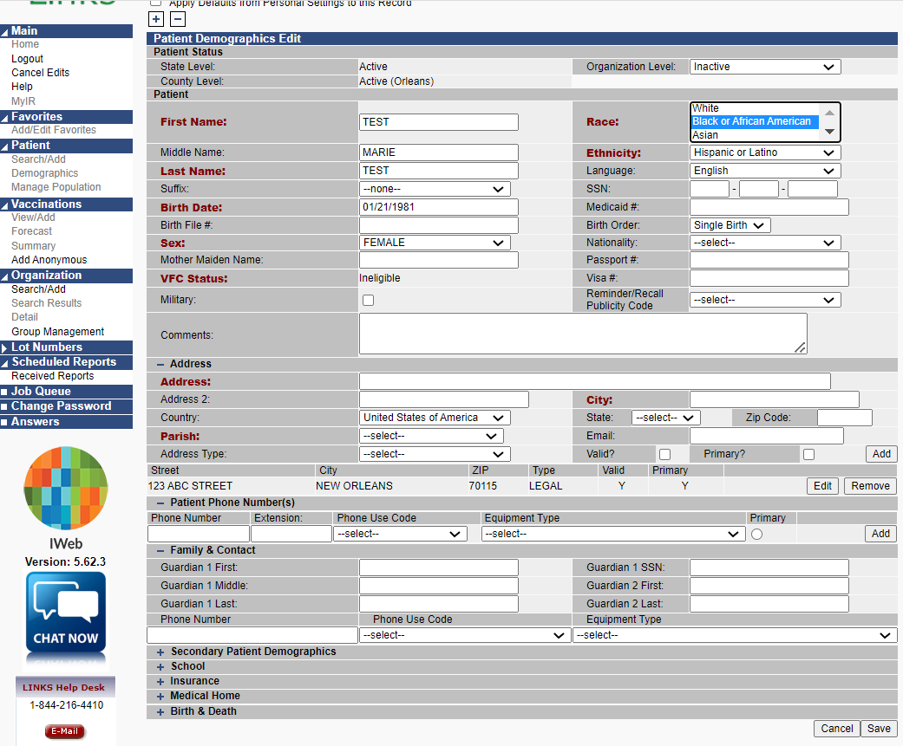
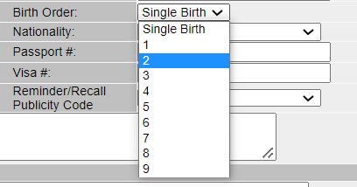
Patient Demographics
From this screen, at the bottom right, click on EDIT to make updates. The sections highlighted in RED must be filled out. That includes, first/last name, sex, VFC status, address (including parish), race & ethnicity. Adding middle name and suffix (if applicable) is extremely helpful. All minors will require a guardian(s) first & last name(s) as well. Complete as much information as possible to help out your patient. This is very important for patient’s who choose to use LA Wallet as proof of their COVID vaccinations.
Helpful Tips:
Click “Add” in the address column or the address will not be connected to the record and you will be unable to save.
If this patient is a twin, in the right column there is a section titled “Birth Order” – please choose the accurate order in which the twin or triplet, etc. was born. This is very important and helps prevent twin records from merging together. Always include twins middle names before saving.
DON’T FORGET TO SAVE!

Slide 5

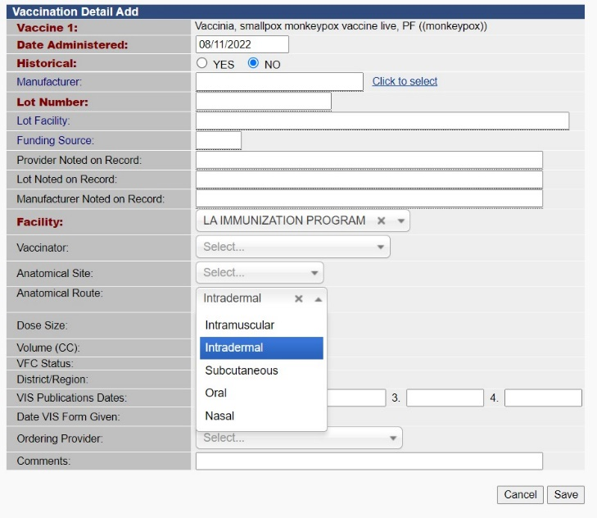
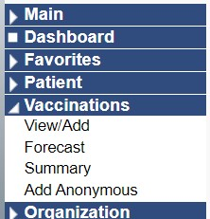
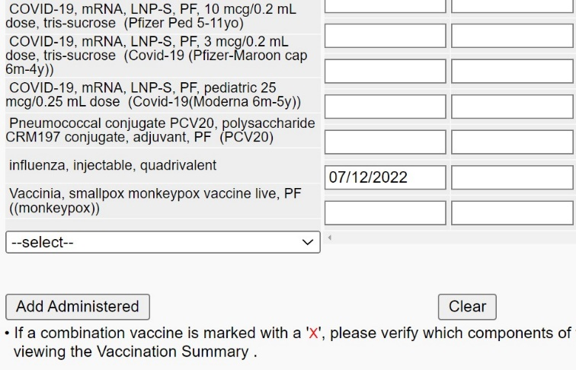
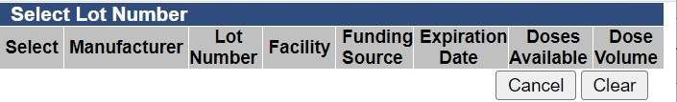

Adding Monkeypox Vaccine to Patient Records in LINKS
STEP THREE:
Once you see the “Vaccination Detail Add” page, click “CLICK TO SELECT”.
This will create a pop-up tab which shows the vaccine administered, lot number, and amount of doses in your inventory.
Make sure to select the correct lot number. Selecting this lot number will subtract a dose from your inventory.
Lot Number Information will automatically fill in. Choose Vaccinator, Anatomical Site and Route, then click SAVE.
STEP ONE:
View the left column of LINKS Home page and click the “Vaccinations” tab then select “View/Add” (highlighted below).
STEP TWO:
Scroll down the list of Vaccine types on the “Vaccination View/Add” page until you find “Vaccinia, smallpox monkeypox vaccine live, PF ((monkeypox))” highlighted in the picture below.
Record the date in the blank box to the right of the vaccination and click “Add Administered” located on bottom left of screen.
You MUST select the Anatomical Site and Anatomical Route to keep your inventory numbers correct.

Slide 6
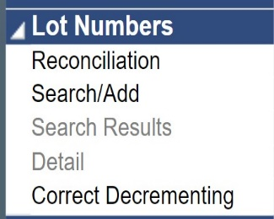
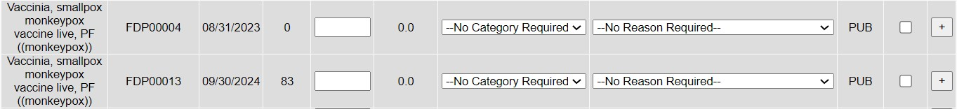
Reconciling Monkeypox Vaccines in LINKS
STEP ONE:
To correct your inventory in LINKS, follow these steps to make the
appropriate adjustments. First, login to LINKS. Select your
organization and facility. View the left column of the LINKS Home
page and click the "Lot Numbers” tab and select “Reconciliation”.
STEP THREE:
After recording your new
inventory count, you must select
the “Category” that describes the
doses and “Reason for
reconciliation. Click “select” to
choose from the options.
Remember to “SAVE”.
IMPORTANT NOTES:
For patients who receive the vaccine by Subcutaneous Injection, 1 dose from the vial must be administered to the patient and 4 doses must be removed from your inventory as “Wasted” due to “dose count variance multi-dose vial”.
Unused/Wasted doses must be reconciled immediately to keep the MPX inventory correct.
Do not change dose volume.
--select—
Administered
Expired
Recall Spoiled
Transfer
Wasted
--select--
Broken/Dropped/Spilled
Dose Count Variance Multi-dose Vial
Drawn up, not used
Lost and Unaccounted
Vaccine Damaged in Transit
STEP TWO:
The Reconcile Inventory page will open and display all vaccines in your inventory. Scroll down the list of vaccines until you find “Vaccinia, smallpox monkeypox vaccine live, PF ((monkeypox))”. You will see the number of doses available in the column “Quantity on Hand” for each LOT Number.
Here you will record the number of physical doses remaining in the “Physical Inventory” blank for the LOT Number you are reconciling.
Example:
Three doses of LOT# FDP00013 were administered Intradermal injection. You now have two doses wasted with 78 physical doses remaining. 78 is to be recorded as Physical Inventory. The Adjustment (+/-) column will automatically calculate # of doses to be reconciled.
(83 Doses – 5 Doses = 78 Doses)
For More Information: https://www.cdc.gov/poxvirus/monkeypox/interim-considerations/jynneos-vaccine.html#interim

